Slide 1
The Origin, History and Destiny of Universe Reality Children of the Infinite Spirit Part2

Slide 2
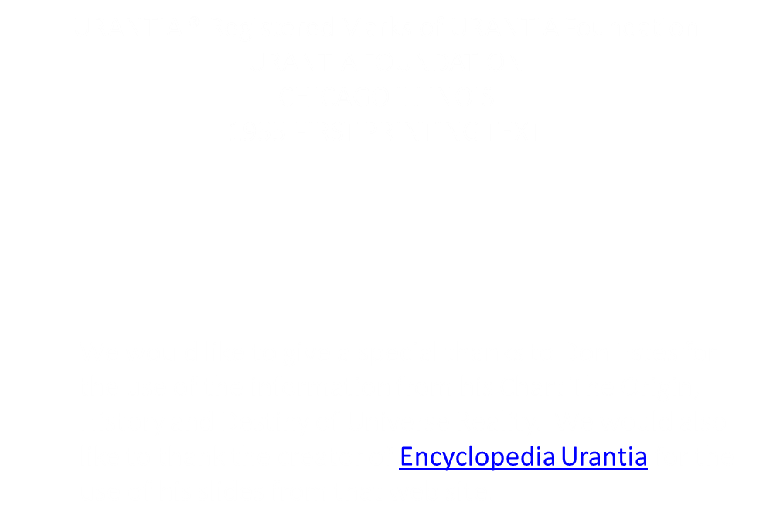

Slide 3
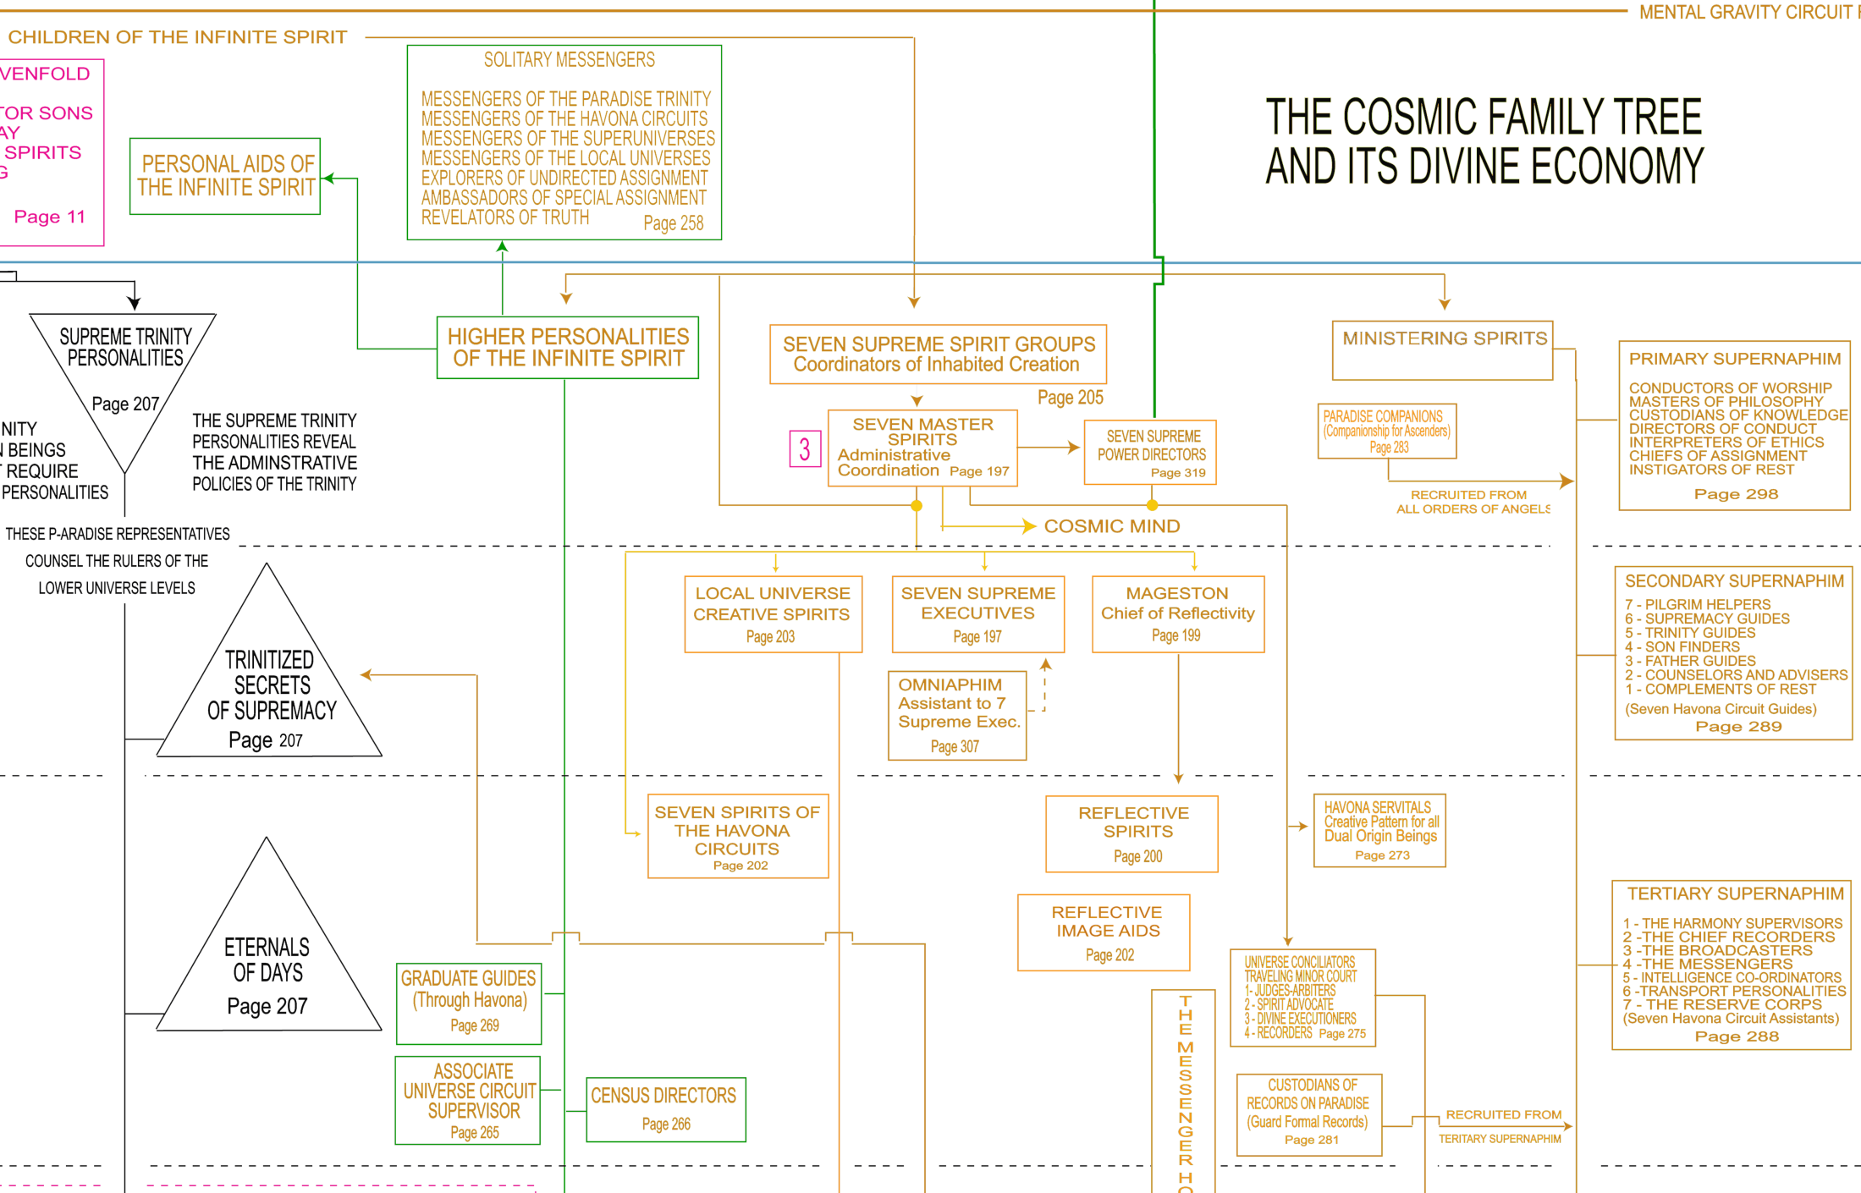

Slide 4
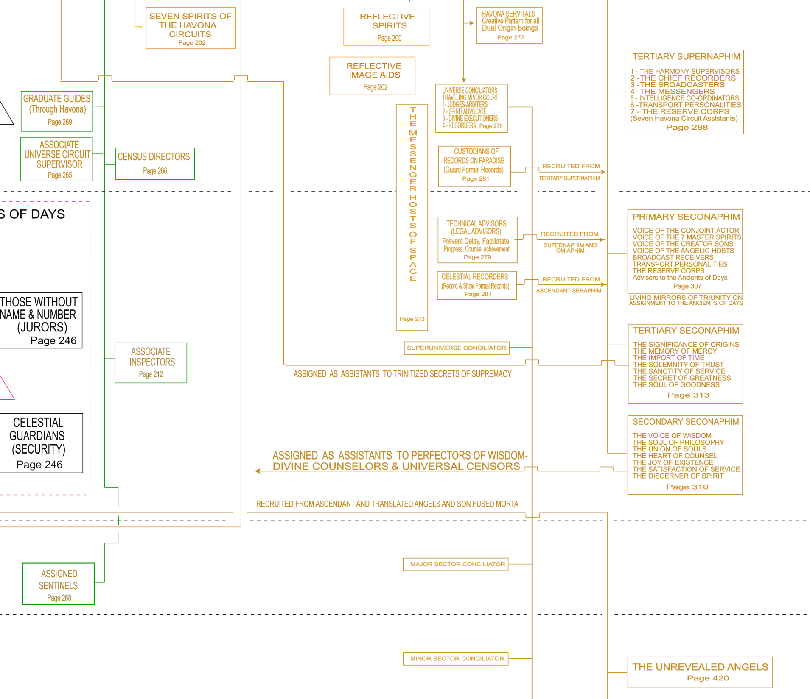

Slide 5
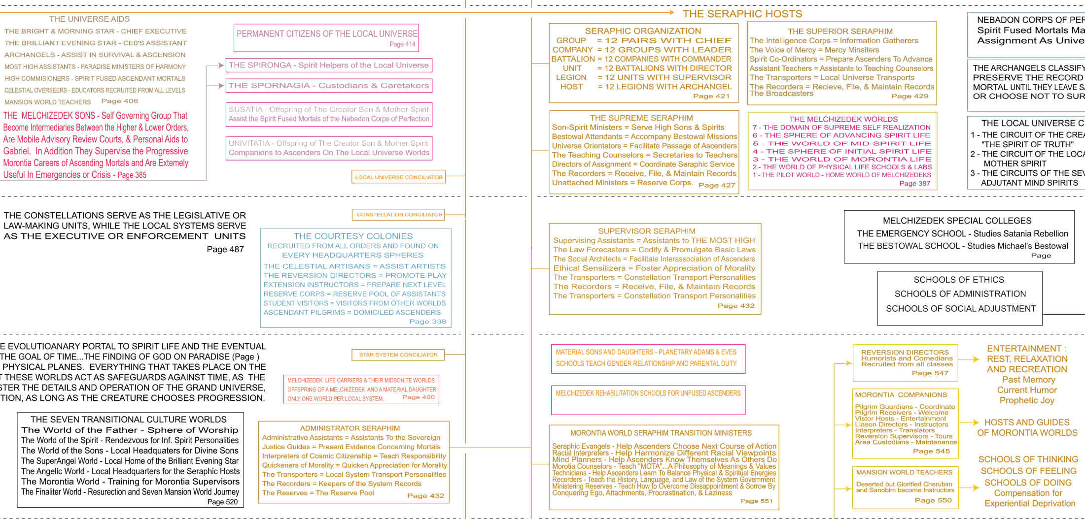

Slide 6
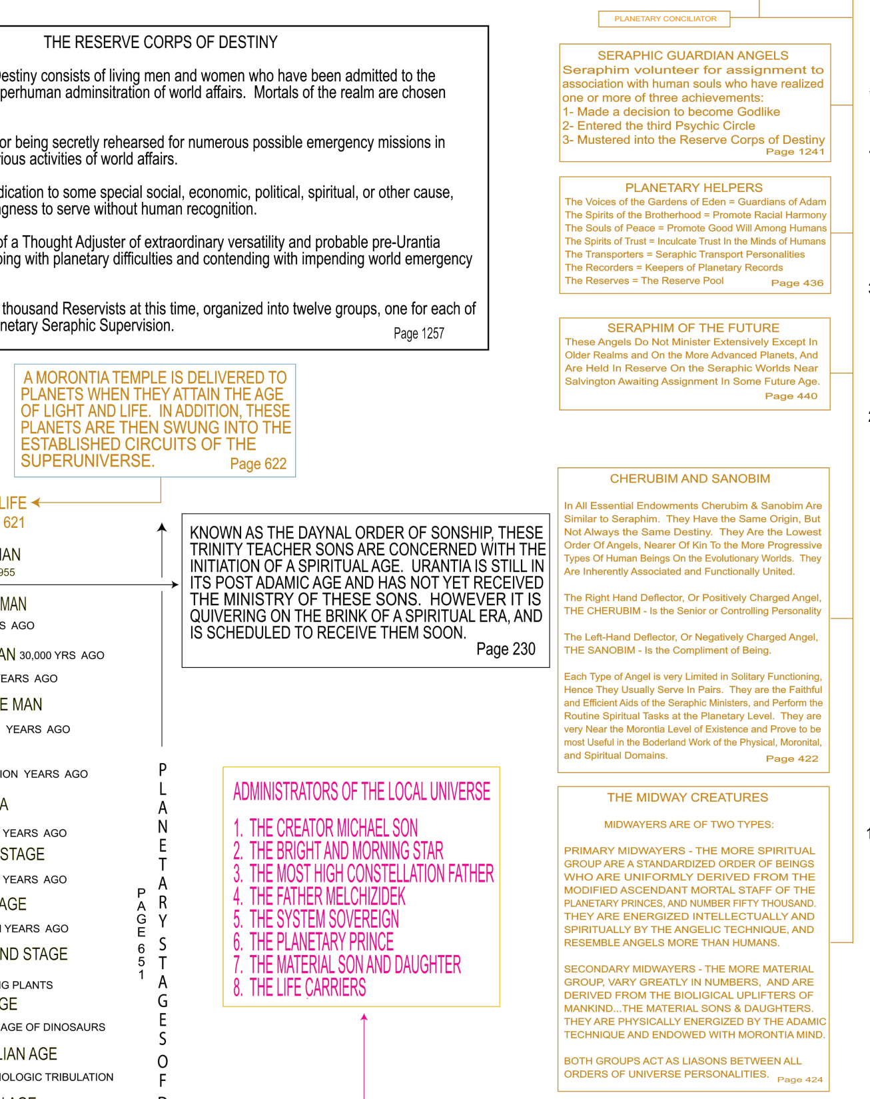

Slide 7
Children of the Infinite Spirit Part 2
(197.1) 17:0.1 THE seven Supreme Spirit groups are the universal co-ordinating directors of the seven-segmented administration of the grand universe. Although all are classed among the functional family of the Infinite Spirit, the following three groups are usually classified as children of the Paradise Trinity:
(197.2) 17:0.2 1. The Seven Master Spirits.
(197.3) 17:0.3 2. The Seven Supreme Executives.
(197.4) 17:0.4 3. The Reflective Spirits.
(197.5) 17:0.5 The remaining four groups are brought into being by the creative acts of the Infinite Spirit or by his associates of creative status:
(197.6) 17:0.6 4. The Reflective Image Aids.
(197.7) 17:0.7 5. The Seven Spirits of the Circuits.
(197.8) 17:0.8 6. The Local Universe Creative Spirits.
(197.9) 17:0.9 7. The Adjutant Mind-Spirits.
(197.10) 17:0.10 These seven orders are known on Uversa as the seven Supreme Spirit groups. Their functional domain extends from the personal presence of the Seven Master Spirits on the periphery of the eternal Isle, through the seven Paradise satellites of the Spirit, the Havona circuits, the governments of the superuniverses, and the administration and supervision of the local universes, even to the lowly service of the adjutants bestowed upon the realms of evolutionary mind on the worlds of time and space.

Slide 8
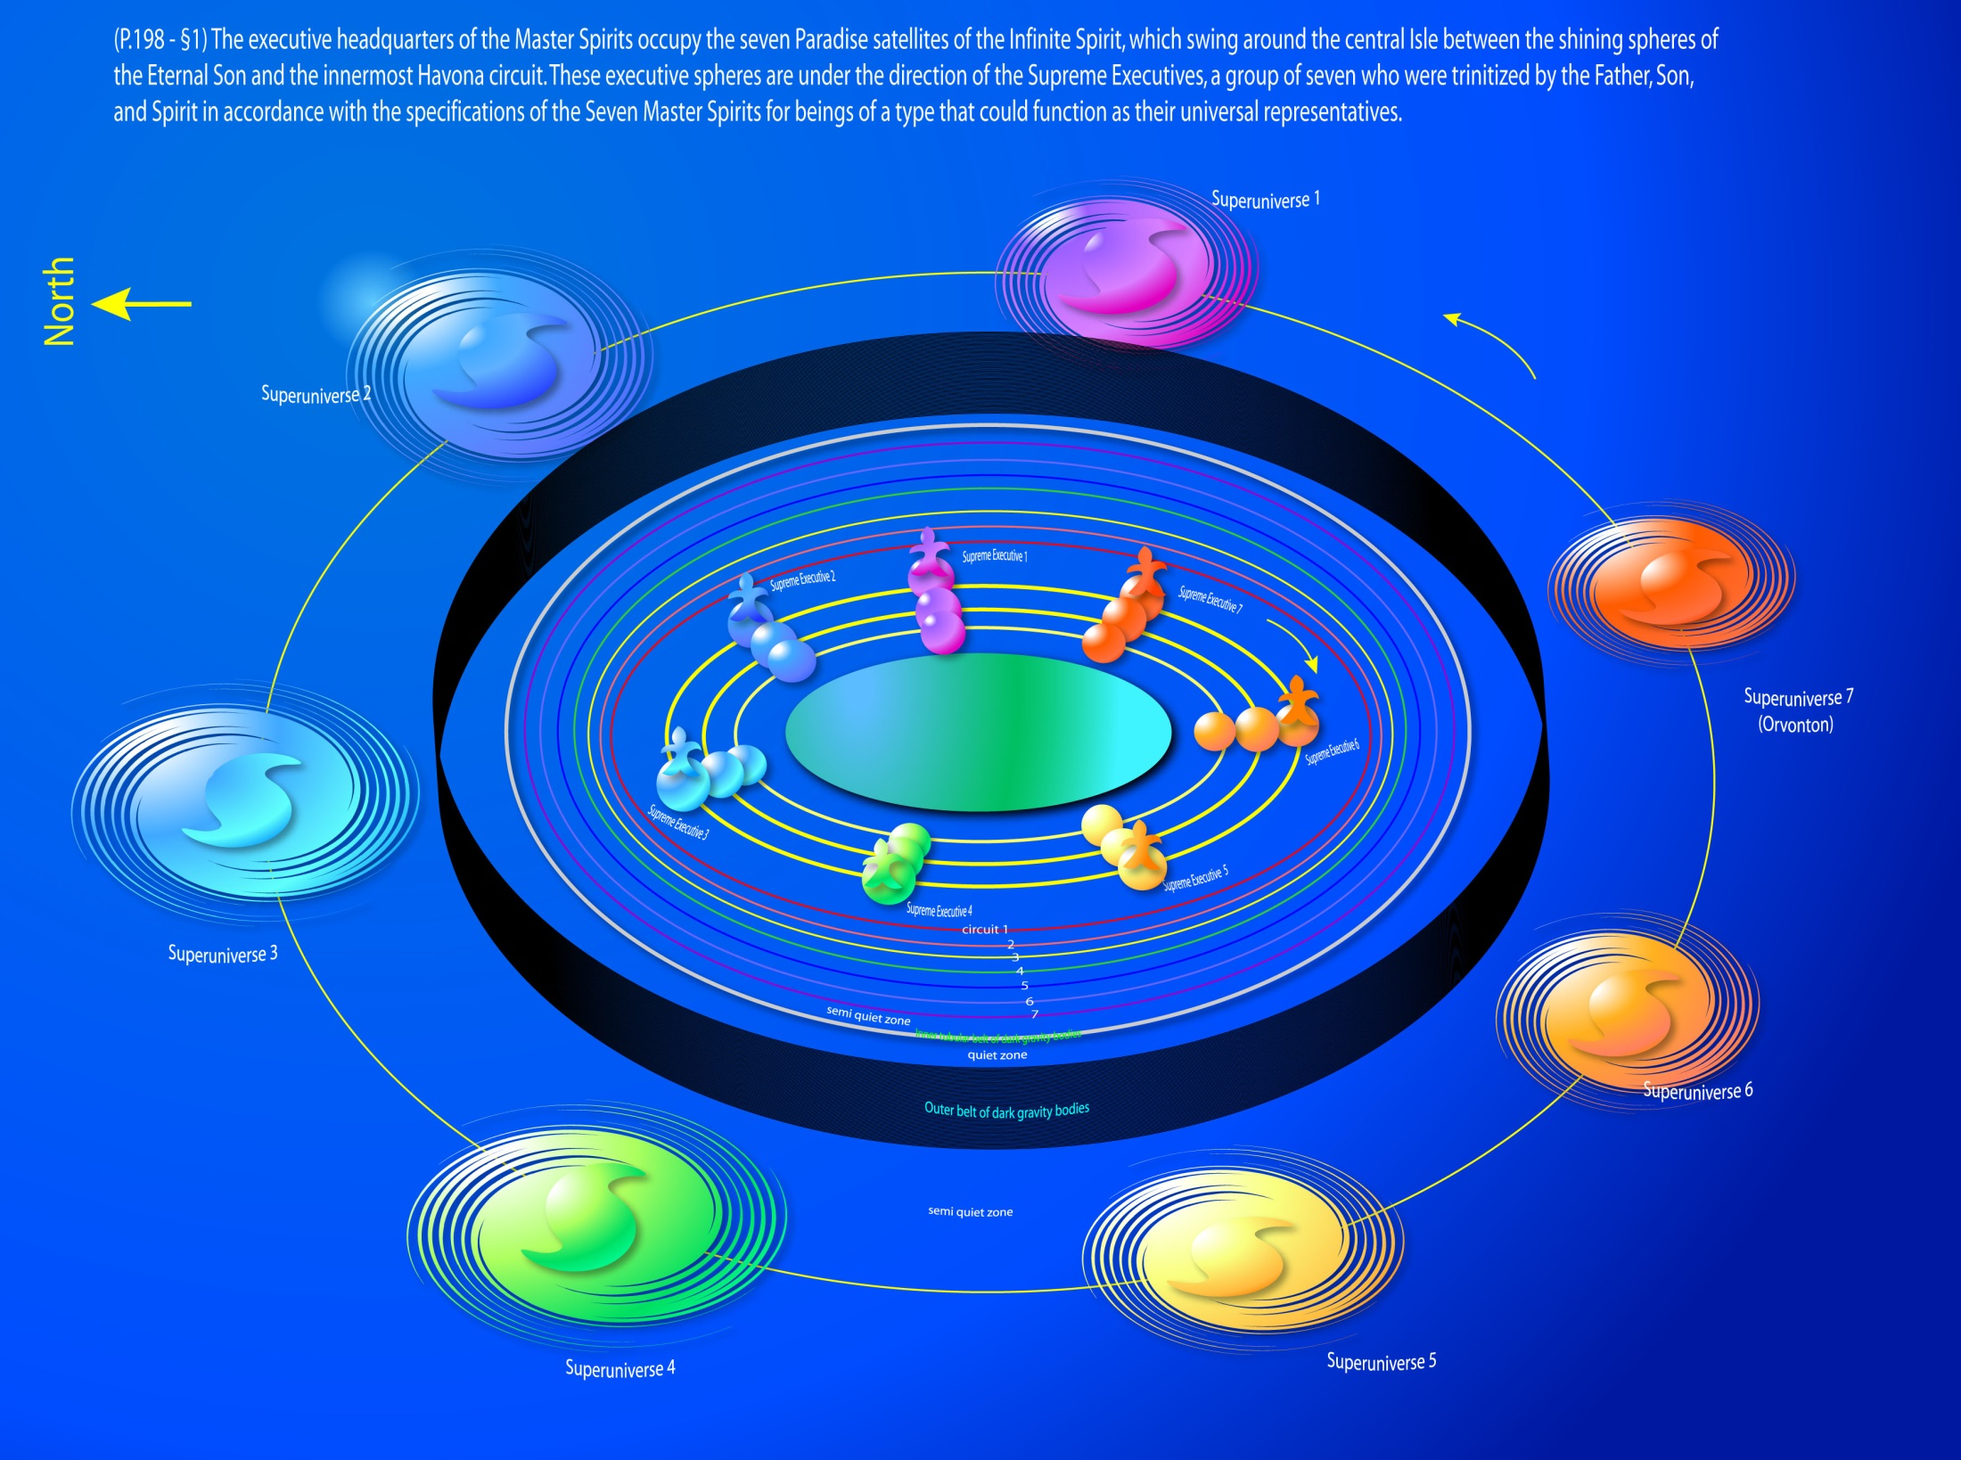
The Seven Master Spirits
Notes:
The Seven Master Spirits

Slide 9
The Seven Master Spirits
(197.11) 17:0.11 The Seven Master Spirits are the co-ordinating directors of this far-flung administrative realm. In some matters pertaining to the administrative regulation of organized physical power, mind energy, and impersonal spirit ministry, they act personally and directly, and in others they function through their multifarious associates. In all matters of an executive nature — rulings, regulations, adjustments, and administrative decisions — the Master Spirits act in the persons of the Seven Supreme Executives. In the central universe the Master Spirits may function through the Seven Spirits of the Havona Circuits; on the headquarters of the seven superuniverses they reveal themselves through the channel of the Reflective Spirits and act through the persons of the Ancients of Days, with whom they are in personal communication through the Reflective Image Aids.
(197.12) 17:0.12 The Seven Master Spirits do not directly and personally contact universe administration below the courts of the Ancients of Days. Your local universe is administered as a part of our superuniverse by the Master Spirit of Orvonton, but his function in relation to the native beings of Nebadon is immediately discharged and personally directed by the Creative Mother Spirit resident on Salvington, the headquarters of your local universe.

Slide 10
The Seven Supreme Executives
(198.1) 17:1.1 The executive headquarters of the Master Spirits occupy the seven Paradise satellites of the Infinite Spirit, which swing around the central Isle between the shining spheres of the Eternal Son and the innermost Havona circuit. These executive spheres are under the direction of the Supreme Executives, a group of seven who were trinitized by the Father, Son, and Spirit in accordance with the specifications of the Seven Master Spirits for beings of a type that could function as their universal representatives.
^{(198.2)} ^{17:1.2} The Master Spirits maintain contact with the various divisions of the superuniverse governments through these Supreme Executives. It is they who very largely determine the basic constitutive trends of the seven superuniverses. They are uniformly and divinely perfect, but they also possess diversity of personality. They have no presiding head; each time they meet together, they choose one of their number to preside over that joint council. Periodically they journey to Paradise to sit in council with the Seven Master Spirits.
^{(198.3)} ^{17:1.3} The Seven Supreme Executives function as the administrative co-ordinators of the grand universe; they might be termed the board of managing directors of the post-Havona creation. They are not concerned with the internal affairs of Paradise, and they direct their limited spheres of Havona activity through the Seven Spirits of the Circuits. Otherwise there are few limits to the scope of their supervision; they engage in the direction of things physical, intellectual, and spiritual; they see all, hear all, feel all, even know all, that transpires in the seven superuniverses and in Havona.
^{(198.4)} ^{17:1.4} These Supreme Executives do not originate policies, nor do they modify universe procedures; they are concerned with the execution of the plans of divinity promulgated by the Seven Master Spirits. Neither do they interfere with the rule of the Ancients of Days in the superuniverses nor with the sovereignty of the Creator Sons in the local universes. They are the co-ordinating executives whose function it is to carry out the combined policies of all duly constituted rulers in the grand universe.

Slide 11
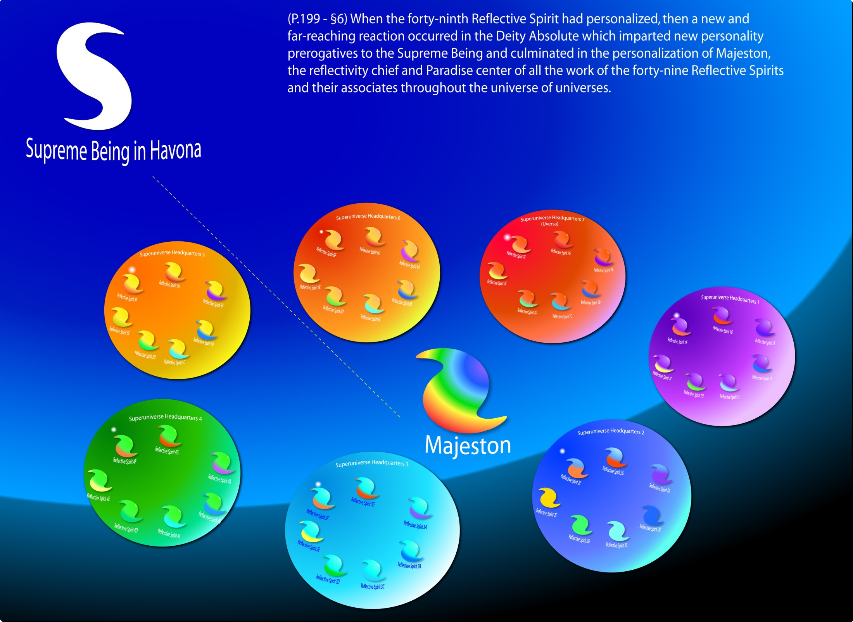
Notes:
Majeston— Chief of Reflectivity

Slide 12
Majeston — Chief of Reflectivity
(199.5) 17:2.1 The Reflective Spirits are of divine Trinity origin. There are fifty of these unique and somewhat mysterious beings. Seven of these extraordinary personalities were created at a time, and each such creative episode was effected by a liaison of the Paradise Trinity and one of the Seven Master Spirits.
(199.6) 17:2.2 This momentous transaction, occurring in the dawn of time, represents the initial effort of the Supreme Creator Personalities, represented by the Master Spirits, to function as cocreators with the Paradise Trinity. This union of the creative power of the Supreme Creators with the creative potentials of the Trinity is the very source of the actuality of the Supreme Being. Therefore, when the cycle of reflective creation had run its course, when each of the Seven Master Spirits had found perfect creative synchrony with the Paradise Trinity, when the forty-ninth Reflective Spirit had personalized, then a new and far-reaching reaction occurred in the Deity Absolute which imparted new personality prerogatives to the Supreme Being and culminated in the personalization of Majeston, the reflectivity chief and Paradise center of all the work of the forty-nine Reflective Spirits and their associates throughout the universe of universes.
(200.1) 17:2.3 Majeston is a true person, the personal and infallible center of reflectivity phenomena in all seven superuniverses of time and space. He maintains permanent Paradise headquarters near the center of all things at the rendezvous of the Seven Master Spirits. He is concerned solely with the co-ordination and maintenance of the reflectivity service in the far-flung creation; he is not otherwise involved in the administration of universe affairs.

Slide 13
Majeston — Chief of Reflectivity (cont.)
(200.2) 17:2.4 Majeston is not included in our catalogue of Paradise personalities because he is the only existing personality of divinity created by the Supreme Being in functional liaison with the Deity Absolute. He is a person, but he is exclusively and apparently automatically concerned with this one phase of universe economy; he does not now function in any personal capacity with relation to other (nonreflective) orders of universe personalities.
(200.3) 17:2.5 The creation of Majeston signalized the first supreme creative act of the Supreme Being. This will to action was volitional in the Supreme Being, but the stupendous reaction of the Deity Absolute was not foreknown. Not since the eternity-appearance of Havona had the universe witnessed such a tremendous factualization of such a gigantic and far-flung alignment of power and co-ordination of functional spirit activities. The Deity response to the creative wills of the Supreme Being and his associates was vastly beyond their purposeful intent and greatly in excess of their conceptual forecasts.
(200.4) 17:2.6 We stand in awe of the possibility of what the future ages, wherein the Supreme and the Ultimate may attain new levels of divinity and ascend to new domains of personality function, may witness in the realms of the deitization of still other unexpected and undreamed of beings who will possess unimagined powers of enhanced universe co-ordination. There would seem to be no limit to the Deity Absolute’s potential of response to such unification of relationships between experiential Deity and the existential Paradise Trinity.

Slide 14
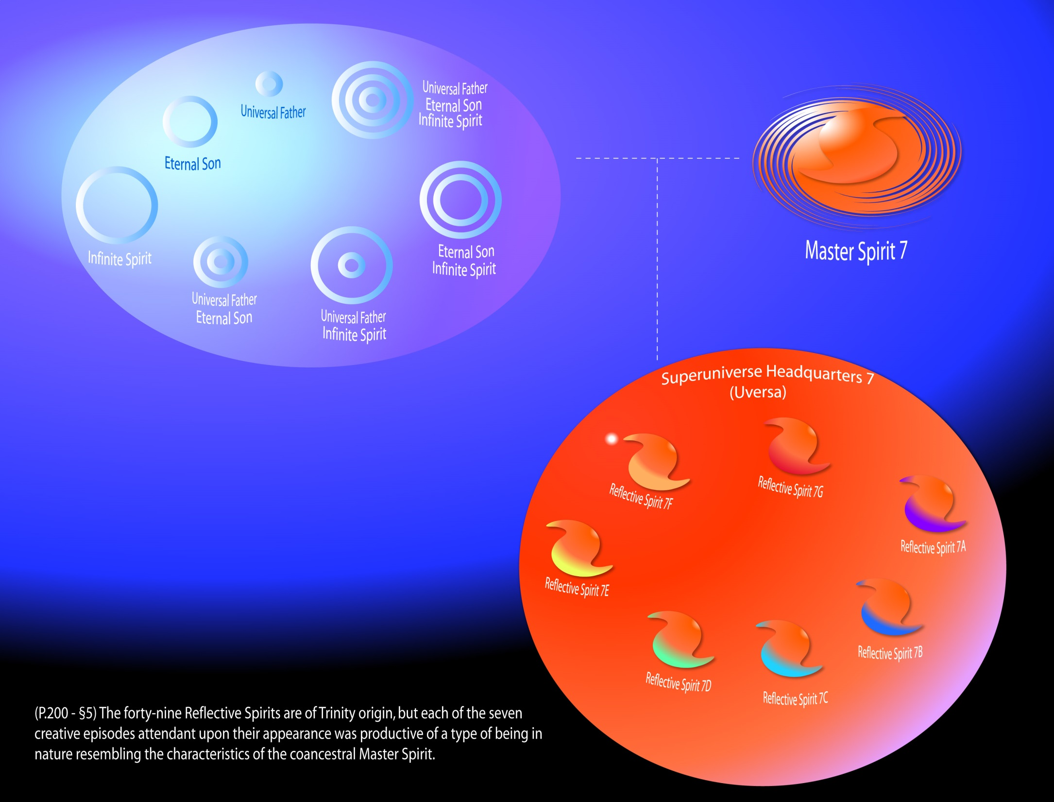
The Reflective Spirits
Notes:
The Reflective Spirits

Slide 15
The Reflective Spirits
(200.5) 17:3.1 The forty-nine Reflective Spirits are of Trinity origin, but each of the seven creative episodes attendant upon their appearance was productive of a type of being in nature resembling the characteristics of the coancestral Master Spirit. Thus they variously reflect the natures and characters of the seven possible combinations of the association of the divinity characteristics of the Universal Father, the Eternal Son, and the Infinite Spirit. For this reason it is necessary to have seven of these Reflective Spirits on the headquarters of each superuniverse. One of each of the seven types is required in order to achieve the perfect reflection of all phases of every possible manifestation of the three Paradise Deities as such phenomena might occur in any part of the seven superuniverses. One of each type was accordingly assigned to service in each of the superuniverses. These groups of seven dissimilar Reflective Spirits maintain headquarters on the capitals of the superuniverses at the reflective focus of each realm, and this is not identical with the point of spiritual polarity.
(200.6) 17:3.2 The Reflective Spirits have names, but these designations are not revealed on the worlds of space. They pertain to the nature and character of these beings and are a part of one of the seven universal mysteries of the secret spheres of Paradise.
(201.1) 17:3.3 The attribute of reflectivity, the phenomenon of the mind levels of the Conjoint Actor, the Supreme Being, and the Master Spirits, is transmissible to all beings concerned in the working of this vast scheme of universal intelligence. And herein is a great mystery: Neither the Master Spirits nor the Paradise Deities, singly or collectively, disclose these powers of co-ordinate universal reflectivity just as they are manifested in these forty-nine liaison personalities of Majeston, and yet they are the creators of all these marvelously endowed beings. Divine heredity does sometimes disclose in the creature certain attributes which are not discernible in the Creator.

Slide 16
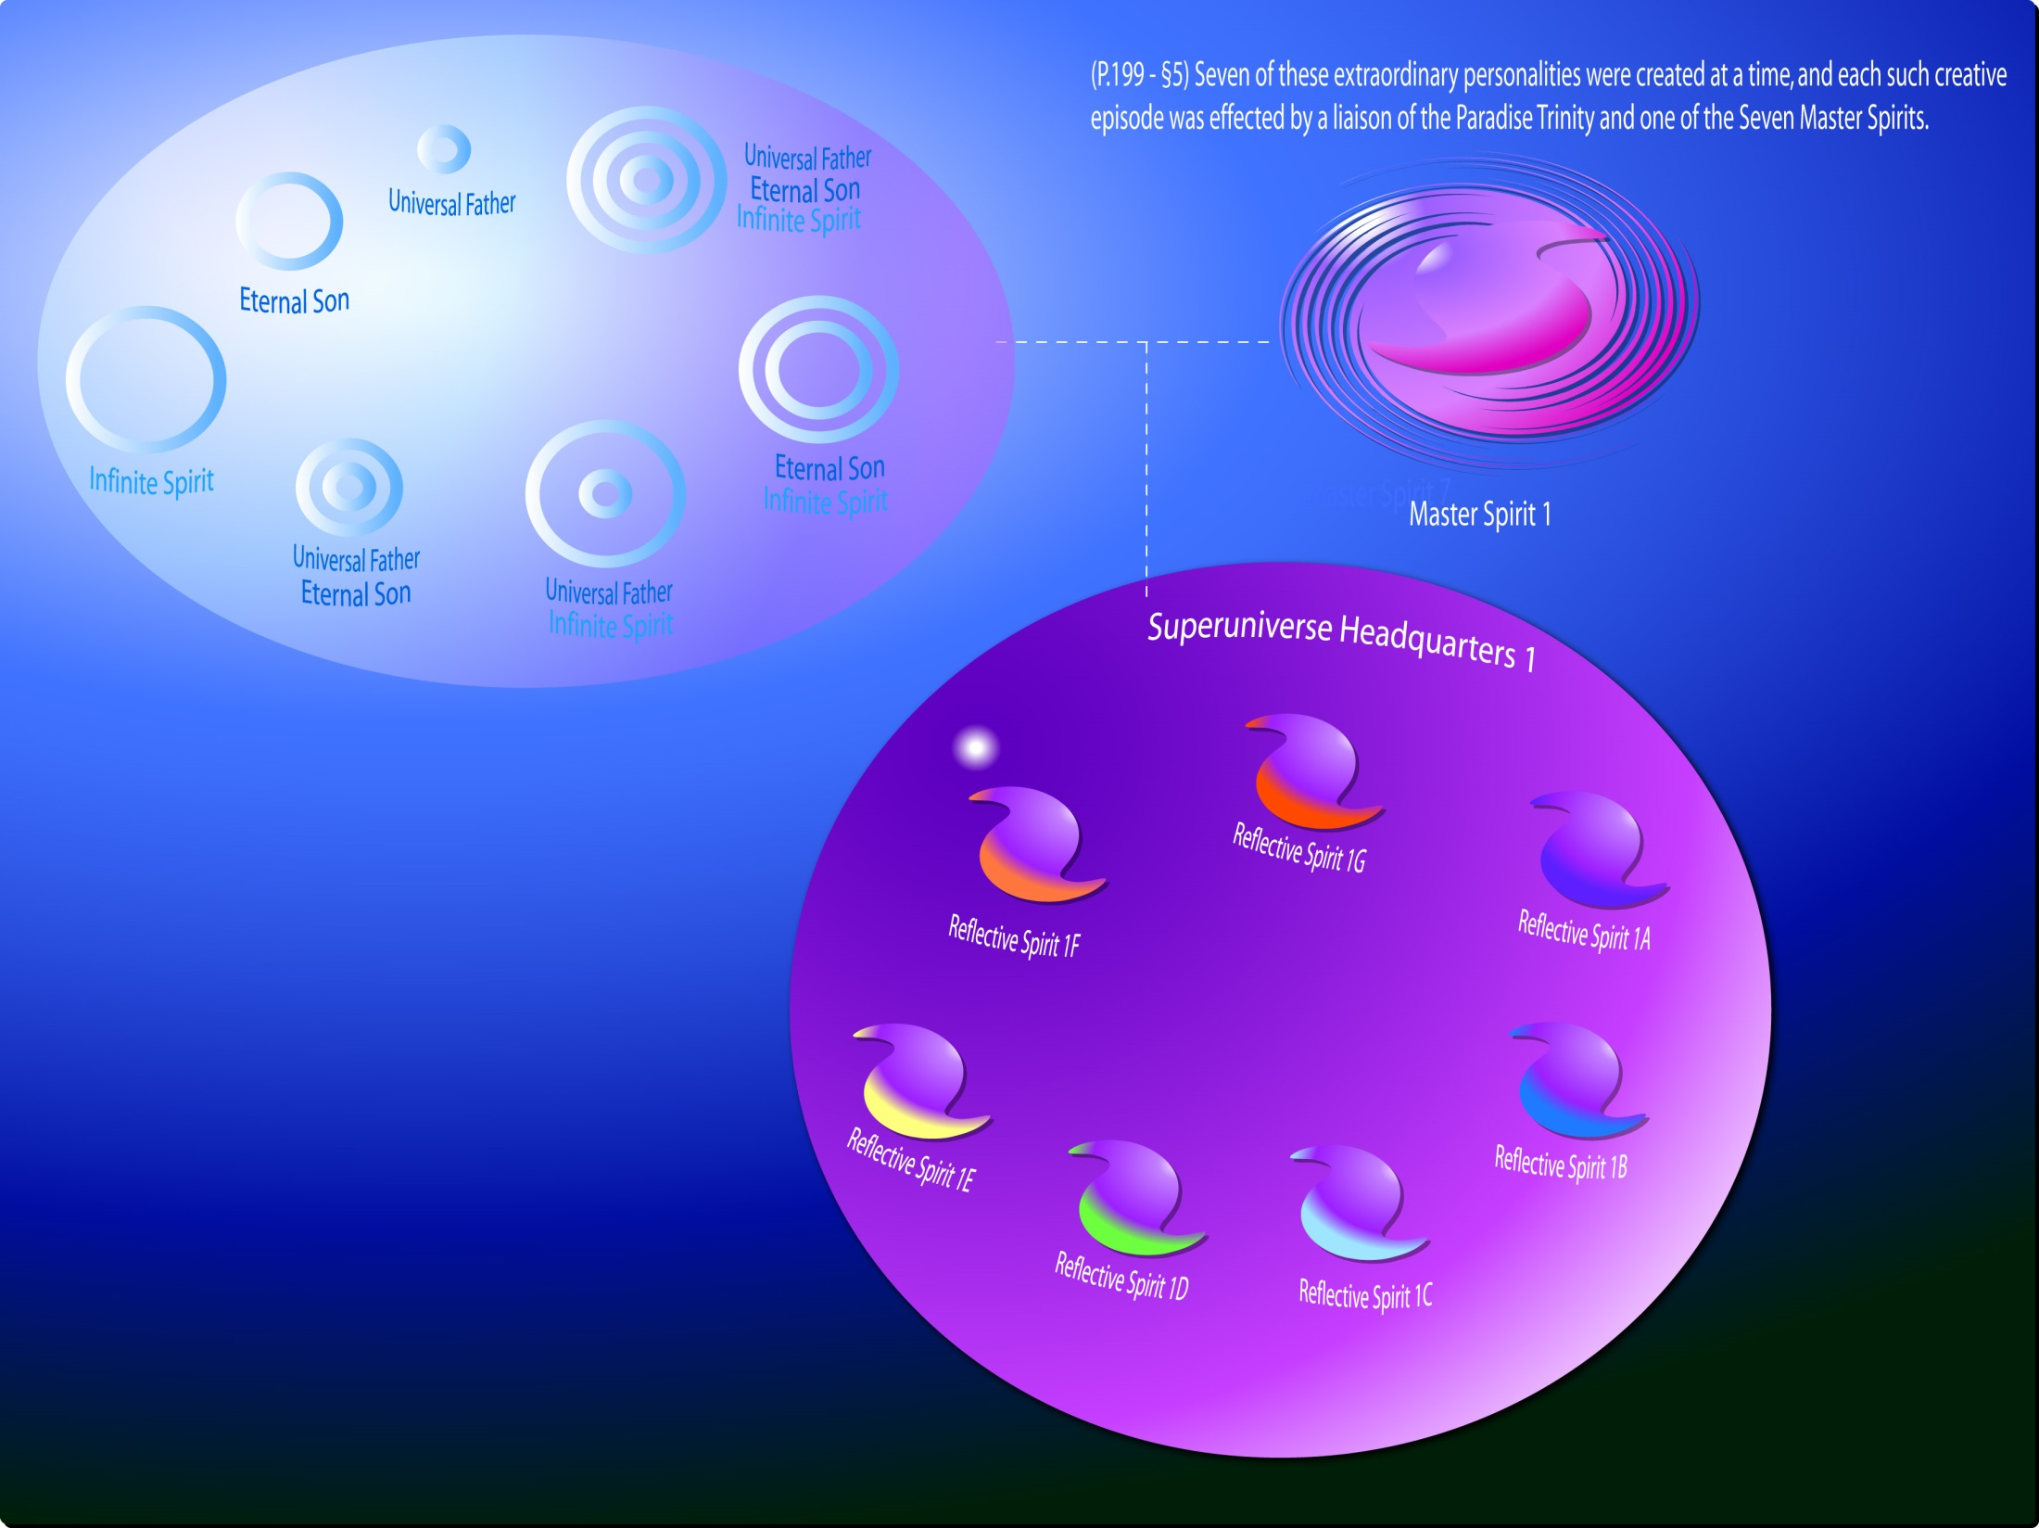
The forty-nine Reflective Spirits
Notes:
The forty-nine Reflective Spirits- Here, seven types refer to Father (A), Son (B), Spirit (C), Father-Son (D), Father-Spirit (E), Son-Spirit (F), and Father-Son-Spirit (G) types.

Slide 17
The forty-nine Reflective Spirits
Here, seven types refer to Father (A), Son (B), Spirit (C), Father-Son (D), Father-Spirit (E), Son-Spirit (F), and Father-Son-Spirit (G) types.

Slide 18
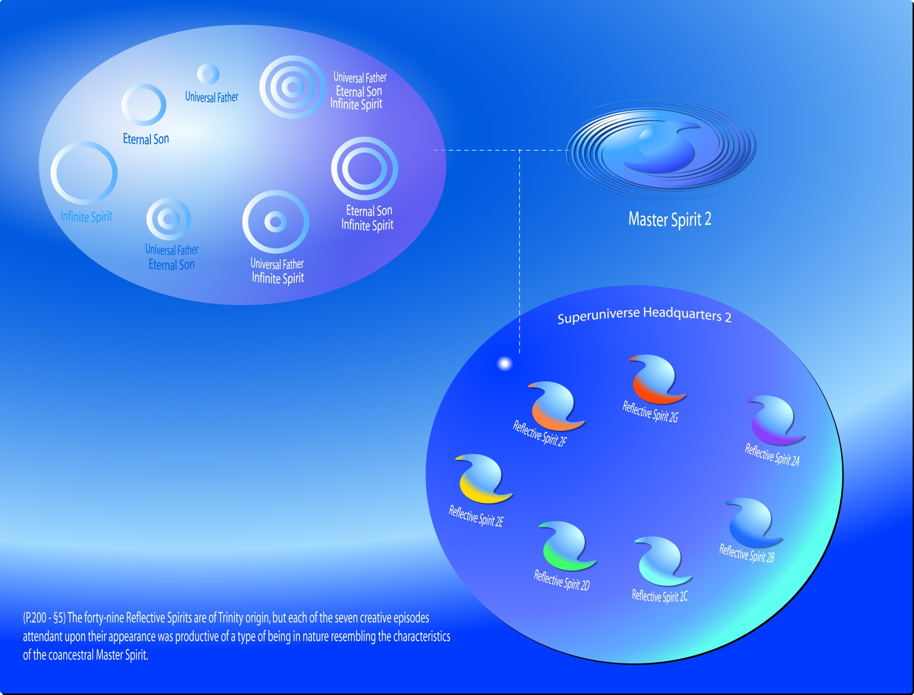
Notes:
Reflective Spirits #8 -14 were the joint creation of the Paradise Trinity and Master Spirit 2.

Slide 19
Reflective Spirits #8 -14 were the joint creation of the Paradise Trinity and Master Spirit 2.

Slide 20
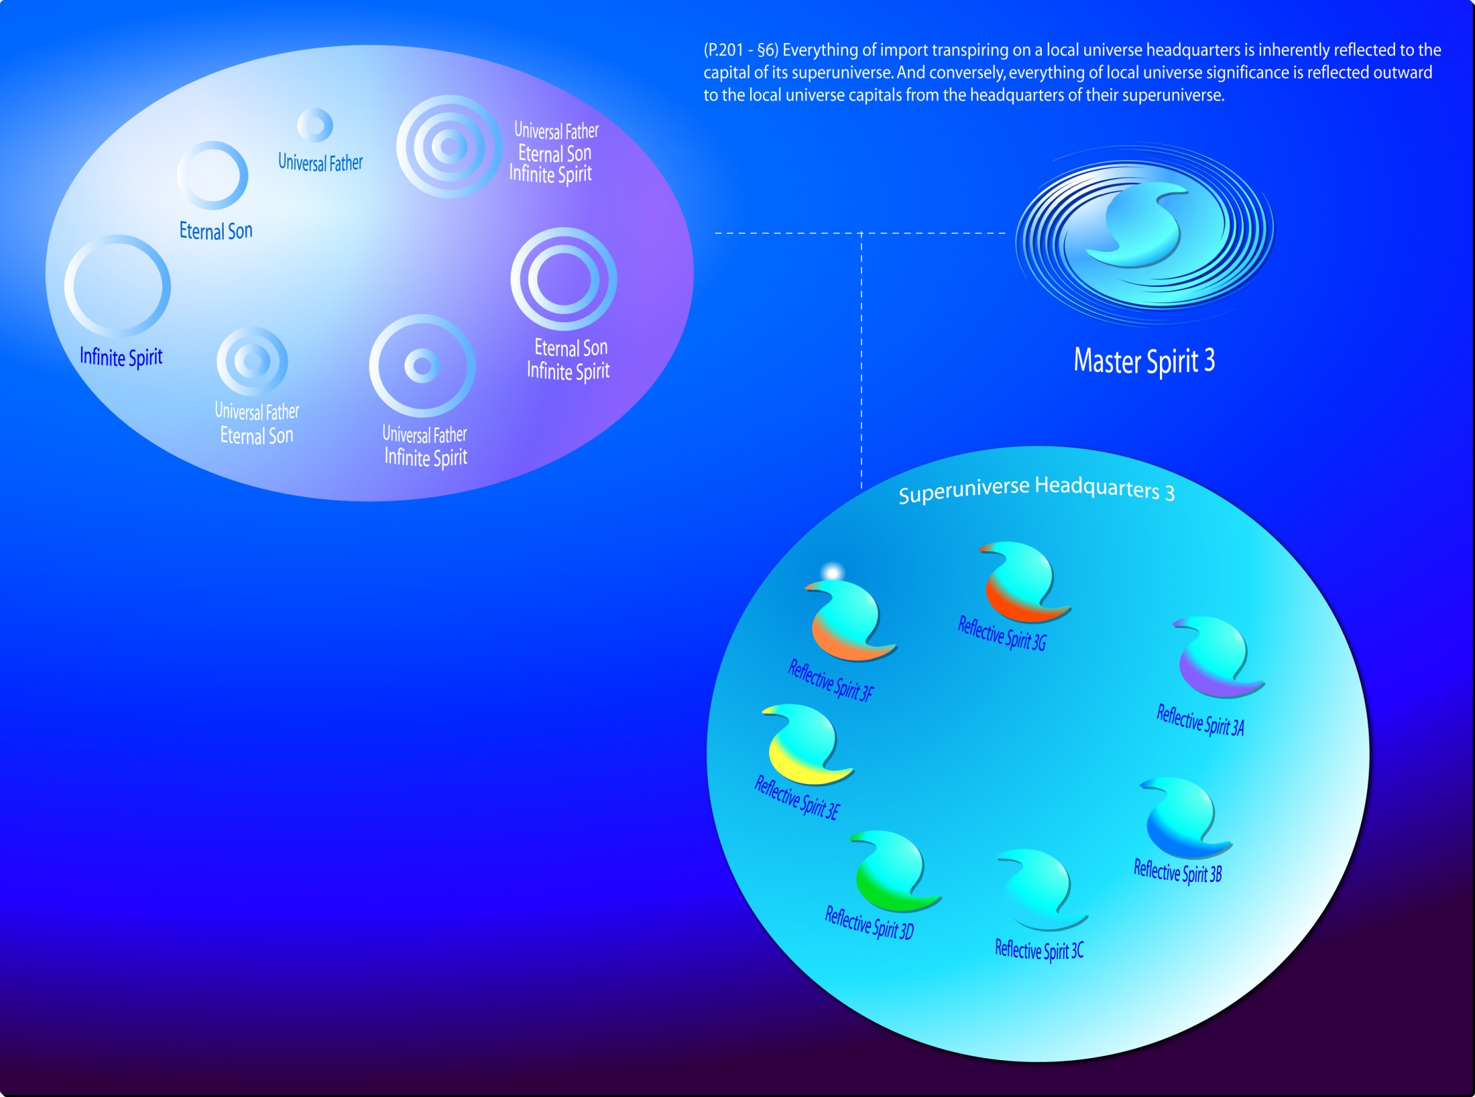
Reflective Spirits #15 -21.
Notes:
Reflective Spirits #15 -21.

Slide 21
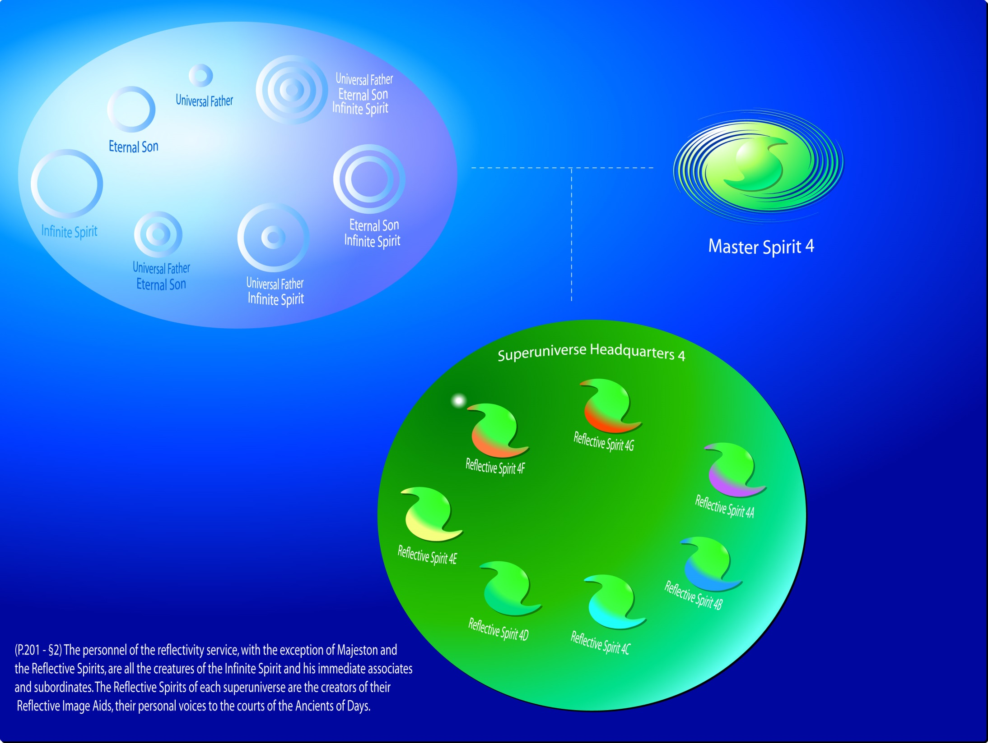
Reflective Spirits #22 -28.
Notes:
Reflective Spirits #22 -28.

Slide 22
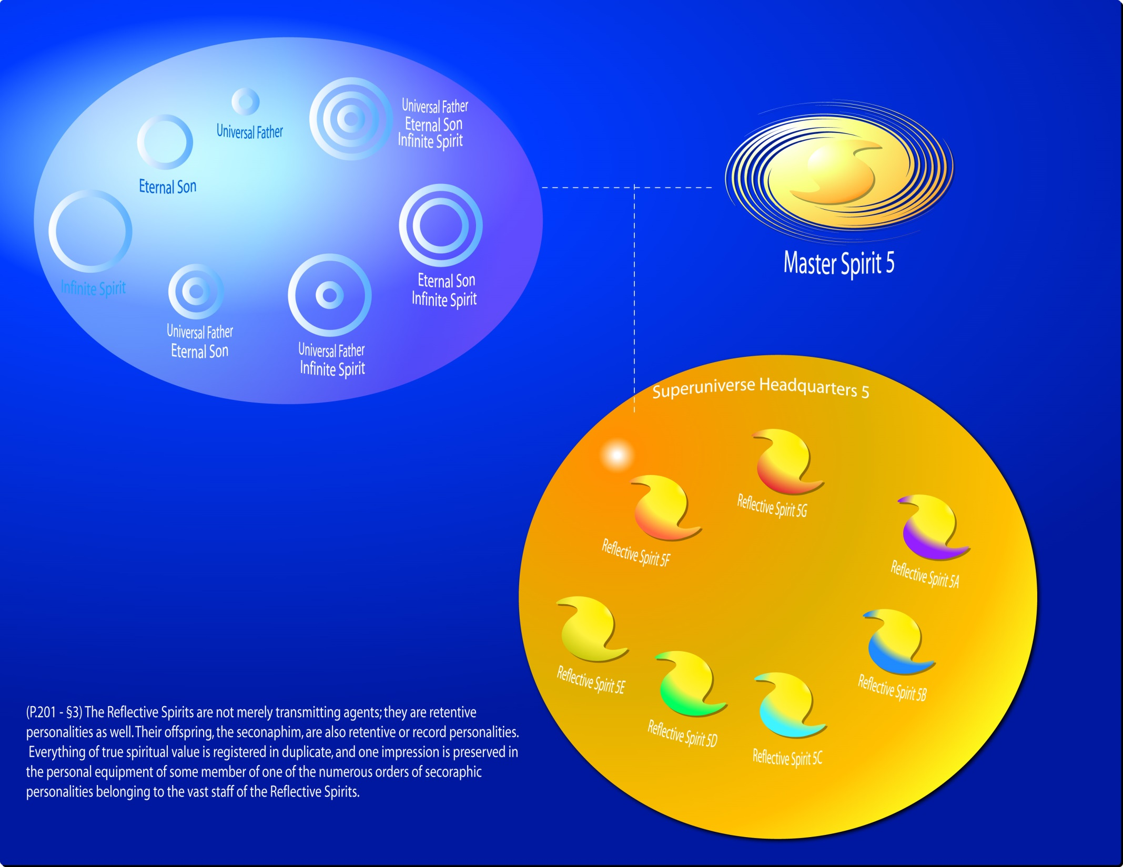
Reflective Spirits #29 - 35.
Notes:
Reflective Spirits #29 - 35.

Slide 23
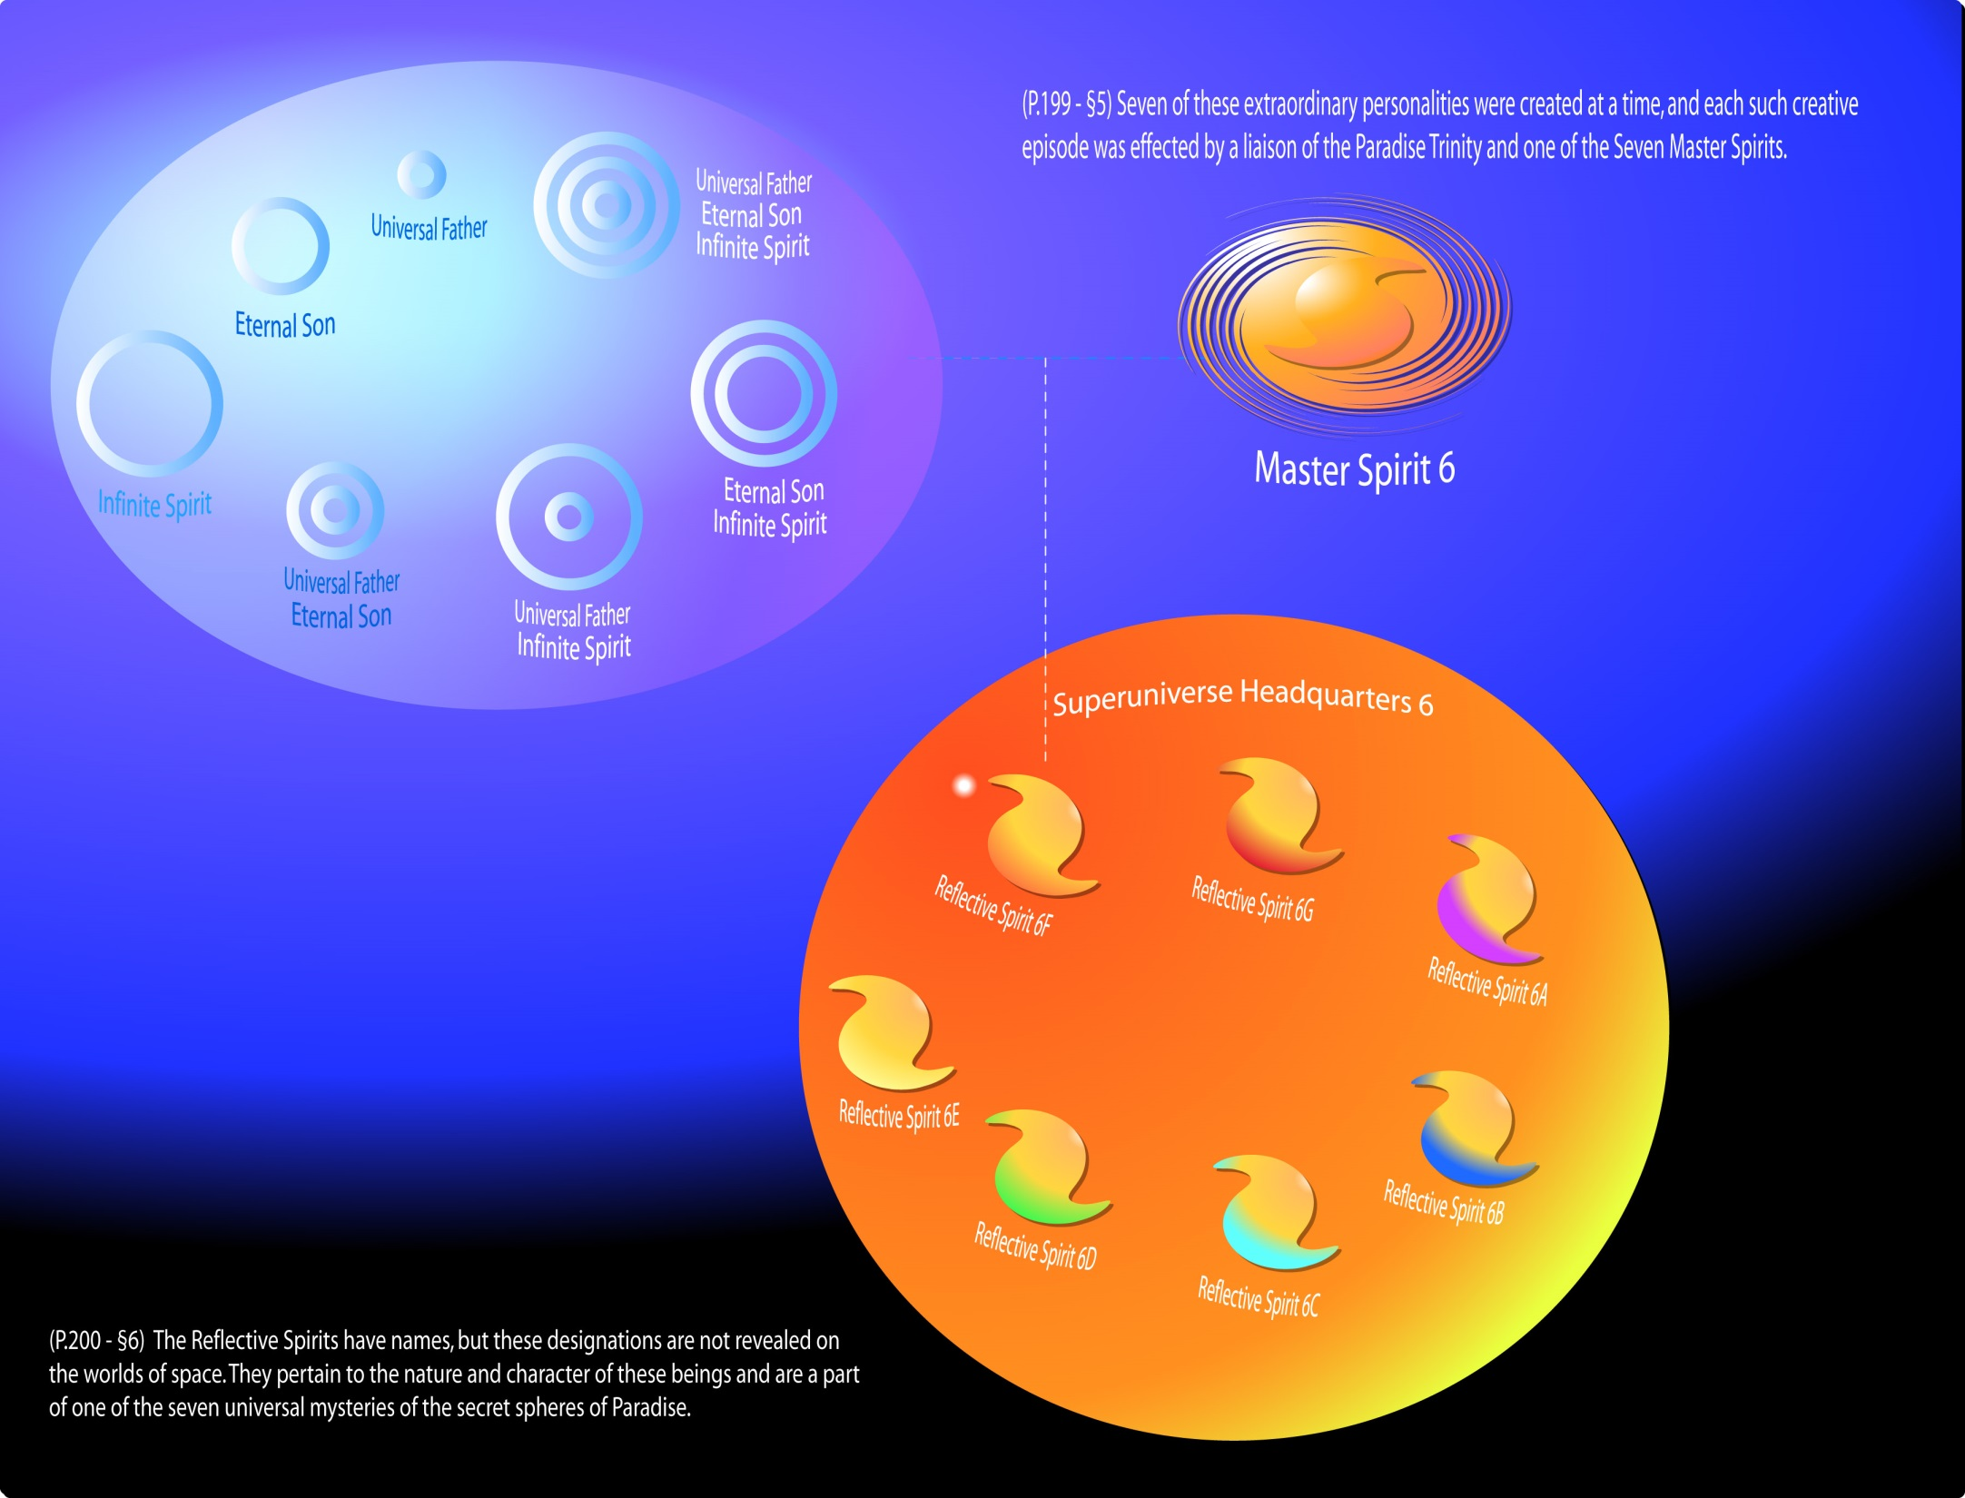
Reflective Spirits #36-42.
Notes:
Reflective Spirits #36-42.

Slide 24
Reflective Spirits #43 - 49.
Notes:
Reflective Spirits #43 - 49.

Slide 25
Notes:
Seven Master Spirits had found perfect creative synchrony with the Paradise Trinity, when the forty-ninth Reflective Spirit had personalized, then a new and far-reaching reaction occurred in the Deity Absolute which imparted new personality prerogatives to the Supreme Being and culminated in the personalization of Majeston

Slide 26
Majeston and the Forty-nine Reflective Spirits
(199.6) 17:2.2 This momentous transaction, occurring in the dawn of time, represents the initial effort of the Supreme Creator Personalities, represented by the Master Spirits, to function as cocreators with the Paradise Trinity. This union of the creative power of the Supreme Creators with the creative potentials of the Trinity is the very source of the actuality of the Supreme Being. Therefore, when the cycle of reflective creation had run its course, when each of the Seven Master Spirits had found perfect creative synchrony with the Paradise Trinity, when the forty-ninth Reflective Spirit had personalized, then a new and far-reaching reaction occurred in the Deity Absolute which imparted new personality prerogatives to the Supreme Being and culminated in the personalization of Majeston, the reflectivity chief and Paradise center of all the work of the forty-nine Reflective Spirits and their associates throughout the universe of universes.

Slide 27
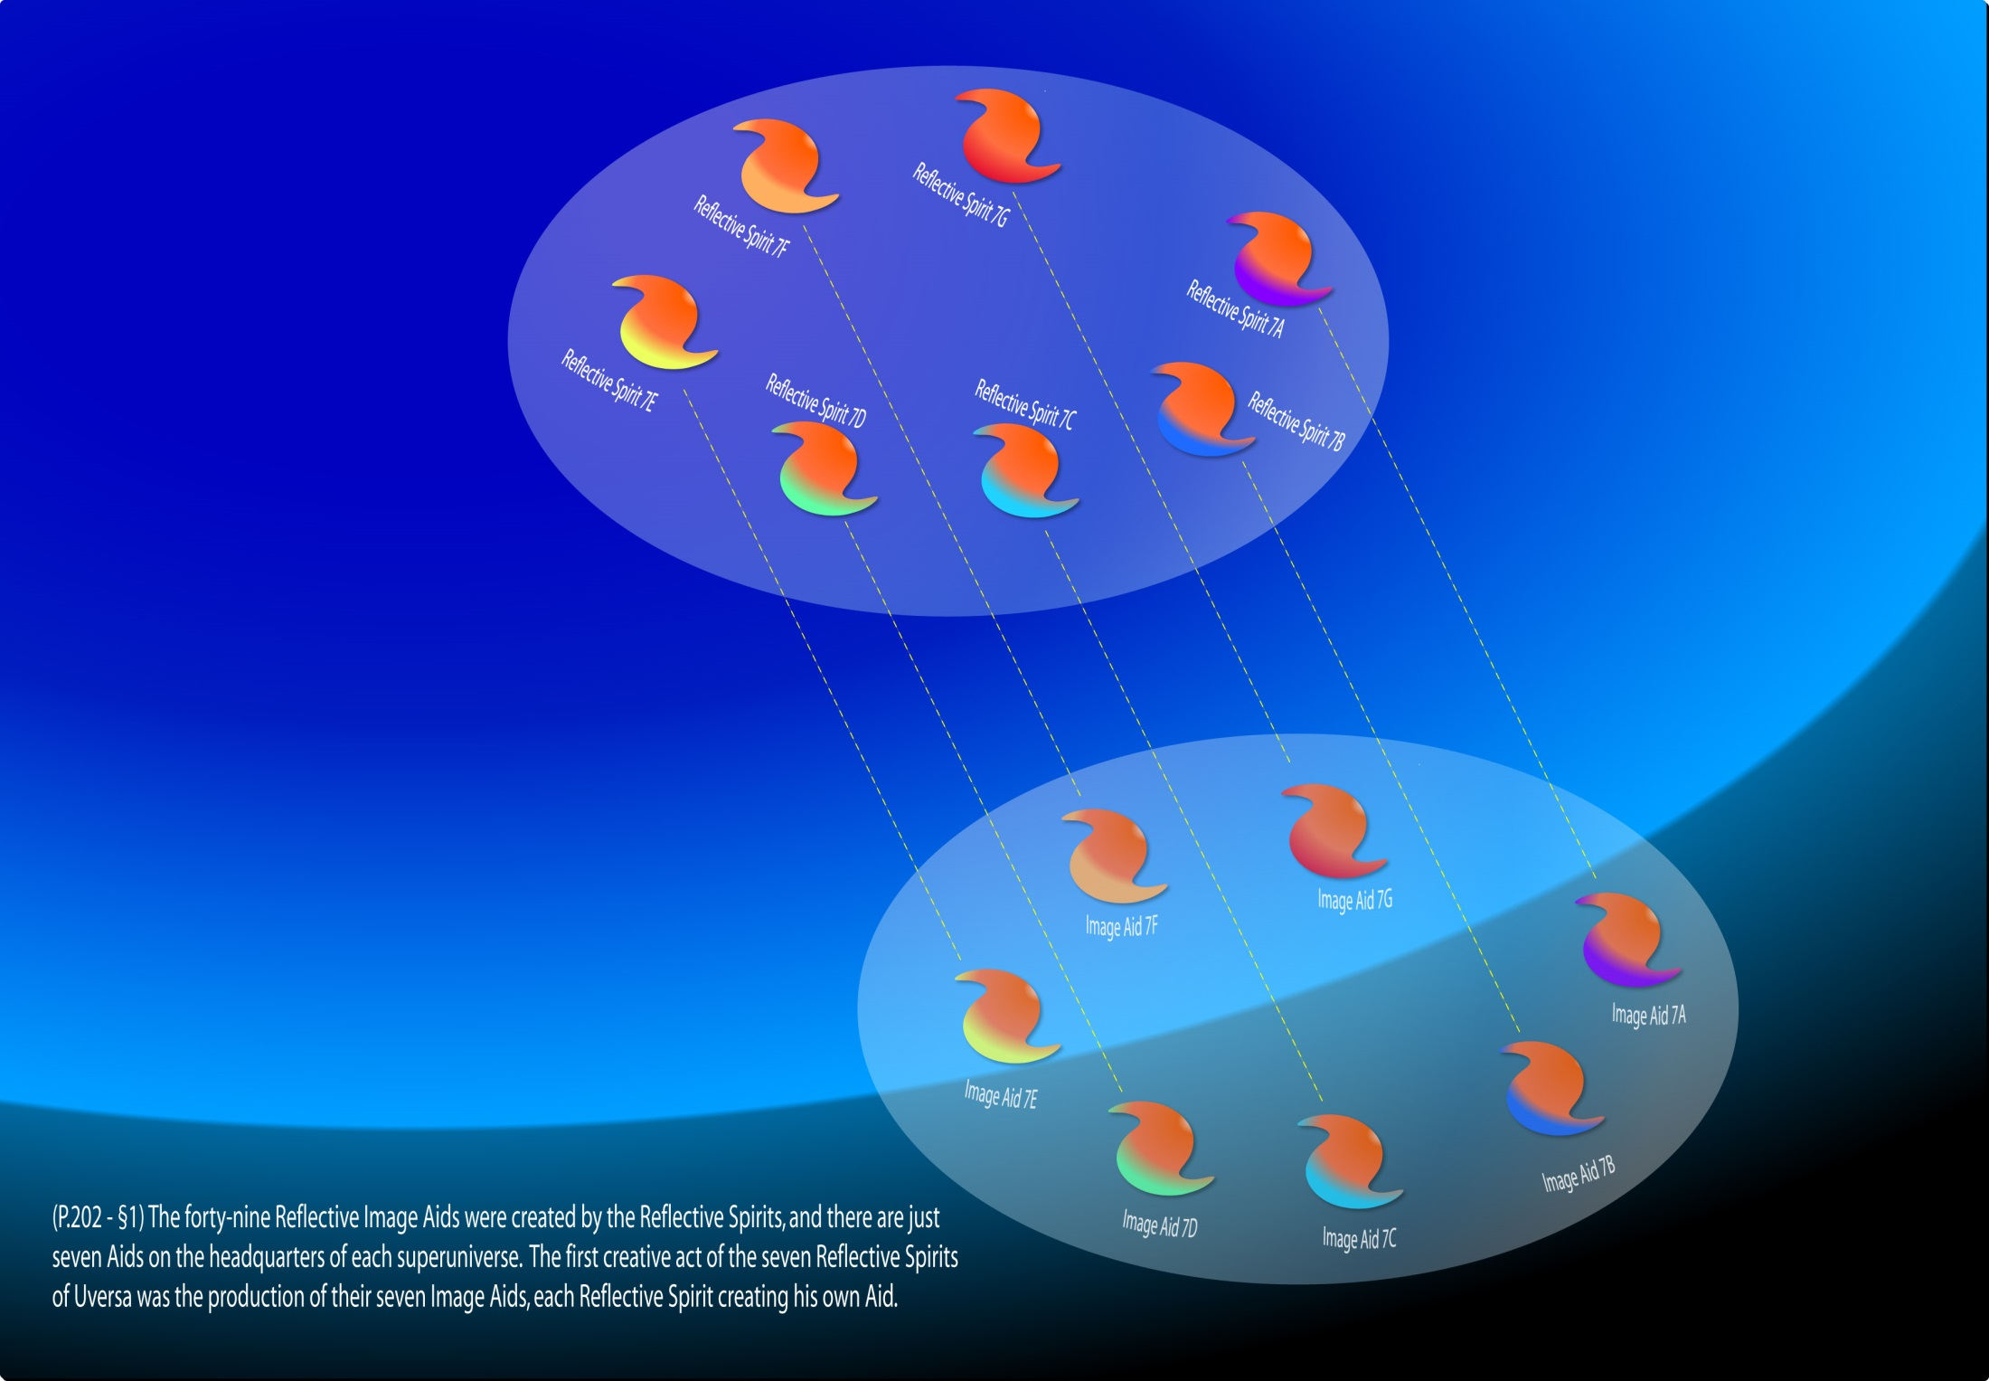
Notes:
The forty-nine Reflective Image Aids were created by the Reflective Spirits, and there are just seven Aids on the headquarters of each superuniverse. The first creative act of the seven Reflective Spirits of Uversa was the production of their seven Image Aids, each Reflective Spirit creating his own Aid.

Slide 28
The Reflective Image Aids
(202.1) 17:4.1 The forty-nine Reflective Image Aids were created by the Reflective Spirits, and there are just seven Aids on the headquarters of each superuniverse. The first creative act of the seven Reflective Spirits of Uversa was the production of their seven Image Aids, each Reflective Spirit creating his own Aid. The Image Aids are, in certain attributes and characteristics, perfect reproductions of their Reflective Mother Spirits; they are virtual duplications minus the attribute of reflectivity. They are true images and constantly function as the channel of communication between the Reflective Spirits and the superuniverse authorities. The Image Aids are not merely assistants; they are actual representations of their respective Spirit ancestors; they are images, and they are true to their name.
(202.2) 17:4.2 The Reflective Spirits themselves are true personalities but of such an order as to be incomprehensible to material beings. Even on a superuniverse headquarters sphere they require the assistance of their Image Aids in all personal intercourse with the Ancients of Days and their associates. In contacts between the Image Aids and the Ancients of Days, sometimes one Aid functions acceptably, while on other occasions two, three, four, or even all seven are required for the full and proper presentation of the communication intrusted to their transmission. Likewise, the messages of the Image Aids are variously received by one, two, or all three Ancients of Days, as the content of the communication may require.
(202.3) 17:4.3 The Image Aids serve forever by the sides of their ancestral Spirits, and they have at their disposal an unbelievable host of helper seconaphim. The Image Aids do not directly function in connection with the training worlds of ascending mortals. They are closely associated with the intelligence service of the universal scheme of mortal progression, but you will not personally come in contact with them when you sojourn in the Uversa schools because these seemingly personal beings are devoid of will; they do not exercise the power of choice. They are true images, wholly reflective of the personality and mind of the individual Spirit ancestor. As a class, ascending mortals do not intimately contact with reflectivity. Always some being of the reflective nature will be interposed between you and the actual operation of the service.

Slide 29
Seven Supreme Spirits Groups
(197.1) 17:0.1 The seven Supreme Spirit groups are the universal co-ordinating directors of the seven-segmented administration of the grand universe. Although all are classed among the functional family of the Infinite Spirit, the following three groups are usually classified as children of the Paradise Trinity:
(197.2) 17:0.2 1. The Seven Master Spirits.
(197.3) 17:0.3 2. The Seven Supreme Executives.
(197.4) 17:0.4 3. The Reflective Spirits.
(197.5) 17:0.5 The remaining four groups are brought into being by the creative acts of the Infinite Spirit or by his associates of creative status:
(197.6) 17:0.6 4. The Reflective Image Aids.
(197.7) 17:0.7 5. The Seven Spirits of the Circuits.
(197.8) 17:0.8 6. The Local Universe Creative Spirits.
(197.9) 17:0.9 7. The Adjutant Mind-Spirits.

Slide 30
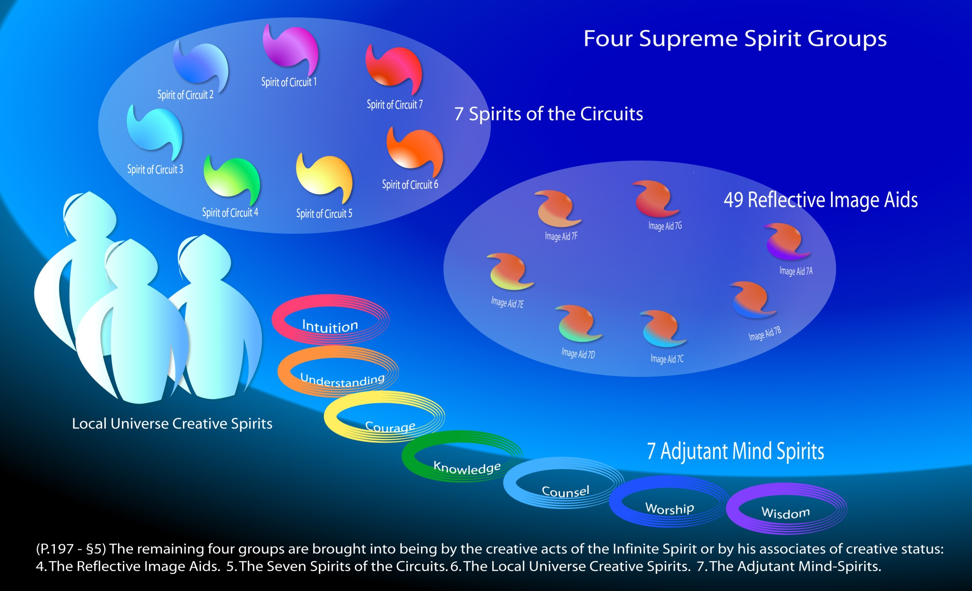
Notes:
Seven Supreme Spirit Groups

Slide 31
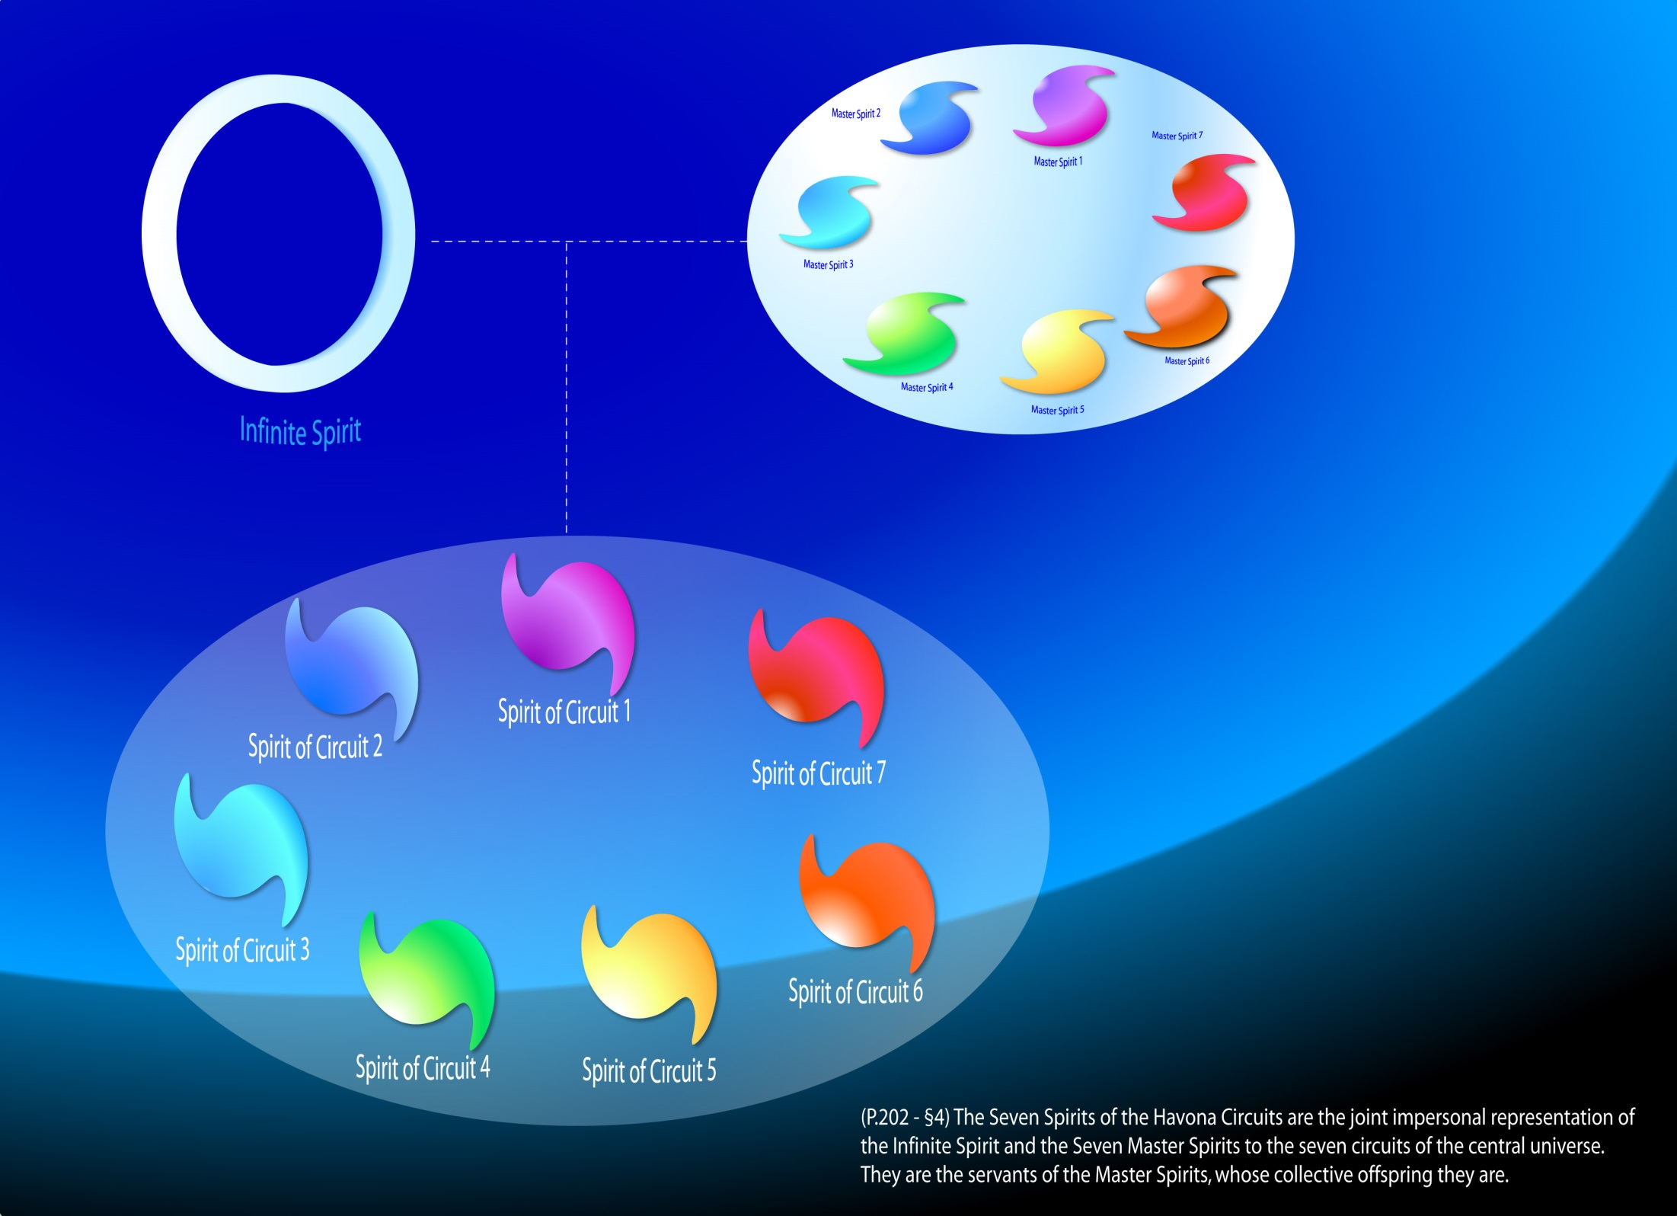
Notes:
The Seven Spirits of the Havona Circuits

Slide 32
The Seven Spirits of the Circuits
(202.4) 17:5.1 The Seven Spirits of the Havona Circuits are the joint impersonal representation of the Infinite Spirit and the Seven Master Spirits to the seven circuits of the central universe. They are the servants of the Master Spirits, whose collective offspring they are. The Master Spirits provide a distinct and diversified administrative individuality in the seven superuniverses. Through these uniform Spirits of the Havona Circuits they are enabled to provide a unified, uniform, and co-ordinated spiritual supervision for the central universe.
(202.5) 17:5.2 The Seven Spirits of the Circuits are each limited to the permeation of a single Havona circuit. They are not directly concerned with the regimes of the Eternals of Days, the rulers of the individual Havona worlds. But they are in liaison with the Seven Supreme Executives, and they synchronize with the central universe presence of the Supreme Being. Their work is wholly confined to Havona.
(203.1) 17:5.3 These Spirits of the Circuits make contact with those who sojourn in Havona through their personal offspring, the tertiary supernaphim. While the Circuit Spirits are coexistent with the Seven Master Spirits, their function in the creation of tertiary supernaphim did not attain major importance until the first pilgrims of time arrived on the outer circuit of Havona in the days of Grandfanda.

Slide 33
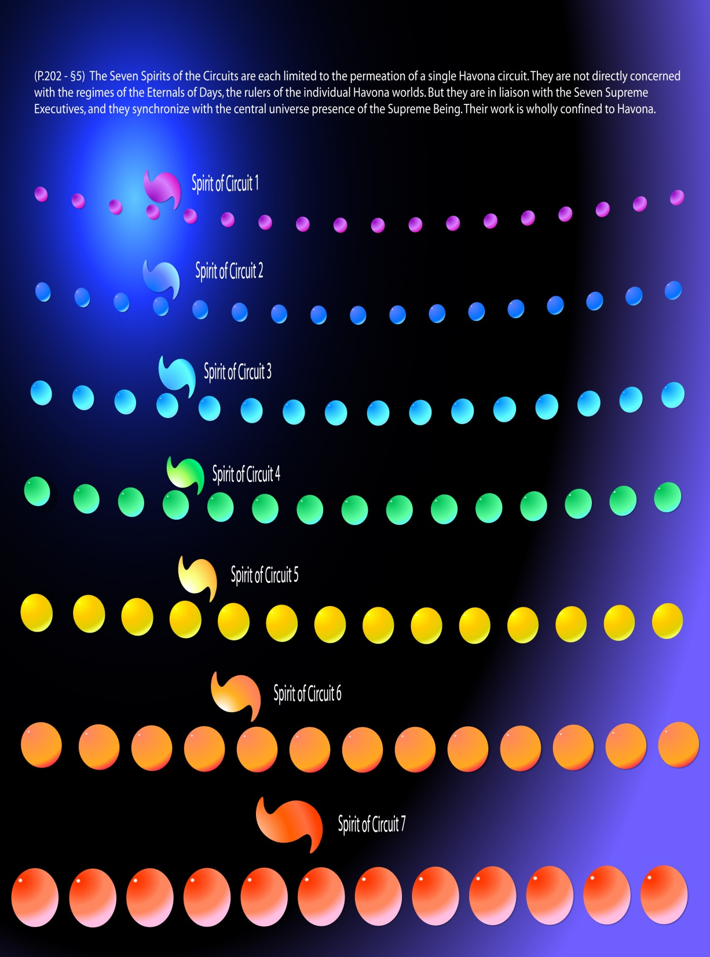
Notes:
The Seven Spirits of the Circuits are each limited to the permeation of a single Havona circuit.

Slide 34
The Seven Spirits of the Circuits(cont.)
(203.2) 17:5.4 As you advance from circuit to circuit in Havona, you will learn of the Spirits of the Circuits, but you will not be able to hold personal communion with them, even though you may personally enjoy, and recognize the impersonal presence of, their spiritual influence.
(203.3) 17:5.5 The Circuit Spirits are related to the native inhabitants of Havona much as the Thought Adjusters are related to the mortal creatures inhabiting the worlds of the evolutionary universes. Like the Thought Adjusters, the Circuit Spirits are impersonal, and they consort with the perfect minds of Havona beings much as the impersonal spirits of the Universal Father indwell the finite minds of mortal men. But the Spirits of the Circuits never become a permanent part of Havona personalities.

Slide 35
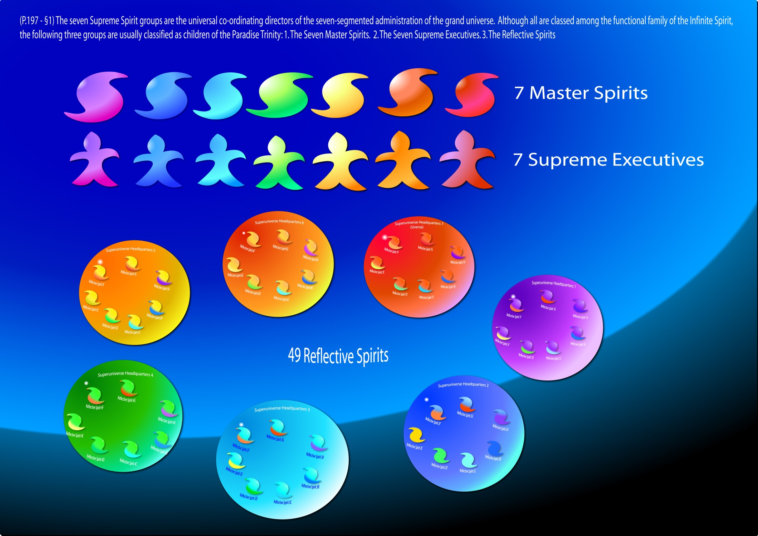
Notes:
The seven Supreme Spirit groups are the universal co-ordinating directors of the seven-segmented administration of the grand universe.

Slide 36
Functions of the Supreme Spirits
(205.2) 17:8.1 The seven groups of Supreme Spirits constitute the nucleus of the functional family of the Third Source and Center both as the Infinite Spirit and as the Conjoint Actor. The domain of the Supreme Spirits extends from the presence of the Trinity on Paradise to the functioning of mind of the evolutionary-mortal order on the planets of space. Thus do they unify the descending administrative levels and co-ordinate the manifold functions of the personnel thereof. Whether it is a Reflective Spirit group in liaison with the Ancients of Days, a Creative Spirit acting in concert with a Michael Son, or the Seven Master Spirits encircuited around the Paradise Trinity, the activity of the Supreme Spirits is encountered everywhere in the central, super-, and local universes. They function alike with the Trinity personalities of the order of “Days” and with the Paradise personalities of the order of “Sons.”
(205.3) 17:8.2 Together with their Infinite Mother Spirit, the Supreme Spirit groups are the immediate creators of the vast creature family of the Third Source and Center. All orders of the ministering spirits spring from this association. Primary supernaphim originate in the Infinite Spirit; secondary beings of this order are created by the Master Spirits; tertiary supernaphim by the Seven Spirits of the Circuits. The Reflective Spirits, collectively, are the mother-makers of a marvelous order of the angelic hosts, the mighty seconaphim of the superuniverse services. A Creative Spirit is the mother of the angelic orders of a local creation; such seraphic ministers are original in each local universe, though they are fashioned after the patterns of the central universe. All these creators of ministering spirits are only indirectly assisted by the central lodgment of the Infinite Spirit, the original and eternal mother of all the angelic ministers.

Slide 37
Functions of the Supreme Spirits (cont.)
(205.4) 17:8.3 The seven Supreme Spirit groups are the co-ordinators of the inhabited creation. The association of their directing heads, the Seven Master Spirits, appears to co-ordinate the far-flung activities of God the Sevenfold:
(205.5) 17:8.4 1. Collectively the Master Spirits near-equivalate to the divinity level of the Trinity of Paradise Deities.
(205.6) 17:8.5 2. Individually they exhaust the primary associable possibilities of triune Deity.
(206.1) 17:8.6 3. As diversified representatives of the Conjoint Actor they are the repositories of that spirit-mind-power sovereignty of the Supreme Being which he does not yet personally exercise.
(206.2) 17:8.7 4. Through the Reflective Spirits they synchronize the superuniverse governments of the Ancients of Days with Majeston, the Paradise center of universal reflectivity.
(206.3) 17:8.8 5. In their participation in the individualization of the local universe Divine Ministers, the Master Spirits contribute to the last level of God the Sevenfold, the Creator Son-Creative Spirit union of the local universes.
(206.4) 17:8.9 Functional unity, inherent in the Conjoint Actor, is disclosed to the evolving universes in the Seven Master Spirits, his primary personalities. But in the perfected superuniverses of the future this unity will undoubtedly be inseparable from the experiential sovereignty of the Supreme.

Slide 38
The Local Universe Creative Spirits
(203.4) 17:6.1 Much that pertains to the nature and function of the local universe Creative Spirits properly belongs to the narrative of their association with the Creator Sons in the organization and management of the local creations; but there are many features of the prelocal universe experiences of these marvelous beings which may be narrated as a part of this discussion of the seven Supreme Spirit groups.
(203.5) 17:6.2 We are conversant with six phases of the career of a local universe Mother Spirit, and we speculate much concerning the probability of a seventh stage of activity. These different stages of existence are:
(203.6) 17:6.3 1. Initial Paradise Differentiation. When a Creator Son is personalized by the joint action of the Universal Father and the Eternal Son, simultaneously there occurs in the person of the Infinite Spirit what is known as the “supreme reaction of complement.” We do not comprehend the nature of this reaction, but we understand that it designates an inherent modification of those personalizable possibilities which are embraced within the creative potential of the Conjoint Creator. The birth of a co-ordinate Creator Son signalizes the birth within the person of the Infinite Spirit of the potential of the future local universe consort of this Paradise Son. We are not cognizant of this new prepersonal identification of entity, but we know that this fact finds place on the Paradise records of the career of such a Creator Son.
(203.7) 17:6.4 2. Preliminary Creatorship Training. During the long period of the preliminary training of a Michael Son in the organization and administration of universes, his future consort undergoes further development of entity and becomes group conscious of destiny. We do not know, but we suspect that such a group-conscious entity becomes space cognizant and begins that preliminary training requisite to the acquirement of spirit skill in her future work of collaboration with the complemental Michael in universe creation and administration.
(204.1) 17:6.5 3. The Stage of Physical Creation. At the time the creatorship charge is administered to a Michael Son by the Eternal Son, the Master Spirit who directs the superuniverse to which this new Creator Son is destined gives expression to the “prayer of identification” in the presence of the Infinite Spirit; and for the first time, the entity of the subsequent Creative Spirit appears as differentiated from the person of the Infinite Spirit. And proceeding directly to the person of the petitioning Master Spirit, this entity is immediately lost to our recognition, becoming apparently a part of the person of this Master Spirit. The newly identified Creative Spirit remains with the Master Spirit until the moment of the departure of the Creator Son for the adventure of space; whereupon the Master Spirit commits the new Spirit consort to the keeping of the Creator Son, at the same time administering to the Spirit consort the charge of eternal fidelity and unending loyalty. And then occurs one of the most profoundly touching episodes which ever take place on Paradise. The Universal Father speaks in acknowledgment of the eternal union of the Creator Son and the Creative Spirit and in confirmation of the bestowal of certain joint powers of administration by the Master Spirit of superuniverse jurisdiction.

Slide 39
The Local Universe Creative Spirits (cont.)
(204.2) 17:6.6 The Father-united Creator Son and Creative Spirit then go forth on their adventure of universe creation. And they work together in this form of association throughout the long and arduous period of the material organization of their universe.
(204.3) 17:6.7 4. The Life-Creation Era. Upon the declaration of intention to create life by the Creator Son, there ensue on Paradise the “personalization ceremonies,” participated in by the Seven Master Spirits and personally experienced by the supervising Master Spirit. This is a Paradise Deity contribution to the individuality of the Spirit consort of the Creator Son and becomes manifest to the universe in the phenomenon of “the primary eruption” in the person of the Infinite Spirit. Simultaneously with this phenomenon on Paradise, the heretofore impersonal Spirit consort of the Creator Son becomes, to all practical intents and purposes, a bona fide person. Henceforth and forevermore, this same local universe Mother Spirit will be regarded as a person and will maintain personal relations with all the personality hosts of the ensuing life creation.
(204.4) 17:6.8 5. The Postbestowal Ages. Another and great change occurs in the never-ending career of a Creative Spirit when the Creator Son returns to universe headquarters after the completion of his seventh bestowal and subsequent to his acquirement of full universe sovereignty. On that occasion, before the assembled administrators of the universe, the triumphant Creator Son elevates the Universe Mother Spirit to cosovereignty and acknowledges the Spirit consort as his equal.
(204.5) 17:6.9 6. The Ages of Light and Life. Upon the establishment of the era of light and life the local universe cosovereign enters upon the sixth phase of a Creative Spirit’s career. But we may not portray the nature of this great experience. Such things pertain to a future stage of evolution in Nebadon.
(204.6) 17:6.10 7. The Unrevealed Career. We know of these six phases of the career of a local universe Mother Spirit. It is inevitable that we should ask: Is there a seventh career? We are mindful that, when finaliters attain what appears to be their final destiny of mortal ascension, they are of record as entering upon the career of sixth-stage spirits. We conjecture that there awaits the finaliters still another and unrevealed career in universe assignment. It is only to be expected that we would likewise regard the Universe Mother Spirits as having ahead of them some undisclosed career which will constitute their seventh phase of personal experience in universe service and loyal co-operation with the order of the Creator Michaels.

Slide 40

Notes:
The Adjutant Mind-Spirits: Intuition, Understanding, Courage, Knowledge, Counsel, Worship and Wisdom.

Slide 41
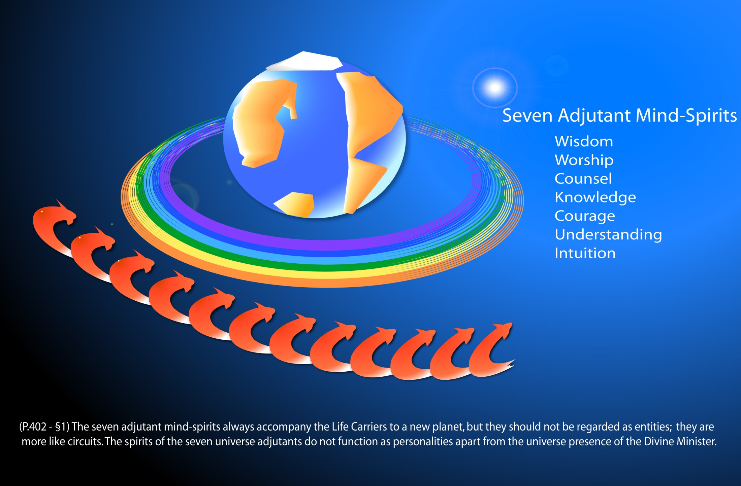
Notes:
P.401 - §6 The seven adjutant mind-spirits are called by names which are the equivalents of the following designations: intuition, understanding, courage, knowledge, counsel, worship, and wisdom. These mind-spirits send forth their influence into all the inhabited worlds as a differential urge, each seeking receptivity capacity for manifestation quite apart from the degree to which its fellows may find reception and opportunity for function.

Slide 42
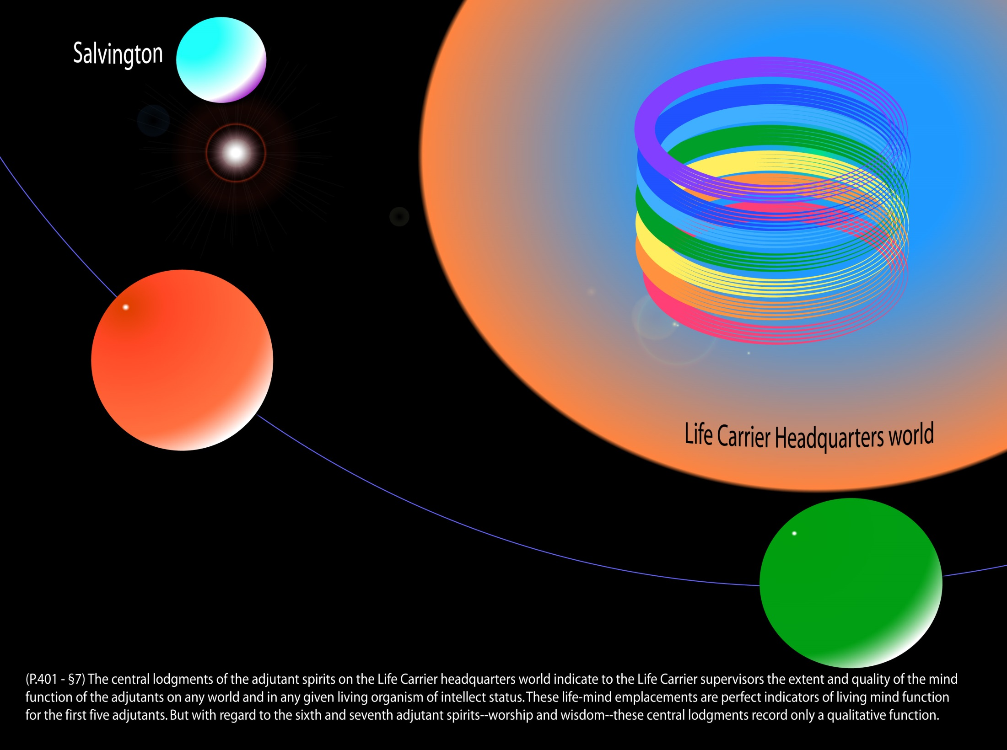

Slide 43
Life Carrier Headquarters World
^{P401:7, 36:5.3} The central lodgments of the adjutant spirits on the Life Carrier headquarters world indicate to the Life Carrier supervisors the extent and quality of the mind function of the adjutants on any world and in any given living organism of intellect status. These life-mind emplacements are perfect indicators of living mind function for the first five adjutants. But with regard to the sixth and seventh adjutant spirits -- worship and wisdom -- these central lodgments record only a qualitative function. The quantitative activity of the adjutant of worship and the adjutant of wisdom is registered in the immediate presence of the Divine Minister on Salvington, being a personal experience of the Universe Mother Spirit.
(402.1) 36:5.4 The seven adjutant mind-spirits always accompany the Life Carriers to a new planet, but they should not be regarded as entities; they are more like circuits. The spirits of the seven universe adjutants do not function as personalities apart from the universe presence of the Divine Minister; they are in fact a level of consciousness of the Divine Minister and are always subordinate to the action and presence of their creative mother.

Slide 44
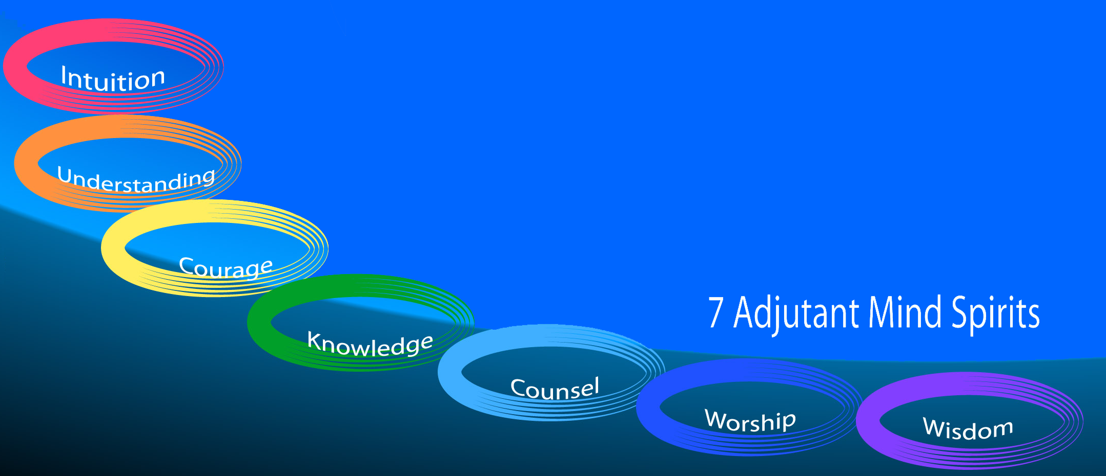
The Adjutant Mind-Spirits
(205.1) 17:7.1 These adjutant spirits are the sevenfold mind bestowal of a local universe Mother Spirit upon the living creatures of the conjoint creation of a Creator Son and such a Creative Spirit. This bestowal becomes possible at the time of the Spirit’s elevation to the status of personality prerogatives. The narration of the nature and functioning of the seven adjutant mind-spirits belongs more appropriately to the story of your local universe of Nebadon.

Slide 45



The Adjutant Mind-Spirits
#1 intuition 34:4.7(378;4)
adjutant of quick perception, reflexes; self-preservation 34:4.7(378;4), 36:5.6(402;3), 65:7.6(739;2)
assists directional control beings 34:4.9(378;6)
extensively contacts nonteachable mind 36:5.6(402;3)
ministers to subhuman mind 42:10.4(481;1)
source of instinctive behavior 62:6.3-6(709;4)
#2 understanding 34:4.7(378;4)
adjutant of quick reasoning, judgment 36:5.7(402;4), 65:7.6(739;2)
gift of spontaneous association of ideas 36:5.7(402;4), 62:6.3-6(709;4)
ministers to subhuman mind 42:10.4(481;1)
#3 courage 34:4.7(378;4)
ministers to subhuman mind 42:10.4(481;1)
mobilizes upon exhaustion of animal life to give origin to prehumans 65:3.5(734;2)
protective self-consciousness 62:6.3-6(709;4)
source of moral stamina and spiritual bravery 36:5.8(402;5)

Slide 46


The Adjutant Mind-Spirits (cont.)
#4 knowledge 34:4.7(378;4), 62:6.3-6(709;4)
adjutant of curiosity, adventure, and discovery 36:5.9(402;6)
ministers to subhuman mind 42:10.4(481;1)
#5 counsel 34:4.7(378;4)
adjutant of social co-operation and harmony 36:5.10(402;7)
ministers to subhuman mind 42:10.4(481;1)
source of herd instinct 62:6.3-6(709;4)
#1 to #5 in animal orders 36:5.13(403;1), 42:10.4(481;1), 65:6.7(737;7)

Slide 47

The Adjutant Mind-Spirits (cont.)
#6 worship 34:4.7(378;4), 62:6.3-6(709;4), 65:7.7(739;3), 85:7sec(948;6)
badge of spirit ascension candidacy 36:5.11(402;8)
central lodgments indicate only quality of response 36:5.3(401;7)
ministers to midwayer mind 42:10.4(481;1)
signifies inclusion in circuits of Mother Spirit 34:5.3(379;3)
sponsors religious reactions 36:5.11(402;8), 92:0.2(1003;2), 103:0.1(1129;1)
#7 wisdom 34:4.7(378;4), 65:7.7(739;3), 85:7sec(948;6)
adjutant of progressive advancement 36:5.12(402;9)
Andon's decision to flee was first use 62:6.5-6(709;6), 62:7.3(710;2)
caused adoration in concepts of Deity 92:0.3(1003;3)
censors man's religious reactions 103:0.1(1129;1)
central lodgments indicate only quality of response 36:5.3(401;7)
coordinates all other adjutants 36:5.12(402;9)
ministers to midwayer mind 42:10.4(481;1)
registers child's first moral choice automatically 108:2.1(1186;8)
signifies inclusion in circuits of Mother Spirit 34:5.3(379;3)

Slide 48
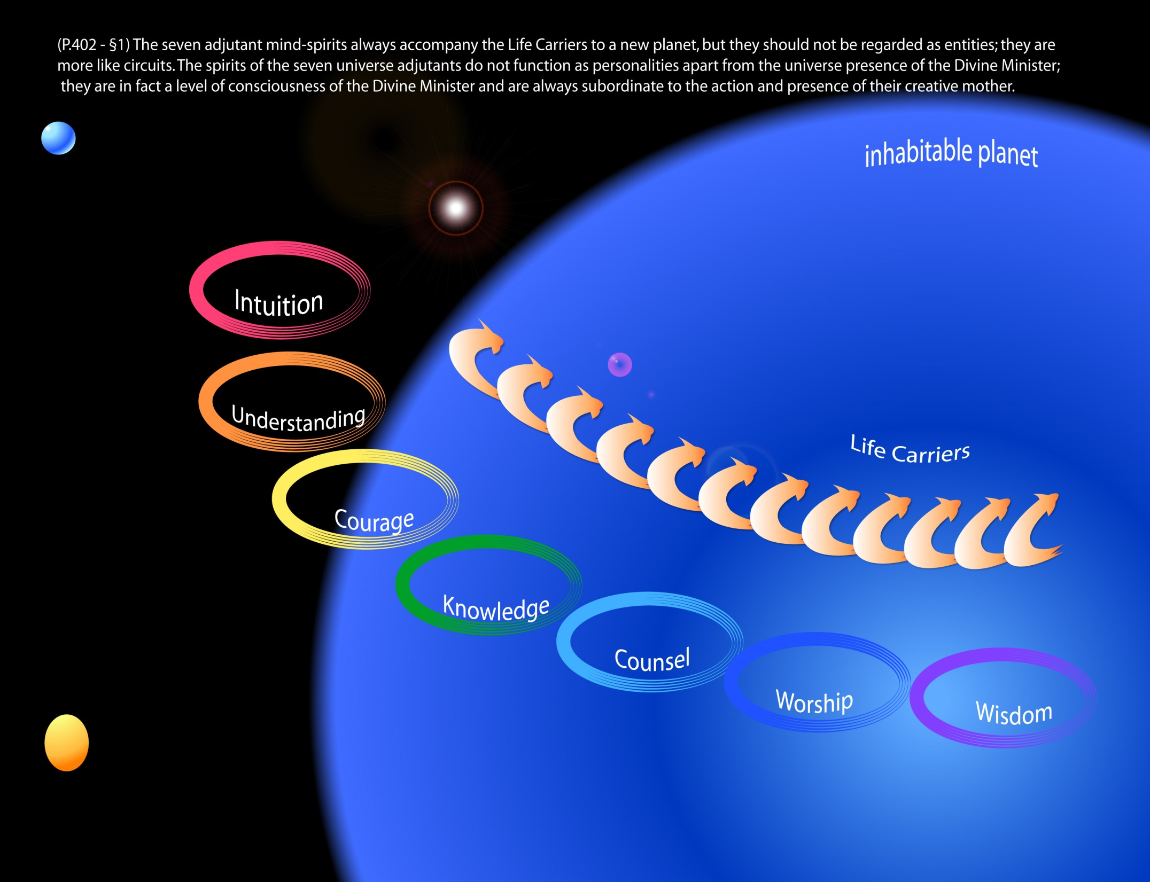
Notes:
The seven adjutant mind-spirits always accompany the Life Carriers to a new planet, but they should not be regarded as entities; they are more like circuits.

Slide 49
The Adjutant Mind-Spirits (cont.)
defined as
circuitlike, not entities 36:5.4(402;1), 65:7.3(738;6)
level of consciousness of Mother Spirit 36:5.3-4(401;7), 117:5.10(1287;1), 194:2.12,18(2062;1)
mind bestowal of Mother Spirit 15:9.14(177;13), 17:7.1(205;1), 34:4.7(378;4), 36:5.1(401;5), 42:10.4(481;1)
mind ministry of Infinite Spirit to lower orders 36:5.1(401;5)
do not transmit one person's experience to another 117:5.7(1286;5)
far better synchronized on average worlds 65:7.3-4(738;6)
five-adjutant mind equivalates to 6th reality 46:7.5(528;3)
grow but never become personal 36:5.13(403;1)
human intellect resides in rhythmic pulsations of 117:5.7(1286;5)
in personality registers 30:1.11(332;2), 30:2.4(335;2)
Infinite Spirit ministers to mind through 9:5.3(103;1)
make evolution purposeful 36:5.1(401;5), 65:6.7,10(737;7)
Master Spirit's influence 16:4.10(190;4)
mortal mind is endowment of 36:2.11(398;5)
Mother Spirits regard as personalities 34:4.7(378;4), 36:5.4(402;1)
not concerned in physical evolution 65:7.2(738;5)

Slide 50
The Adjutant Mind-Spirits (cont.)
function
#1 to #5 in animal orders 36:5.13(403;1), 42:10.4(481;1), 65:6.7(737;7)
#1 to #5 in spornagia 46:7.5(528;3)
#1 to #7 function as moral intellect in humans 42:10.4(481;1)
#6 and #7 only function with secondary midwayers; none with primary midwayers 38:9.6(424;6), 42:10.4(481;1)
activate energy-matter 118:7.7(1301;4)
assist Life Carriers 62:7.6(710;5)
co-ordinate; qualify man for receiving Adjuster 108:2.2-3(1187;1)
collaborate with Master Physical Controllers 36:5.14-15(403;2)
evolve human body with cosmic mind 42:12.4(483;4)
in light and life 55:6.4(630;7)
independently seek receptivity capacity 36:5.2(401;6)
influence diminishes after 3rd psychic circle 110:6.20-21(1211;5)
initial full function on Urantia 62:6.2-5(709;3)
lead towards higher ideas and ideals 34:5.2(379;2)
mother love is instinctive endowment of 84:1.6-7(932;3)
Mother Spirits endow life through 34:5.2(379;2)
regulate teachable mind; no contact with purely mechanical orders 65:0.3(730;3), 65:7.5(739;1)
under direction of spirit of wisdom 112:6.9(1237;1)
wholly dependent on brain capacity 58:6.7(670;1)

