Slide 1

The Urantia Book
Paper 88 Fetishes, Charms, and Magic
Reading Paper 88 - Fetishes Charms and Magic
Paper 88 - Video study group link
Paper 87 - The Ghost Cults

Slide 2
We would like to give a special thanks to Don Estes for the use of the information from his Chart The Origin, History and Destiny of Universe Reality. We would also like to thank the creator of Encyclopedia Urantia for the use of his slides from that web site.

Slide 3
Paper 88 Fetishes, Charms, and Magic AUDIO VERSION
^{88:0.1} ^{(967.1)} The concept of a spirit's entering into an inanimate object, an animal, or a human being, is a very ancient and honorable belief, having prevailed since the beginning of the evolution of religion. This doctrine of spirit possession is nothing more nor less than fetishism. The savage does not necessarily worship the fetish; he very logically worships and reverences the spirit resident therein.

Slide 4
^{88:0.2} ^{(967.2)} At first, the spirit of a fetish was believed to be the ghost of a dead man; later on, the higher spirits were supposed to reside in fetishes. And so the fetish cult eventually incorporated all of the primitive ideas of ghosts, souls, spirits, and demon possession.

Slide 5
1. Belief in Fetishes AUDIO VERSION
^{88:1.1} ^{(967.3)} Primitive man always wanted to make anything extraordinary into a fetish; chance therefore gave origin to many. A man is sick, something happens, and he gets well. The same thing is true of the reputation of many medicines and the chance methods of treating disease. Objects connected with dreams were likely to be converted into fetishes. Volcanoes, but not mountains, became fetishes; comets, but not stars. Early man regarded shooting stars and meteors as indicating the arrival on earth of special visiting spirits.

Slide 6
^{88:1.2} ^{(967.4)} The first fetishes were peculiarly marked pebbles, and " sacred stones " have ever since been sought by man; a string of beads was once a collection of sacred stones, a battery of charms. Many tribes had fetish stones, but few have survived as have the Kaaba and the Stone of Scone. Fire and water were also among the early fetishes, and fire worship, together with belief in holy water, still survives.

Slide 7
^{88:1.3} ^{(967.5)} Tree fetishes were a later development, but among some tribes the persistence of nature worship led to belief in charms indwelt by some sort of nature spirit. When plants and fruits became fetishes, they were taboo as food. The apple was among the first to fall into this category; it was never eaten by the Levantine peoples.

Slide 8
^{88:1.4} ^{(967.6)} If an animal ate human flesh, it became a fetish. In this way the dog came to be the sacred animal of the Parsees. If the fetish is an animal and the ghost is permanently resident therein, then fetishism may impinge on reincarnation. In many ways the savages envied the animals; they did not feel superior to them and were often named after their favorite beasts.

Slide 9
^{88:1.5} ^{(967.7)} When animals became fetishes, there ensued the taboos on eating the flesh of the fetish animal. Apes and monkeys, because of resemblance to man, early became fetish animals; later, snakes, birds, and swine were also similarly regarded. At one time the cow was a fetish, the milk being taboo while the excreta were highly esteemed. The serpent was revered in Palestine, especially by the Phoenicians, who, along with the Jews, considered it to be the mouthpiece of evil spirits. Even many moderns believe in the charm powers of reptiles. From Arabia on through India to the snake dance of the Moqui tribe of red men the serpent has been revered.

Slide 10
^{88:1.6} ^{(968.1)} Certain days of the week were fetishes. For ages Friday has been regarded as an unlucky day and the number thirteen as an evil numeral. The lucky numbers three and seven came from later revelations; four was the lucky number of primitive man and was derived from the early recognition of the four points of the compass. It was held unlucky to count cattle or other possessions; the ancients always opposed the taking of a census, " numbering the people. "

Slide 11
^{88:1.7} ^{(968.2)} Primitive man did not make an undue fetish out of sex; the reproductive function received only a limited amount of attention. The savage was natural minded, not obscene or prurient.

Slide 12
^{88:1.8} ^{(968.3)} Saliva was a potent fetish; devils could be driven out by spitting on a person. For an elder or superior to spit on one was the highest compliment. Parts of the human body were looked upon as potential fetishes, particularly the hair and nails. The long-growing fingernails of the chiefs were highly prized, and the trimmings thereof were a powerful fetish. Belief in skull fetishes accounts for much of later-day head-hunting. The umbilical cord was a highly prized fetish; even today it is so regarded in Africa. Mankind's first toy was a preserved umbilical cord. Set with pearls, as was often done, it was man's first necklace.

Slide 13
^{88:1.9} ^{(968.4)} Hunchbacked and crippled children were regarded as fetishes; lunatics were believed to be moon-struck. Primitive man could not distinguish between genius and insanity; idiots were either beaten to death or revered as fetish personalities. Hysteria increasingly confirmed the popular belief in witchcraft; epileptics often were priests and medicine men. Drunkenness was looked upon as a form of spirit possession; when a savage went on a spree, he put a leaf in his hair for the purpose of disavowing responsibility for his acts. Poisons and intoxicants became fetishes; they were deemed to be possessed.

Slide 14
^{88:1.10} ^{(968.5)} Many people looked upon geniuses as fetish personalities possessed by a wise spirit. And these talented humans soon learned to resort to fraud and trickery for the advancement of their selfish interests. A fetish man was thought to be more than human; he was divine, even infallible. Thus did chiefs, kings, priests, prophets, and church rulers eventually wield great power and exercise unbounded authority.

Slide 15
2. Evolution of the Fetish AUDIO VERSION
^{88:2.1} ^{(968.6)} It was a supposed preference of ghosts to indwell some object which had belonged to them when alive in the flesh. This belief explains the efficacy of many modern relics. The ancients always revered the bones of their leaders, and the skeletal remains of saints and heroes are still regarded with superstitious awe by many. Even today, pilgrimages are made to the tombs of great men.

Slide 16
^{88:2.2} ^{(968.7)} Belief in relics is an outgrowth of the ancient fetish cult. The relics of modern religions represent an attempt to rationalize the fetish of the savage and thus elevate it to a place of dignity and respectability in the modern religious systems. It is heathenish to believe in fetishes and magic but supposedly all right to accept relics and miracles.

Slide 17
^{88:2.3} ^{(969.1)} The hearth—fireplace—became more or less of a fetish, a sacred spot. The shrines and temples were at first fetish places because the dead were buried there. The fetish hut of the Hebrews was elevated by Moses to that place where it harbored a superfetish, the then existent concept of the law of God. But the Israelites never gave up the peculiar Canaanite belief in the stone altar: " And this stone which I have set up as a pillar shall be God's house. " They truly believed that the spirit of their God dwelt in such stone altars, which were in reality fetishes.

Slide 18
^{88:2.4} ^{(969.2)} The earliest images were made to preserve the appearance and memory of the illustrious dead; they were really monuments. Idols were a refinement of fetishism. The primitives believed that a ceremony of consecration caused the spirit to enter the image; likewise, when certain objects were blessed, they became charms.

Slide 19
^{88:2.5} ^{(969.3)} Moses, in the addition of the second commandment to the ancient Dalamatian moral code, made an effort to control fetish worship among the Hebrews. He carefully directed that they should make no sort of image that might become consecrated as a fetish. He made it plain, " You shall not make a graven image or any likeness of anything that is in heaven above, or on the earth beneath, or in the waters of the earth. " While this commandment did much to retard art among the Jews, it did lessen fetish worship. But Moses was too wise to attempt suddenly to displace the olden fetishes, and he therefore consented to the putting of certain relics alongside the law in the combined war altar and religious shrine which was the ark.

Slide 20
^{88:2.6} ^{(969.4)} Words eventually became fetishes, more especially those which were regarded as God's words; in this way the sacred books of many religions have become fetishistic prisons incarcerating the spiritual imagination of man. Moses' very effort against fetishes became a supreme fetish; his commandment was later used to stultify art and to retard the enjoyment and adoration of the beautiful.

Slide 21
^{88:2.7} ^{(969.5)} In olden times the fetish word of authority was a fear-inspiring doctrine, the most terrible of all tyrants which enslave men. A doctrinal fetish will lead mortal man to betray himself into the clutches of bigotry, fanaticism, superstition, intolerance, and the most atrocious of barbarous cruelties. Modern respect for wisdom and truth is but the recent escape from the fetish-making tendency up to the higher levels of thinking and reasoning. Concerning the accumulated fetish writings which various religionists hold as sacred books, it is not only believed that what is in the book is true, but also that every truth is contained in the book. If one of these sacred books happens to speak of the earth as being flat, then, for long generations, otherwise sane men and women will refuse to accept positive evidence that the planet is round.

Slide 22
^{88:2.8} ^{(969.6)} The practice of opening one of these sacred books to let the eye chance upon a passage, the following of which may determine important life decisions or projects, is nothing more nor less than arrant fetishism. To take an oath on a " holy book " or to swear by some object of supreme veneration is a form of refined fetishism.

Slide 23
^{88:2.9} ^{(969.7)} But it does represent real evolutionary progress to advance from the fetish fear of a savage chief's fingernail trimmings to the adoration of a superb collection of letters, laws, legends, allegories, myths, poems, and chronicles which, after all, reflect the winnowed moral wisdom of many centuries, at least up to the time and event of their being assembled as a " sacred book. "

Slide 24
^{88:2.10} ^{(970.1)} To become fetishes, words had to be considered inspired, and the invocation of supposed divinely inspired writings led directly to the establishment of the authority of the church, while the evolution of civil forms led to the fruition of the authority of the state.

Slide 25
3. Totemism AUDIO VERSION
^{88:3.1} ^{(970.2)} Fetishism ran through all the primitive cults from the earliest belief in sacred stones, through idolatry, cannibalism, and nature worship, to totemism.

Slide 26
^{88:3.2} ^{(970.3)} Totemism is a combination of social and religious observances. Originally it was thought that respect for the totem animal of supposed biologic origin insured the food supply. Totems were at one and the same time symbols of the group and their god. Such a god was the clan personified. Totemism was one phase of the attempted socialization of otherwise personal religion. The totem eventually evolved into the flag, or national symbol, of the various modern peoples.

Slide 27
^{88:3.3} ^{(970.4)} A fetish bag, a medicine bag, was a pouch containing a reputable assortment of ghost-impregnated articles, and the medicine man of old never allowed his bag, the symbol of his power, to touch the ground. Civilized peoples in the twentieth century see to it that their flags, emblems of national consciousness, likewise never touch the ground.

Slide 28
^{88:3.4} ^{(970.5)} The insignia of priestly and kingly office were eventually regarded as fetishes, and the fetish of the state supreme has passed through many stages of development, from clans to tribes, from suzerainty to sovereignty, from totems to flags. Fetish kings have ruled by " divine right, " and many other forms of government have obtained. Men have also made a fetish of democracy, the exaltation and adoration of the common man's ideas when collectively called " public opinion. " One man's opinion, when taken by itself, is not regarded as worth much, but when many men are collectively functioning as a democracy, this same mediocre judgment is held to be the arbiter of justice and the standard of righteousness.

Slide 29
4. Magic AUDIO VERSION
^{88:4.1} ^{(970.6)} Civilized man attacks the problems of a real environment through his science; savage man attempted to solve the real problems of an illusory ghost environment by magic. Magic was the technique of manipulating the conjectured spirit environment whose machinations endlessly explained the inexplicable; it was the art of obtaining voluntary spirit co-operation and of coercing involuntary spirit aid through the use of fetishes or other and more powerful spirits.

Slide 30
^{88:4.2} ^{(970.7)} The object of magic, sorcery, and necromancy was twofold:
^{88:4.3} ^{(970.8)} 1. To secure insight into the future.
^{88:4.4} ^{(970.9)} 2. Favorably to influence environment.

Slide 31
^{88:4.5} ^{(970.10)} The objects of science are identical with those of magic. Mankind is progressing from magic to science, not by meditation and reason, but rather through long experience, gradually and painfully. Man is gradually backing into the truth, beginning in error, progressing in error, and finally attaining the threshold of truth. Only with the arrival of the scientific method has he faced forward. But primitive man had to experiment or perish.

Slide 32
^{88:4.6} ^{(970.11)} The fascination of early superstition was the mother of the later scientific curiosity. There was progressive dynamic emotion—fear plus curiosity—in these primitive superstitions; there was progressive driving power in the olden magic. These superstitions represented the emergence of the human desire to know and to control planetary environment.

Slide 33
^{88:4.7} ^{(971.1)} Magic gained such a strong hold upon the savage because he could not grasp the concept of natural death. The later idea of original sin helped much to weaken the grip of magic on the race in that it accounted for natural death. It was at one time not at all uncommon for ten innocent persons to be put to death because of supposed responsibility for one natural death. This is one reason why ancient peoples did not increase faster, and it is still true of some African tribes. The accused individual usually confessed guilt, even when facing death.

Slide 34
^{88:4.8} ^{(971.2)} Magic is natural to a savage. He believes that an enemy can actually be killed by practicing sorcery on his shingled hair or fingernail trimmings. The fatality of snake bites was attributed to the magic of the sorcerer. The difficulty in combating magic arises from the fact that fear can kill. Primitive peoples so feared magic that it did actually kill, and such results were sufficient to substantiate this erroneous belief. In case of failure there was always some plausible explanation; the cure for defective magic was more magic.

Slide 35
5. Magical Charms AUDIO VERSION
^{88:5.1} ^{(971.3)} Since anything connected with the body could become a fetish, the earliest magic had to do with hair and nails. Secrecy attendant upon body elimination grew up out of fear that an enemy might get possession of something derived from the body and employ it in detrimental magic; all excreta of the body were therefore carefully buried. Public spitting was refrained from because of the fear that saliva would be used in deleterious magic; spittle was always covered. Even food remnants, clothing, and ornaments could become instruments of magic. The savage never left any remnants of his meal on the table. And all this was done through fear that one's enemies might use these things in magical rites, not from any appreciation of the hygienic value of such practices.

Slide 36
^{88:5.2} ^{(971.4)} Magical charms were concocted from a great variety of things: human flesh, tiger claws, crocodile teeth, poison plant seeds, snake venom, and human hair. The bones of the dead were very magical. Even the dust from footprints could be used in magic. The ancients were great believers in love charms. Blood and other forms of bodily secretions were able to insure the magic influence of love.

Slide 37
^{88:5.3} ^{(971.5)} Images were supposed to be effective in magic. Effigies were made, and when treated ill or well, the same effects were believed to rest upon the real person. When making purchases, superstitious persons would chew a bit of hard wood in order to soften the heart of the seller.

Slide 38
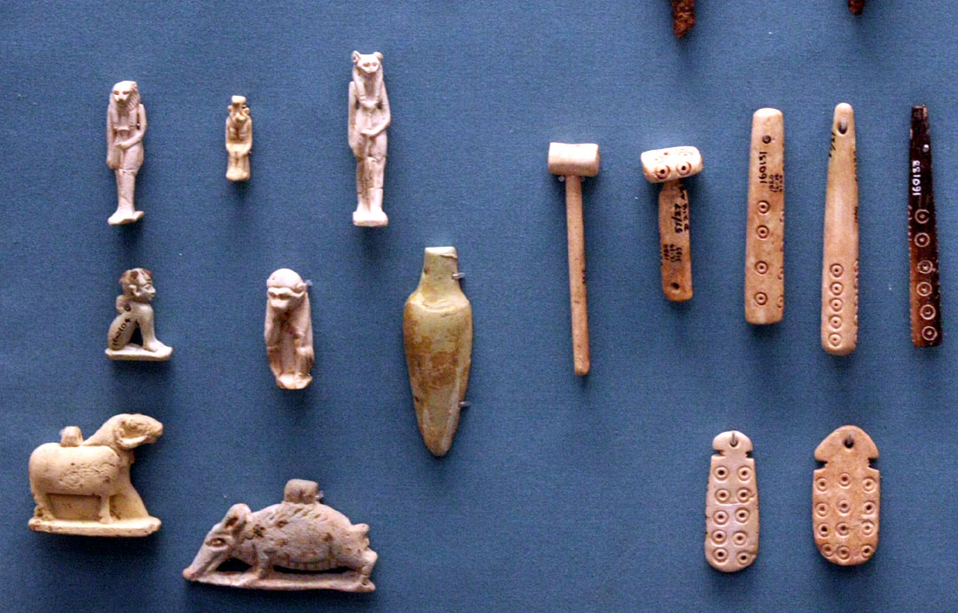
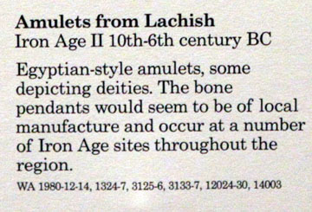

Slide 39
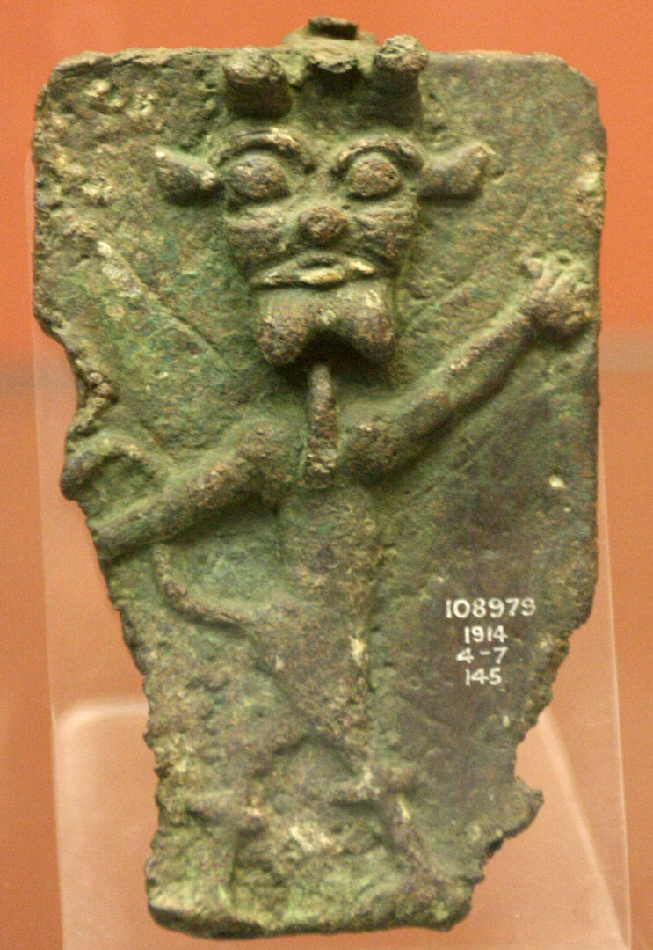
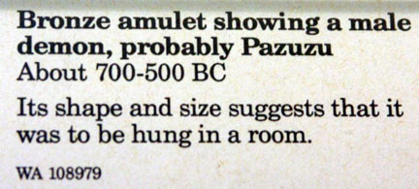

Slide 40
^{88:5.4} ^{(971.6)} The milk of a black cow was highly magical; so also were black cats. The staff or wand was magical, along with drums, bells, and knots. All ancient objects were magical charms. The practices of a new or higher civilization were looked upon with disfavor because of their supposedly evil magical nature. Writing, printing, and pictures were long so regarded.

Slide 41
^{88:5.5} ^{(971.7)} Primitive man believed that names must be treated with respect, especially names of the gods. The name was regarded as an entity, an influence distinct from the physical personality; it was esteemed equally with the soul and the shadow. Names were pawned for loans; a man could not use his name until it had been redeemed by payment of the loan. Nowadays one signs his name to a note. An individual's name soon became important in magic. The savage had two names; the important one was regarded as too sacred to use on ordinary occasions, hence the second or everyday name—a nickname. He never told his real name to strangers. Any experience of an unusual nature caused him to change his name; sometimes it was in an effort to cure disease or to stop bad luck. The savage could get a new name by buying it from the tribal chief; men still invest in titles and degrees. But among the most primitive tribes, such as the African Bushmen, individual names do not exist.

Slide 42
6. The Practice of Magic AUDIO VERSION
^{88:6.1} ^{(972.1)} Magic was practiced through the use of wands, " medicine " ritual, and incantations, and it was customary for the practitioner to work unclothed. Women outnumbered the men among primitive magicians. In magic, " medicine " means mystery, not treatment. The savage never doctored himself; he never used medicines except on the advice of the specialists in magic. And the voodoo doctors of the twentieth century are typical of the magicians of old.

Slide 43
^{88:6.2} ^{(972.2)} There was both a public and a private phase to magic. That performed by the medicine man, shaman, or priest was supposed to be for the good of the whole tribe. Witches, sorcerers, and wizards dispensed private magic, personal and selfish magic which was employed as a coercive method of bringing evil on one's enemies. The concept of dual spiritism, good and bad spirits, gave rise to the later beliefs in white and black magic. And as religion evolved, magic was the term applied to spirit operations outside one's own cult, and it also referred to older ghost beliefs.

Slide 44
^{88:6.3} ^{(972.3)} Word combinations, the ritual of chants and incantations, were highly magical. Some early incantations finally evolved into prayers. Presently, imitative magic was practiced; prayers were acted out; magical dances were nothing but dramatic prayers. Prayer gradually displaced magic as the associate of sacrifice.

Slide 45
^{88:6.4} ^{(972.4)} Gesture, being older than speech, was the more holy and magical, and mimicry was believed to have strong magical power. The red men often staged a buffalo dance in which one of their number would play the part of a buffalo and, in being caught, would insure the success of the impending hunt. The sex festivities of May Day were simply imitative magic, a suggestive appeal to the sex passions of the plant world. The doll was first employed as a magic talisman by the barren wife.

Slide 46
^{88:6.5} ^{(972.5)} Magic was the branch off the evolutionary religious tree which eventually bore the fruit of a scientific age. Belief in astrology led to the development of astronomy; belief in a philosopher's stone led to the mastery of metals, while belief in magic numbers founded the science of mathematics.

Slide 47
^{88:6.6} ^{(972.6)} But a world so filled with charms did much to destroy all personal ambition and initiative. The fruits of extra labor or of diligence were looked upon as magical. If a man had more grain in his field than his neighbor, he might be haled before the chief and charged with enticing this extra grain from the indolent neighbor's field. Indeed, in the days of barbarism it was dangerous to know very much; there was always the chance of being executed as a black artist.

Slide 48
^{88:6.7} ^{(972.7)} Gradually science is removing the gambling element from life. But if modern methods of education should fail, there would be an almost immediate reversion to the primitive beliefs in magic. These superstitions still linger in the minds of many so-called civilized people. Language contains many fossils which testify that the race has long been steeped in magical superstition, such words as spellbound, ill-starred, possessions, inspiration, spirit away, ingenuity, entrancing, thunderstruck, and astonished. And intelligent human beings still believe in good luck, evil eye, and astrology.*

Slide 49
^{88:6.8} ^{(973.1)} Ancient magic was the cocoon of modern science, indispensable in its time but now no longer useful. And so the phantasms of ignorant superstition agitated the primitive minds of men until the concepts of science could be born. Today, Urantia is in the twilight zone of this intellectual evolution. One half the world is grasping eagerly for the light of truth and the facts of scientific discovery, while the other half languishes in the arms of ancient superstition and but thinly disguised magic.
^{88:6.9} ^{(973.2)} [Presented by a Brilliant Evening Star of Nebadon. ]

Slide 50
Paper 9 - Sin, Sacrifice and Atonement

