Slide 1

The Urantia Book
Paper 194 Bestowal of the Spirit of Truth
Reading Paper 194 – Bestowal of the Spirit of Truth
Paper 194 - Video study group link
Paper 193 - Final Appearances and Ascension

Slide 2
We would like to give a special thanks to Don Estes for the use of the information from his Chart The Origin, History and Destiny of Universe Reality. We would also like to thank the creator of Encyclopedia Urantia for the use of his slides from that web site.

Slide 3
Paper 194 Bestowal of the Spirit of Truth AUDIO VERSION
^{194:0.1} ^{(2059.1)} About one o'clock, as the one hundred and twenty believers were engaged in prayer, they all became aware of a strange presence in the room. At the same time these disciples all became conscious of a new and profound sense of spiritual joy, security, and confidence. This new consciousness of spiritual strength was immediately followed by a strong urge to go out and publicly proclaim the gospel of the kingdom and the good news that Jesus had risen from the dead.

Slide 4
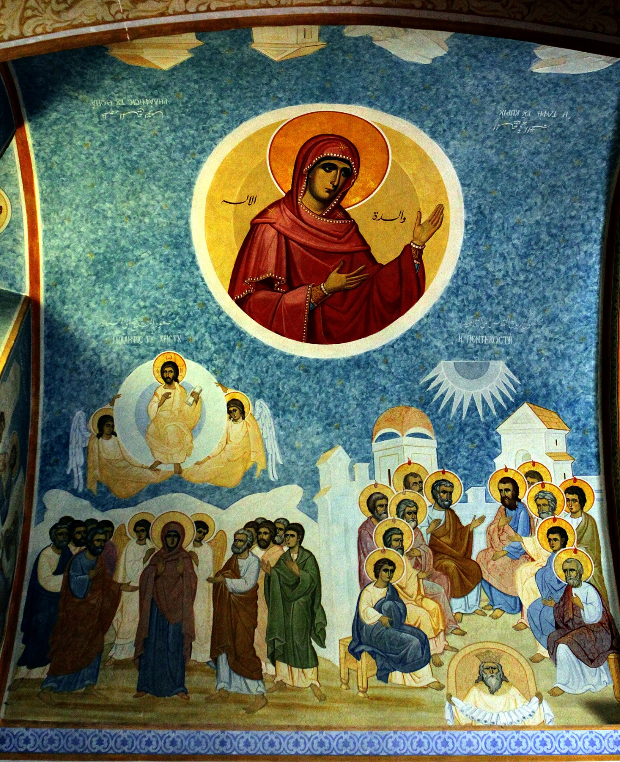
A fresco in a Greek Orthodox Church in Capernaum.

Slide 5
^{194:0.2} ^{(2059.2)} Peter stood up and declared that this must be the coming of the Spirit of Truth which the Master had promised them and proposed that they go to the temple and begin the proclamation of the good news committed to their hands. And they did just what Peter suggested.

Slide 6
^{194:0.3} ^{(2059.3)} These men had been trained and instructed that the gospel which they should preach was the fatherhood of God and the sonship of man, but at just this moment of spiritual ecstasy and personal triumph, the best tidings, the greatest news, these men could think of was the fact of the risen Master. And so they went forth, endowed with power from on high, preaching glad tidings to the people—even salvation through Jesus—but they unintentionally stumbled into the error of substituting some of the facts associated with the gospel for the gospel message itself. Peter unwittingly led off in this mistake, and others followed after him on down to Paul, who created a new religion out of the new version of the good news.

Slide 7
^{194:0.4} ^{(2059.4)} The gospel of the kingdom is: the fact of the fatherhood of God, coupled with the resultant truth of the sonship-brotherhood of men. Christianity, as it developed from that day, is: the fact of God as the Father of the Lord Jesus Christ, in association with the experience of believer-fellowship with the risen and glorified Christ.

Slide 8
^{194:0.5} ^{(2059.5)} It is not strange that these spirit-infused men should have seized upon this opportunity to express their feelings of triumph over the forces which had sought to destroy their Master and end the influence of his teachings. At such a time as this it was easier to remember their personal association with Jesus and to be thrilled with the assurance that the Master still lived, that their friendship had not ended, and that the spirit had indeed come upon them even as he had promised.

Slide 9
^{194:0.6} ^{(2059.6)} These believers felt themselves suddenly translated into another world, a new existence of joy, power, and glory. The Master had told them the kingdom would come with power, and some of them thought they were beginning to discern what he meant.

Slide 10
^{194:0.7} ^{(2059.7)} And when all of this is taken into consideration, it is not difficult to understand how these men came to preach a new gospel about Jesus in the place of their former message of the fatherhood of God and the brotherhood of men.

Slide 11
1. The Pentecost Sermon AUDIO VERSION
^{194:1.1} ^{(2060.1)} The apostles had been in hiding for forty days. This day happened to be the Jewish festival of Pentecost, and thousands of visitors from all parts of the world were in Jerusalem. Many arrived for this feast, but a majority had tarried in the city since the Passover. Now these frightened apostles emerged from their weeks of seclusion to appear boldly in the temple, where they began to preach the new message of a risen Messiah. And all the disciples were likewise conscious of having received some new spiritual endowment of insight and power.

Slide 12
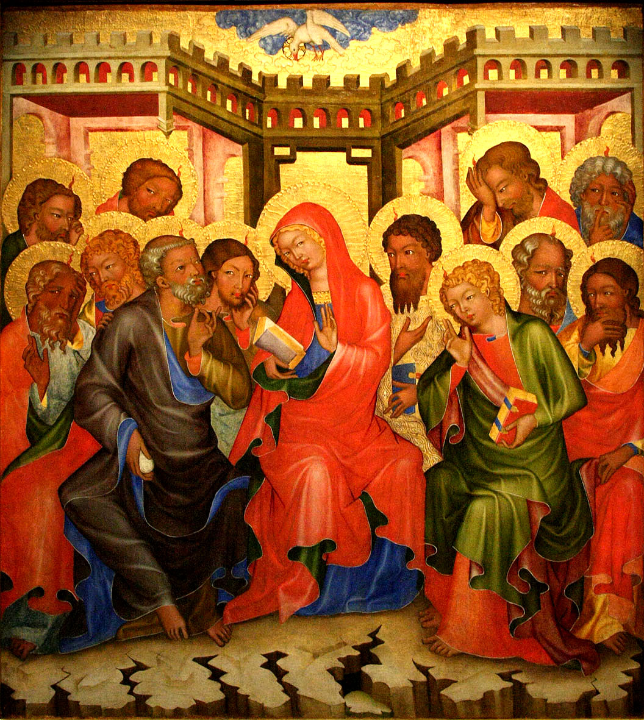
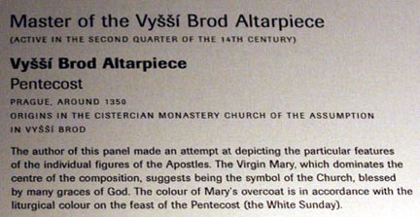

Slide 13
^{194:1.2} ^{(2060.2)} It was about two o'clock when Peter stood up in that very place where his Master had last taught in this temple, and delivered that impassioned appeal which resulted in the winning of more than two thousand souls. The Master had gone, but they suddenly discovered that this story about him had great power with the people. No wonder they were led on into the further proclamation of that which vindicated their former devotion to Jesus and at the same time so constrained men to believe in him. Six of the apostles participated in this meeting: Peter, Andrew, James, John, Philip, and Matthew. They talked for more than an hour and a half and delivered messages in Greek, Hebrew, and Aramaic, as well as a few words in even other tongues with which they had a speaking acquaintance.

Slide 14
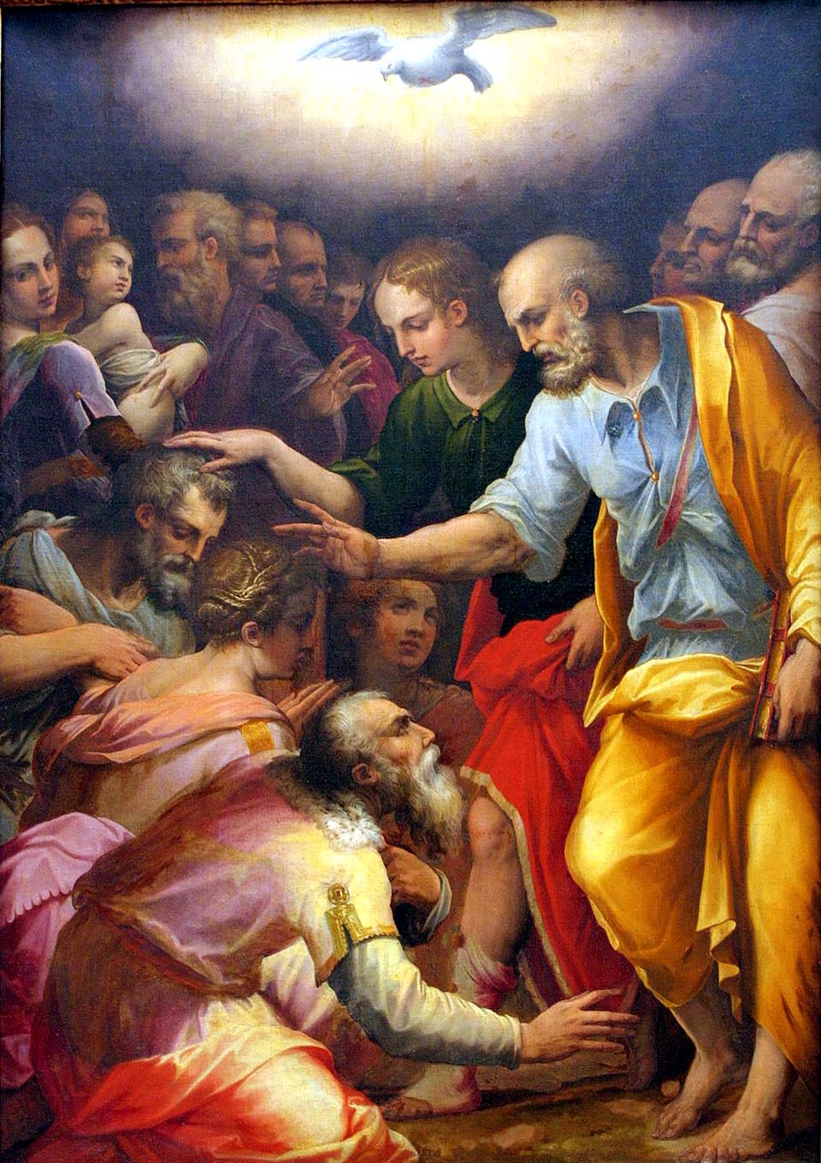


Slide 15
^{194:1.3} ^{(2060.3)} The leaders of the Jews were astounded at the boldness of the apostles, but they feared to molest them because of the large numbers who believed their story.

Slide 16
^{194:1.4} ^{(2060.4)} By half past four o'clock more than two thousand new believers followed the apostles down to the pool of Siloam, where Peter, Andrew, James, and John baptized them in the Master's name. And it was dark when they had finished with baptizing this multitude.

Slide 17
^{194:1.5} ^{(2060.5)} Pentecost was the great festival of baptism, the time for fellowshipping the proselytes of the gate, those gentiles who desired to serve Yahweh. It was, therefore, the more easy for large numbers of both the Jews and believing gentiles to submit to baptism on this day. In doing this, they were in no way disconnecting themselves from the Jewish faith. Even for some time after this the believers in Jesus were a sect within Judaism. All of them, including the apostles, were still loyal to the essential requirements of the Jewish ceremonial system.

Slide 18
2. The Significance of Pentecost AUDIO VERSION
^{194:2.1} ^{(2060.6)} Jesus lived on earth and taught a gospel which redeemed man from the superstition that he was a child of the devil and elevated him to the dignity of a faithson of God. Jesus' message, as he preached it and lived it in his day, was an effective solvent for man's spiritual difficulties in that day of its statement. And now that he has personally left the world, he sends in his place his Spirit of Truth, who is designed to live in man and, for each new generation, to restate the Jesus message so that every new group of mortals to appear upon the face of the earth shall have a new and up-to-date version of the gospel, just such personal enlightenment and group guidance as will prove to be an effective solvent for man's ever-new and varied spiritual difficulties.

Slide 19
^{194:2.2} ^{(2060.7)} The first mission of this spirit is, of course, to foster and personalize truth, for it is the comprehension of truth that constitutes the highest form of human liberty. Next, it is the purpose of this spirit to destroy the believer's feeling of orphanhood. Jesus having been among men, all believers would experience a sense of loneliness had not the Spirit of Truth come to dwell in men's hearts.

Slide 20
^{194:2.3} ^{(2061.1)} This bestowal of the Son's spirit effectively prepared all normal men's minds for the subsequent universal bestowal of the Father's spirit (the Adjuster) upon all mankind. In a certain sense, this Spirit of Truth is the spirit of both the Universal Father and the Creator Son.

Slide 21
^{194:2.4} ^{(2061.2)} Do not make the mistake of expecting to become strongly intellectually conscious of the outpoured Spirit of Truth. The spirit never creates a consciousness of himself, only a consciousness of Michael, the Son. From the beginning Jesus taught that the spirit would not speak of himself. The proof, therefore, of your fellowship with the Spirit of Truth is not to be found in your consciousness of this spirit but rather in your experience of enhanced fellowship with Michael.

Slide 22
^{194:2.5} ^{(2061.3)} The spirit also came to help men recall and understand the words of the Master as well as to illuminate and reinterpret his life on earth.

Slide 23
^{194:2.6} ^{(2061.4)} Next, the Spirit of Truth came to help the believer to witness to the realities of Jesus' teachings and his life as he lived it in the flesh, and as he now again lives it anew and afresh in the individual believer of each passing generation of the spirit-filled sons of God.

Slide 24
^{194:2.7} ^{(2061.5)} Thus it appears that the Spirit of Truth comes really to lead all believers into all truth, into the expanding knowledge of the experience of the living and growing spiritual consciousness of the reality of eternal and ascending sonship with God.

Slide 25
^{194:2.8} ^{(2061.6)} Jesus lived a life which is a revelation of man submitted to the Father's will, not an example for any man literally to attempt to follow. This life in the flesh, together with his death on the cross and subsequent resurrection, presently became a new gospel of the ransom which had thus been paid in order to purchase man back from the clutch of the evil one—from the condemnation of an offended God. Nevertheless, even though the gospel did become greatly distorted, it remains a fact that this new message about Jesus carried along with it many of the fundamental truths and teachings of his earlier gospel of the kingdom. And, sooner or later, these concealed truths of the fatherhood of God and the brotherhood of men will emerge to effectually transform the civilization of all mankind.

Slide 26
^{194:2.9} ^{(2061.7)} But these mistakes of the intellect in no way interfered with the believer's great progress in growth in spirit. In less than a month after the bestowal of the Spirit of Truth, the apostles made more individual spiritual progress than during their almost four years of personal and loving association with the Master. Neither did this substitution of the fact of the resurrection of Jesus for the saving gospel truth of sonship with God in any way interfere with the rapid spread of their teachings; on the contrary, this overshadowing of Jesus' message by the new teachings about his person and resurrection seemed greatly to facilitate the preaching of the good news.

Slide 27
^{194:2.10} ^{(2061.8)} The term "baptism of the spirit," which came into such general use about this time, merely signified the conscious reception of this gift of the Spirit of Truth and the personal acknowledgment of this new spiritual power as an augmentation of all spiritual influences previously experienced by God-knowing souls.

Slide 28
^{194:2.11} ^{(2061.9)} Since the bestowal of the Spirit of Truth, man is subject to the teaching and guidance of a threefold spirit endowment: the spirit of the Father, the Thought Adjuster; the spirit of the Son, the Spirit of Truth; the spirit of the Spirit, the Holy Spirit.

Slide 29
^{194:2.12} ^{(2062.1)} In a way, mankind is subject to the double influence of the sevenfold appeal of the universe spirit influences. The early evolutionary races of mortals are subject to the progressive contact of the seven adjutant mind-spirits of the local universe Mother Spirit. As man progresses upward in the scale of intelligence and spiritual perception, there eventually come to hover over him and dwell within him the seven higher spirit influences. And these seven spirits of the advancing worlds are:

Slide 30
^{194:2.13} ^{(2062.2)} 1. The bestowed spirit of the Universal Father—the Thought Adjusters.
^{194:2.14} ^{(2062.3)} 2. The spirit presence of the Eternal Son—the spirit gravity of the universe of universes and the certain channel of all spirit communion.
^{194:2.15} ^{(2062.4)} 3. The spirit presence of the Infinite Spirit—the universal spirit-mind of all creation, the spiritual source of the intellectual kinship of all progressive intelligences.
^{194:2.16} ^{(2062.5)} 4. The spirit of the Universal Father and the Creator Son—the Spirit of Truth, generally regarded as the spirit of the Universe Son.
^{194:2.17} ^{(2062.6)} 5. The spirit of the Infinite Spirit and the Universe Mother Spirit—the Holy Spirit, generally regarded as the spirit of the Universe Spirit.
^{194:2.18} ^{(2062.7)} 6. The mind-spirit of the Universe Mother Spirit—the seven adjutant mind-spirits of the local universe.
^{194:2.19} ^{(2062.8)} 7. The spirit of the Father, Sons, and Spirits—the new-name spirit of the ascending mortals of the realms after the fusion of the mortal spirit-born soul with the Paradise Thought Adjuster and after the subsequent attainment of the divinity and glorification of the status of the Paradise Corps of the Finality.

Slide 31
^{194:2.20} ^{(2062.9)} And so did the bestowal of the Spirit of Truth bring to the world and its peoples the last of the spirit endowment designed to aid in the ascending search for God.

Slide 32
3. What Happened at Pentecost AUDIO VERSION
^{194:3.1} ^{(2062.10)} Many queer and strange teachings became associated with the early narratives of the day of Pentecost. In subsequent times the events of this day, on which the Spirit of Truth, the new teacher, came to dwell with mankind, have become confused with the foolish outbreaks of rampant emotionalism. The chief mission of this outpoured spirit of the Father and the Son is to teach men about the truths of the Father's love and the Son's mercy. These are the truths of divinity which men can comprehend more fully than all the other divine traits of character. The Spirit of Truth is concerned primarily with the revelation of the Father's spirit nature and the Son's moral character. The Creator Son, in the flesh, revealed God to men; the Spirit of Truth, in the heart, reveals the Creator Son to men. When man yields the " fruits of the spirit" in his life, he is simply showing forth the traits which the Master manifested in his own earthly life. When Jesus was on earth, he lived his life as one personality—Jesus of Nazareth. As the indwelling spirit of the "new teacher," the Master has, since Pentecost, been able to live his life anew in the experience of every truth-taught believer.

Slide 33
^{194:3.2} ^{(2062.11)} Many things which happen in the course of a human life are hard to understand, difficult to reconcile with the idea that this is a universe in which truth prevails and in which righteousness triumphs. It so often appears that slander, lies, dishonesty, and unrighteousness—sin—prevail. Does faith, after all, triumph over evil, sin, and iniquity? It does. And the life and death of Jesus are the eternal proof that the truth of goodness and the faith of the spirit-led creature will always be vindicated. They taunted Jesus on the cross, saying, "Let us see if God will come and deliver him." It looked dark on that day of the crucifixion, but it was gloriously bright on the resurrection morning; it was still brighter and more joyous on the day of Pentecost. The religions of pessimistic despair seek to obtain release from the burdens of life; they crave extinction in endless slumber and rest. These are the religions of primitive fear and dread. The religion of Jesus is a new gospel of faith to be proclaimed to struggling humanity. This new religion is founded on faith, hope, and love.

Slide 34
^{194:3.3} ^{(2063.1)} To Jesus, mortal life had dealt its hardest, cruelest, and bitterest blows; and this man met these ministrations of despair with faith, courage, and the unswerving determination to do his Father's will. Jesus met life in all its terrible reality and mastered it—even in death. He did not use religion as a release from life. The religion of Jesus does not seek to escape this life in order to enjoy the waiting bliss of another existence. The religion of Jesus provides the joy and peace of another and spiritual existence to enhance and ennoble the life which men now live in the flesh.

Slide 35
^{194:3.4} ^{(2063.2)} If religion is an opiate to the people, it is not the religion of Jesus. On the cross he refused to drink the deadening drug, and his spirit, poured out upon all flesh, is a mighty world influence which leads man upward and urges him onward. The spiritual forward urge is the most powerful driving force present in this world; the truth-learning believer is the one progressive and aggressive soul on earth.

Slide 36
^{194:3.5} ^{(2063.3)} On the day of Pentecost the religion of Jesus broke all national restrictions and racial fetters. It is forever true, "Where the spirit of the Lord is, there is liberty." On this day the Spirit of Truth became the personal gift from the Master to every mortal. This spirit was bestowed for the purpose of qualifying believers more effectively to preach the gospel of the kingdom, but they mistook the experience of receiving the outpoured spirit for a part of the new gospel which they were unconsciously formulating.

Slide 37
^{194:3.6} ^{(2063.4)} Do not overlook the fact that the Spirit of Truth was bestowed upon all sincere believers; this gift of the spirit did not come only to the apostles. The one hundred and twenty men and women assembled in the upper chamber all received the new teacher, as did all the honest of heart throughout the whole world. This new teacher was bestowed upon mankind, and every soul received him in accordance with the love for truth and the capacity to grasp and comprehend spiritual realities. At last, true religion is delivered from the custody of priests and all sacred classes and finds its real manifestation in the individual souls of men.

Slide 38
^{194:3.7} ^{(2063.5)} The religion of Jesus fosters the highest type of human civilization in that it creates the highest type of spiritual personality and proclaims the sacredness of that person.

Slide 39
^{194:3.8} ^{(2063.6)} The coming of the Spirit of Truth on Pentecost made possible a religion which is neither radical nor conservative; it is neither the old nor the new; it is to be dominated neither by the old nor the young. The fact of Jesus' earthly life provides a fixed point for the anchor of time, while the bestowal of the Spirit of Truth provides for the everlasting expansion and endless growth of the religion which he lived and the gospel which he proclaimed. The spirit guides into all truth; he is the teacher of an expanding and always-growing religion of endless progress and divine unfolding. This new teacher will be forever unfolding to the truth-seeking believer that which was so divinely folded up in the person and nature of the Son of Man.

Slide 40
^{194:3.9} ^{(2064.1)} The manifestations associated with the bestowal of the "new teacher," and the reception of the apostles' preaching by the men of various races and nations gathered together at Jerusalem, indicate the universality of the religion of Jesus. The gospel of the kingdom was to be identified with no particular race, culture, or language. This day of Pentecost witnessed the great effort of the spirit to liberate the religion of Jesus from its inherited Jewish fetters. Even after this demonstration of pouring out the spirit upon all flesh, the apostles at first endeavored to impose the requirements of Judaism upon their converts. Even Paul had trouble with his Jerusalem brethren because he refused to subject the gentiles to these Jewish practices. No revealed religion can spread to all the world when it makes the serious mistake of becoming permeated with some national culture or associated with established racial, social, or economic practices.

Slide 41
^{194:3.10} ^{(2064.2)} The bestowal of the Spirit of Truth was independent of all forms, ceremonies, sacred places, and special behavior by those who received the fullness of its manifestation. When the spirit came upon those assembled in the upper chamber, they were simply sitting there, having just been engaged in silent prayer. The spirit was bestowed in the country as well as in the city. It was not necessary for the apostles to go apart to a lonely place for years of solitary meditation in order to receive the spirit. For all time, Pentecost disassociates the idea of spiritual experience from the notion of especially favorable environments.

Slide 42
^{194:3.11} ^{(2064.3)} Pentecost, with its spiritual endowment, was designed forever to loose the religion of the Master from all dependence upon physical force; the teachers of this new religion are now equipped with spiritual weapons. They are to go out to conquer the world with unfailing forgiveness, matchless good will, and abounding love. They are equipped to overcome evil with good, to vanquish hate by love, to destroy fear with a courageous and living faith in truth. Jesus had already taught his followers that his religion was never passive; always were his disciples to be active and positive in their ministry of mercy and in their manifestations of love. No longer did these believers look upon Yahweh as "the Lord of Hosts." They now regarded the eternal Deity as the "God and Father of the Lord Jesus Christ." They made that progress, at least, even if they did in some measure fail fully to grasp the truth that God is also the spiritual Father of every individual.

Slide 43
^{194:3.12} ^{(2064.4)} Pentecost endowed mortal man with the power to forgive personal injuries, to keep sweet in the midst of the gravest injustice, to remain unmoved in the face of appalling danger, and to challenge the evils of hate and anger by the fearless acts of love and forbearance. Urantia has passed through the ravages of great and destructive wars in its history. All participants in these terrible struggles met with defeat. There was but one victor; there was only one who came out of these embittered struggles with an enhanced reputation—that was Jesus of Nazareth and his gospel of overcoming evil with good. The secret of a better civilization is bound up in the Master's teachings of the brotherhood of man, the good will of love and mutual trust.

Slide 44
^{194:3.13} ^{(2065.1)} Up to Pentecost, religion had revealed only man seeking for God; since Pentecost, man is still searching for God, but there shines out over the world the spectacle of God also seeking for man and sending his spirit to dwell within him when he has found him.

Slide 45
^{194:3.14} ^{(2065.2)} Before the teachings of Jesus which culminated in Pentecost, women had little or no spiritual standing in the tenets of the older religions. After Pentecost, in the brotherhood of the kingdom woman stood before God on an equality with man. Among the one hundred and twenty who received this special visitation of the spirit were many of the women disciples, and they shared these blessings equally with the men believers. No longer can man presume to monopolize the ministry of religious service. The Pharisee might go on thanking God that he was "not born a woman, a leper, or a gentile," but among the followers of Jesus woman has been forever set free from all religious discriminations based on sex. Pentecost obliterated all religious discrimination founded on racial distinction, cultural differences, social caste, or sex prejudice. No wonder these believers in the new religion would cry out, "Where the spirit of the Lord is, there is liberty."

Slide 46
^{194:3.15} ^{(2065.3)} Both the mother and brother of Jesus were present among the one hundred and twenty believers, and as members of this common group of disciples, they also received the outpoured spirit. They received no more of the good gift than did their fellows. No special gift was bestowed upon the members of Jesus' earthly family. Pentecost marked the end of special priesthoods and all belief in sacred families.

Slide 47
^{194:3.16} ^{(2065.4)} Before Pentecost the apostles had given up much for Jesus. They had sacrificed their homes, families, friends, worldly goods, and positions. At Pentecost they gave themselves to God, and the Father and the Son responded by giving themselves to man—sending their spirits to live within men. This experience of losing self and finding the spirit was not one of emotion; it was an act of intelligent self-surrender and unreserved consecration.

Slide 48
^{194:3.17} ^{(2065.5)} Pentecost was the call to spiritual unity among gospel believers. When the spirit descended on the disciples at Jerusalem, the same thing happened in Philadelphia, Alexandria, and at all other places where true believers dwelt. It was literally true that "there was but one heart and soul among the multitude of the believers." The religion of Jesus is the most powerful unifying influence the world has ever known.

Slide 49
^{194:3.18} ^{(2065.6)} Pentecost was designed to lessen the self-assertiveness of individuals, groups, nations, and races. It is this spirit of self-assertiveness which so increases in tension that it periodically breaks loose in destructive wars. Mankind can be unified only by the spiritual approach, and the Spirit of Truth is a world influence which is universal.

Slide 50
^{194:3.19} ^{(2065.7)} The coming of the Spirit of Truth purifies the human heart and leads the recipient to formulate a life purpose single to the will of God and the welfare of men. The material spirit of selfishness has been swallowed up in this new spiritual bestowal of selflessness. Pentecost, then and now, signifies that the Jesus of history has become the divine Son of living experience. The joy of this outpoured spirit, when it is consciously experienced in human life, is a tonic for health, a stimulus for mind, and an unfailing energy for the soul.

Slide 51
^{194:3.20} ^{(2065.8)} Prayer did not bring the spirit on the day of Pentecost, but it did have much to do with determining the capacity of receptivity which characterized the individual believers. Prayer does not move the divine heart to liberality of bestowal, but it does so often dig out larger and deeper channels wherein the divine bestowals may flow to the hearts and souls of those who thus remember to maintain unbroken communion with their Maker through sincere prayer and true worship.

Slide 52
4. Beginnings of the Christian Church AUDIO VERSION
^{194:4.1} ^{(2066.1)} When Jesus was so suddenly seized by his enemies and so quickly crucified between two thieves, his apostles and disciples were completely demoralized. The thought of the Master, arrested, bound, scourged, and crucified, was too much for even the apostles. They forgot his teachings and his warnings. He might, indeed, have been "a prophet mighty in deed and word before God and all the people," but he could hardly be the Messiah they had hoped would restore the kingdom of Israel.

Slide 53
^{194:4.2} ^{(2066.2)} Then comes the resurrection, with its deliverance from despair and the return of their faith in the Master's divinity. Again and again they see him and talk with him, and he takes them out on Olivet, where he bids them farewell and tells them he is going back to the Father. He has told them to tarry in Jerusalem until they are endowed with power—until the Spirit of Truth shall come. And on the day of Pentecost this new teacher comes, and they go out at once to preach their gospel with new power. They are the bold and courageous followers of a living Lord, not a dead and defeated leader. The Master lives in the hearts of these evangelists; God is not a doctrine in their minds; he has become a living presence in their souls.

Slide 54
^{194:4.3} ^{(2066.3)} "Day by day they continued steadfastly and with one accord in the temple and breaking bread at home. They took their food with gladness and singleness of heart, praising God and having favor with all the people. They were all filled with the spirit, and they spoke the word of God with boldness. And the multitudes of those who believed were of one heart and soul; and not one of them said that aught of the things which he possessed was his own, and they had all things in common."

Slide 55
^{194:4.4} ^{(2066.4)} What has happened to these men whom Jesus had ordained to go forth preaching the gospel of the kingdom, the fatherhood of God and the brotherhood of man? They have a new gospel; they are on fire with a new experience; they are filled with a new spiritual energy. Their message has suddenly shifted to the proclamation of the risen Christ: "Jesus of Nazareth, a man God approved by mighty works and wonders; him, being delivered up by the determinate counsel and foreknowledge of God, you did crucify and slay. The things which God foreshadowed by the mouth of all the prophets, he thus fulfilled. This Jesus did God raise up. God has made him both Lord andChrist. Being, by the right hand of God, exalted and having received from the Father the promise of the spirit, he has poured forth this which you see and hear. Repent, that your sins may be blotted out; that the Father may send the Christ, who has been appointed for you, even Jesus, whom the heaven must receive until the times of the restoration of all things."*

Slide 56
^{194:4.5} ^{(2066.5)} The gospel of the kingdom, the message of Jesus, had been suddenly changed into the gospel of the Lord Jesus Christ. They now proclaimed the facts of his life, death, and resurrection and preached the hope of his speedy return to this world to finish the work he began. Thus the message of the early believers had to do with preaching about the facts of his first coming and with teaching the hope of his second coming, an event which they deemed to be very near at hand.

Slide 57
^{194:4.6} ^{(2067.1)} Christ was about to become the creed of the rapidly forming church. Jesus lives; he died for men; he gave the spirit; he is coming again. Jesus filled all their thoughts and determined all their new concept of God and everything else. They were too much enthused over the new doctrine that "God is the Father of the Lord Jesus" to be concerned with the old message that "God is the loving Father of all men," even of every single individual. True, a marvelous manifestation of brotherly love and unexampled good will did spring up in these early communities of believers. But it was a fellowship of believers in Jesus, not a fellowship of brothers in the family kingdom of the Father in heaven. Their good will arose from the love born of the concept of Jesus' bestowal and not from the recognition of the brotherhood of mortal man. Nevertheless, they were filled with joy, and they lived such new and unique lives that all men were attracted to their teachings about Jesus. They made the great mistake of using the living and illustrative commentary on the gospel of the kingdom for that gospel, but even that represented the greatest religion mankind had ever known.*

Slide 58
^{194:4.7} ^{(2067.2)} Unmistakably, a new fellowship was arising in the world. "The multitude who believed continued steadfastly in the apostles' teaching and fellowship, in the breaking of bread, and in prayers." They called each other brother and sister; they greeted one another with a holy kiss; they ministered to the poor. It was a fellowship of living as well as of worship. They were not communal by decree but by the desire to share their goods with their fellow believers. They confidently expected that Jesus would return to complete the establishment of the Father's kingdom during their generation. This spontaneous sharing of earthly possessions was not a direct feature of Jesus' teaching; it came about because these men and women so sincerely and so confidently believed that he was to return any day to finish his work and to consummate the kingdom. But the final results of this well-meant experiment in thoughtless brotherly love were disastrous and sorrow-breeding. Thousands of earnest believers sold their property and disposed of all their capital goods and other productive assets. With the passing of time, the dwindling resources of Christian "equal-sharing" came to an end —but the world did not. Very soon the believers at Antioch were taking up a collection to keep their fellow believers at Jerusalem from starving.

Slide 59
^{194:4.8} ^{(2067.3)} In these days they celebrated the Lord's Supper after the manner of its establishment; that is, they assembled for a social meal of good fellowship and partook of the sacrament at the end of the meal.

Slide 60
^{194:4.9} ^{(2067.4)} At first they baptized in the name of Jesus; it was almost twenty years before they began to baptize in "the name of the Father, the Son, and the Holy Spirit." Baptism was all that was required for admission into the fellowship of believers. They had no organization as yet; it was simply the Jesus brotherhood.

Slide 61
^{194:4.10} ^{(2067.5)} This Jesus sect was growing rapidly, and once more the Sadducees took notice of them. The Pharisees were little bothered about the situation, seeing that none of the teachings in any way interfered with the observance of the Jewish laws. But the Sadducees began to put the leaders of the Jesus sect in jail until they were prevailed upon to accept the counsel of one of the leading rabbis, Gamaliel, who advised them: "Refrain from these men and let them alone, for if this counsel or this work is of men, it will be overthrown; but if it is of God, you will not be able to overthrow them, lest haply you be found even to be fighting against God." They decided to follow Gamaliel's counsel, and there ensued a time of peace and quiet in Jerusalem, during which the new gospel about Jesus spread rapidly.

Slide 62
^{194:4.11} ^{(2068.1)} And so all went well in Jerusalem until the time of the coming of the Greeks in large numbers from Alexandria. Two of the pupils of Rodan arrived in Jerusalem and made many converts from among the Hellenists. Among their early converts were Stephen and Barnabas. These able Greeks did not so much have the Jewish viewpoint, and they did not so well conform to the Jewish mode of worship and other ceremonial practices. And it was the doings of these Greek believers that terminated the peaceful relations between the Jesus brotherhood and the Pharisees and Sadducees. Stephen and his Greek associate began to preach more as Jesus taught, and this brought them into immediate conflict with the Jewish rulers. In one of Stephen's public sermons, when he reached the objectionable part of the discourse, they dispensed with all formalities of trial and proceeded to stone him to death on the spot.

Slide 63
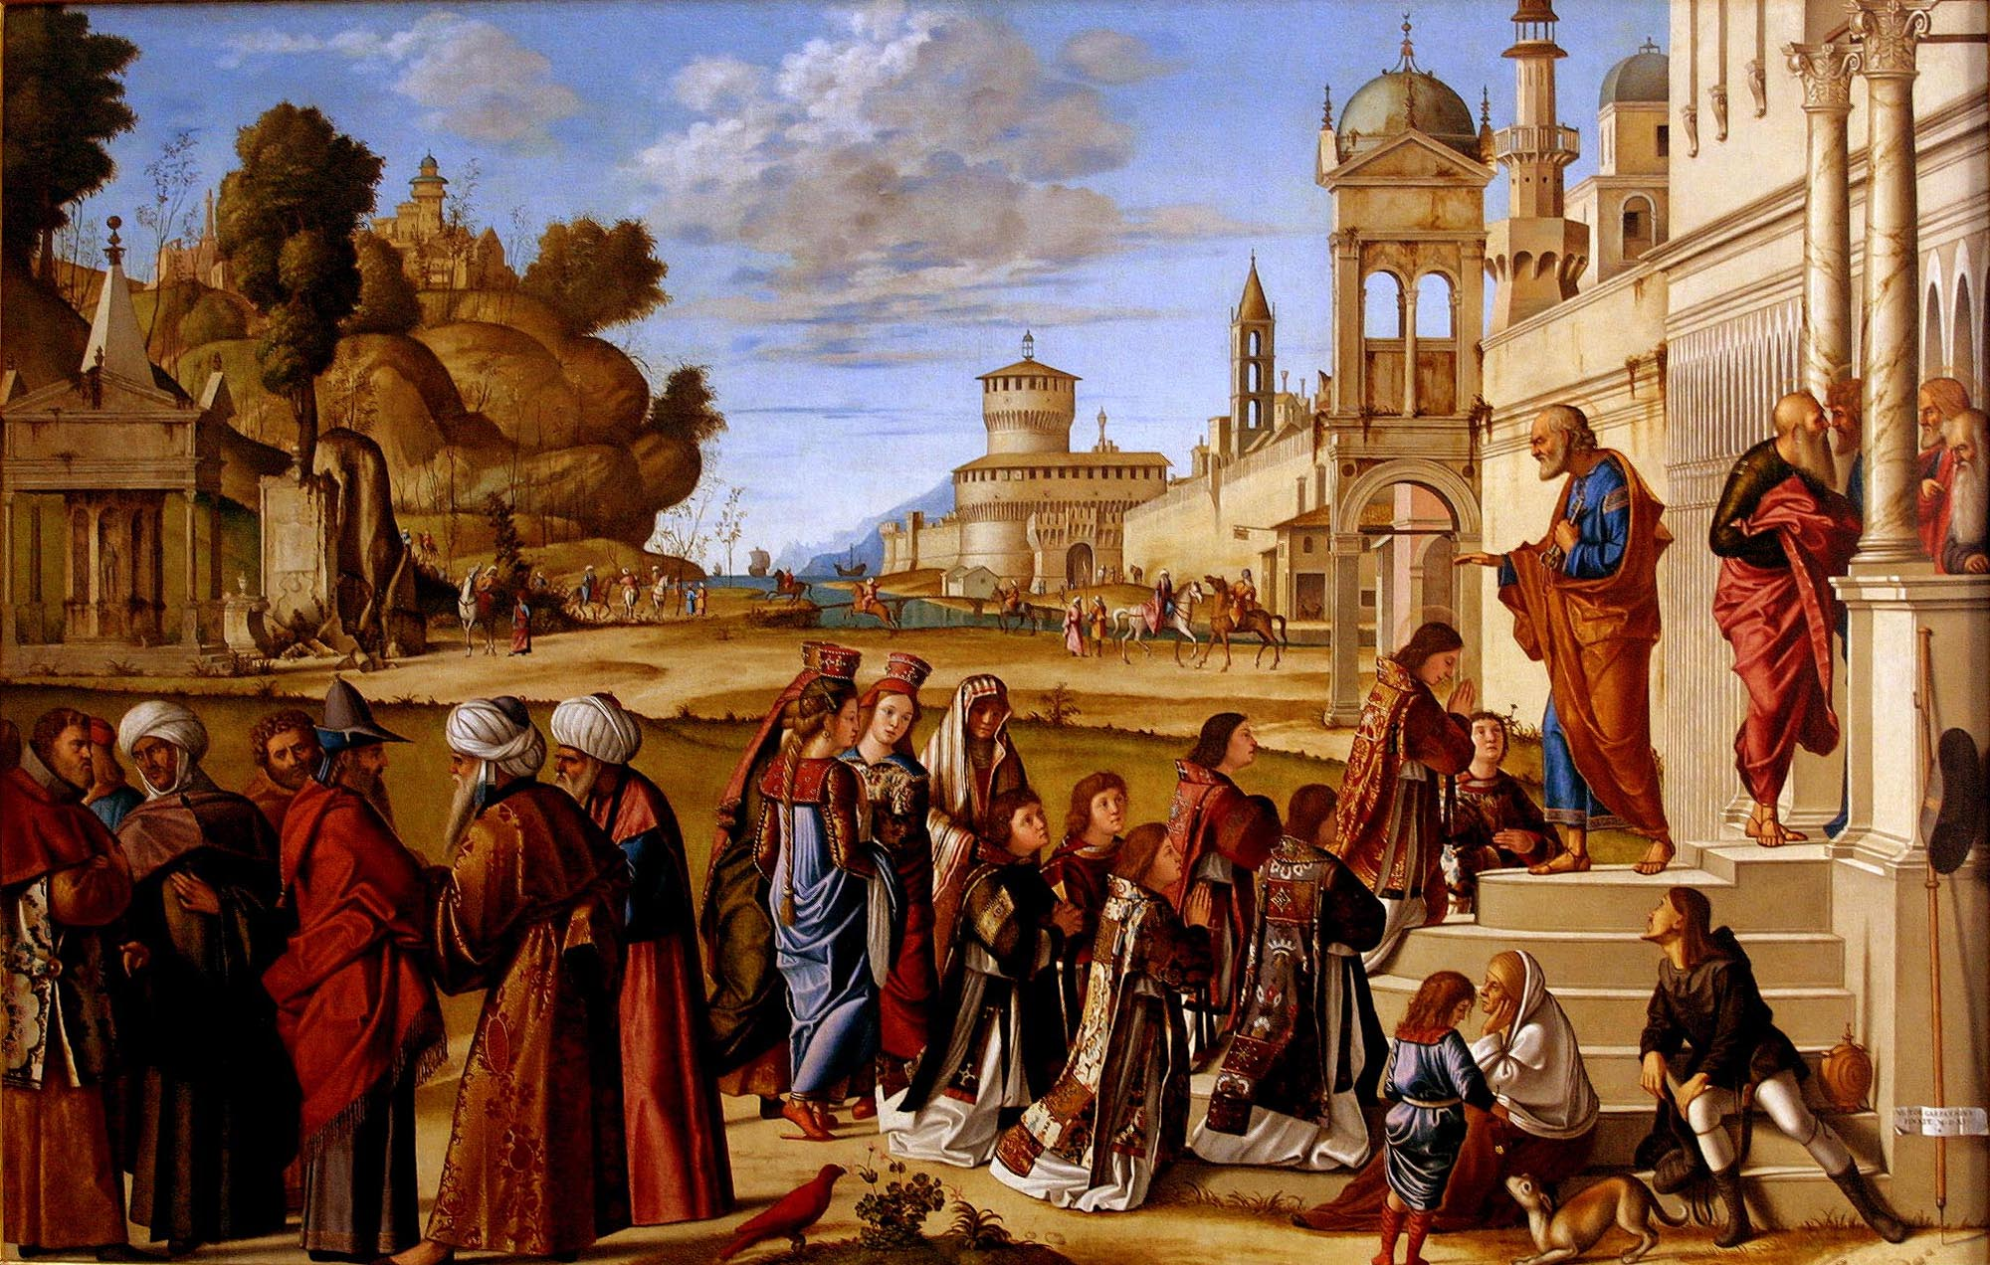


Slide 64
^{194:4.12} ^{(2068.2)} Stephen, the leader of the Greek colony of Jesus' believers in Jerusalem, thus became the first martyr to the new faith and the specific cause for the formal organization of the early Christian church. This new crisis was met by the recognition that believers could not longer go on as a sect within the Jewish faith. They all agreed that they must separate themselves from unbelievers; and within one month from the death of Stephen the church at Jerusalem had been organized under the leadership of Peter, and James the brother of Jesus had been installed as its titular head.

Slide 65
^{194:4.13} ^{(2068.3)} And then broke out the new and relentless persecutions by the Jews, so that the active teachers of the new religion about Jesus, which subsequently at Antioch was called Christianity, went forth to the ends of the empire proclaiming Jesus. In carrying this message, before the time of Paul the leadership was in Greek hands; and these first missionaries, as also the later ones, followed the path of Alexander's march of former days, going by way of Gaza and Tyre to Antioch and then over Asia Minor to Macedonia, then on to Rome and to the uttermost parts of the empire.

Slide 66
Paper 195 - After Pentecost

