Slide 1

The Urantia Book
Paper 147
The Interlude Visit to Jerusalem
Reading Paper 147 - The Interlude Visit to Jerusalem
The Urantia Book Paper 147, What Really Happened on the Journey to Jerusalem?
Paper 147 - Video study group link
Paper 146 - First Preaching Tour of Galilee

Slide 2


Slide 3
We would like to give a special thanks to Don Estes for the use of the information from his Chart The Origin, History and Destiny of Universe Reality. We would also like to thank the creator of Encyclopedia Urantia for the use of his slides from that web site.

Slide 4
Paper 147 The Interlude Visit to Jerusalem Audio Version
^{147:0.1} ^{(1647.1)} Jesus and the apostles arrived in Capernaum on Wednesday, March 17, and spent two weeks at the Bethsaida headquarters before they departed for Jerusalem. These two weeks the apostles taught the people by the seaside while Jesus spent much time alone in the hills about his Father's business. During this period Jesus, accompanied by James and John Zebedee, made two secret trips to Tiberias, where they met with the believers and instructed them in the gospel of the kingdom.

Slide 5
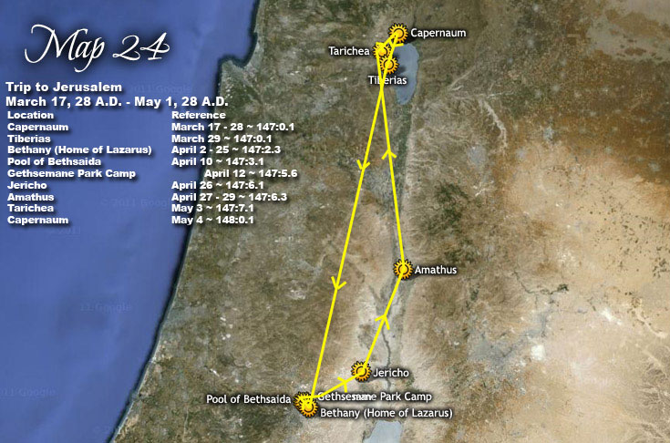

Slide 6
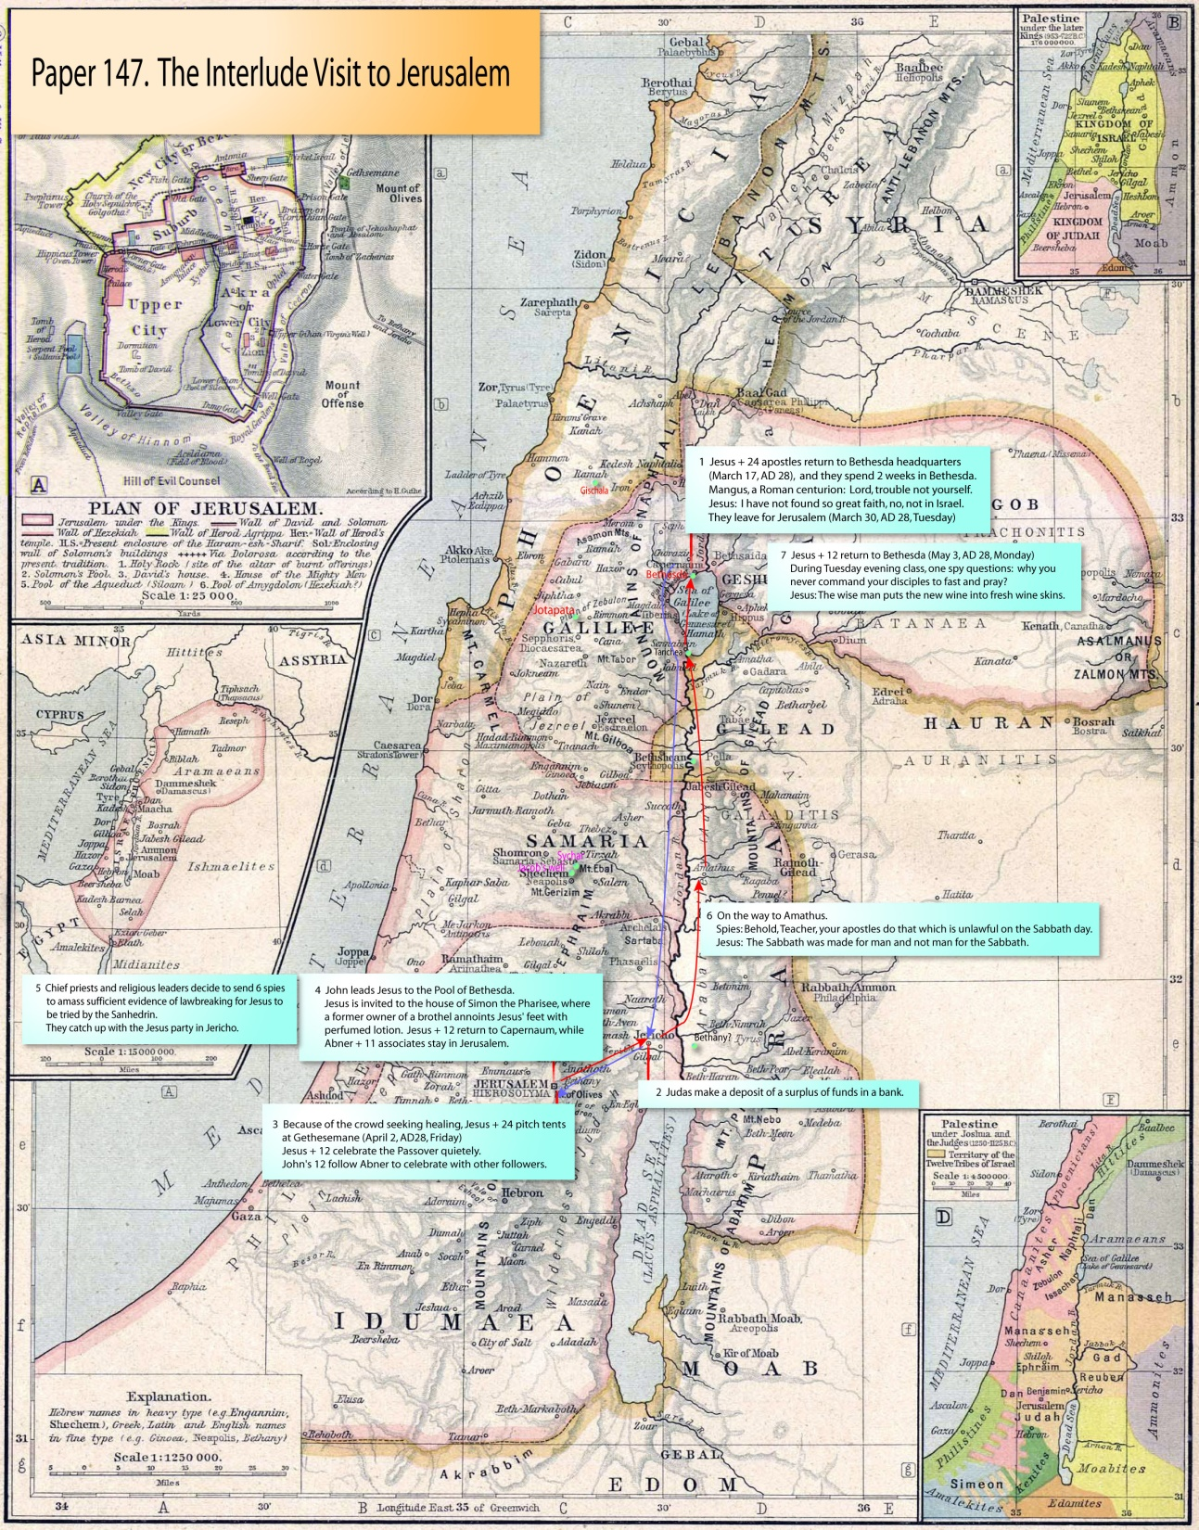

Slide 7
^{147:0.2} ^{(1647.2)} Many of the household of Herod believed in Jesus and attended these meetings. It was the influence of these believers among Herod's official family that had helped to lessen that ruler's enmity toward Jesus. These believers at Tiberias had fully explained to Herod that the "kingdom" which Jesus proclaimed was spiritual in nature and not a political venture. Herod rather believed these members of his own household and therefore did not permit himself to become unduly alarmed by the spreading abroad of the reports concerning Jesus' teaching and healing. He had no objections to Jesus' work as a healer or religious teacher. Notwithstanding the favorable attitude of many of Herod's advisers, and even of Herod himself, there existed a group of his subordinates who were so influenced by the religious leaders at Jerusalem that they remained bitter and threatening enemies of Jesus and the apostles and, later on, did much to hamper their public activities. The greatest danger to Jesus lay in the Jerusalem religious leaders and not in Herod. And it was for this very reason that Jesus and the apostles spent so much time and did most of their public preaching in Galilee rather than at Jerusalem and in Judea.

Slide 8
1. The Centurion’s Servant Audio Version
^{147:1.1} ^{(1647.3)} On the day before they made ready to go to Jerusalem for the feast of the Passover, Mangus, a centurion, or captain, of the Roman guard stationed at Capernaum, came to the rulers of the synagogue, saying: "My faithful orderly is sick and at the point of death. Would you, therefore, go to Jesus in my behalf and beseech him to heal my servant?" The Roman captain did this because he thought the Jewish leaders would have more influence with Jesus. So the elders went to see Jesus and their spokesman said: "Teacher, we earnestly request you to go over to Capernaum and save the favorite servant of the Roman centurion, who is worthy of your notice because he loves our nation and even built us the very synagogue wherein you have so many times spoken."

Slide 9
^{147:1.2} ^{(1647.4)} And when Jesus had heard them, he said, "I will go with you." And as he went with them over to the centurion's house, and before they had entered his yard, the Roman soldier sent his friends out to greet Jesus, instructing them to say: "Lord, trouble not yourself to enter my house, for I am not worthy that you should come under my roof. Neither did I think myself worthy to come to you; wherefore I sent the elders of your own people. But I know that you can speak the word where you stand and my servant will be healed. For I am myself under the orders of others, and I have soldiers under me, and I say to this one go, and he goes; to another come, and he comes, and to my servants do this or do that, and they do it."

Slide 10
^{147:1.3} ^{(1648.1)} And when Jesus heard these words, he turned and said to his apostles and those who were with them: "I marvel at the belief of the gentile. Verily, verily, I say to you, I have not found so great faith, no, not in Israel." Jesus, turning from the house, said, "Let us go hence." And the friends of the centurion went into the house and told Mangus what Jesus had said. And from that hour the servant began to mend and was eventually restored to his normal health and usefulness.

Slide 11
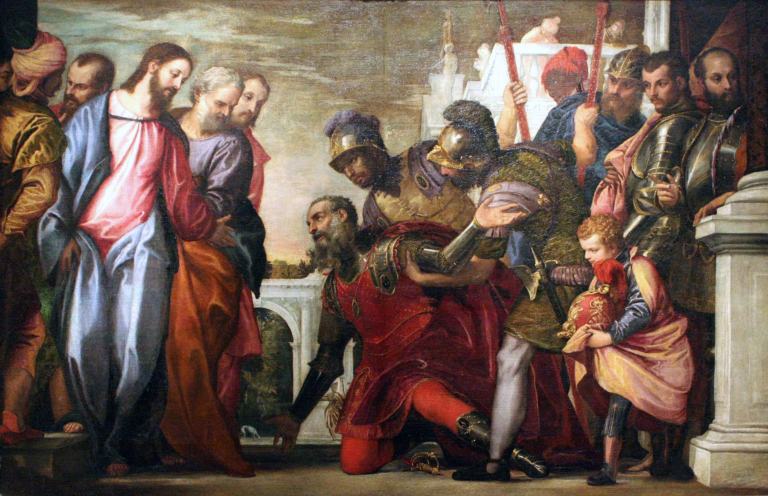
Notes:
"Verily, verily, I say to you, I have not found so great faith, no, not in Israel." (p.1648)

Slide 12
^{147:1.4} ^{(1648.2)} But we never knew just what happened on this occasion. This is simply the record, and as to whether or not invisible beings ministered healing to the centurion's servant, was not revealed to those who accompanied Jesus. We only know of the fact of the servant's complete recovery.

Slide 13
2. The Journey to Jerusalem Audio Version
^{147:2.1} ^{(1648.3)} Early on the morning of Tuesday, March 30, Jesus and the apostolic party started on their journey to Jerusalem for the Passover, going by the route of the Jordan valley. They arrived on the afternoon of Friday, April 2, and established their headquarters, as usual, at Bethany. Passing through Jericho, they paused to rest while Judas made a deposit of some of their common funds in the bank of a friend of his family. This was the first time Judas had carried a surplus of money, and this deposit was left undisturbed until they passed through Jericho again when on that last and eventful journey to Jerusalem just before the trial and death of Jesus.

Slide 14
^{147:2.2} ^{(1648.4)} The party had an uneventful trip to Jerusalem, but they had hardly got themselves settled at Bethany when from near and far those seeking healing for their bodies, comfort for troubled minds, and salvation for their souls, began to congregate, so much so that Jesus had little time for rest. Therefore they pitched tents at Gethsemane, and the Master would go back and forth from Bethany to Gethsemane to avoid the crowds which so constantly thronged him. The apostolic party spent almost three weeks at Jerusalem, but Jesus enjoined them to do no public preaching, only private teaching and personal work.

Slide 15
^{147:2.3} ^{(1648.5)} At Bethany they quietly celebrated the Passover. And this was the first time that Jesus and all of the twelve partook of the bloodless Passover feast. The apostles of John did not eat the Passover with Jesus and his apostles; they celebrated the feast with Abner and many of the early believers in John's preaching. This was the second Passover Jesus had observed with his apostles in Jerusalem.

Slide 16
^{147:2.4} ^{(1648.6)} When Jesus and the twelve departed for Capernaum, the apostles of John did not return with them. Under the direction of Abner they remained in Jerusalem and the surrounding country, quietly laboring for the extension of the kingdom, while Jesus and the twelve returned to work in Galilee. Never again were the twenty-four all together until a short time before the commissioning and sending forth of the seventy evangelists. But the two groups were co-operative, and notwithstanding their differences of opinion, the best of feelings prevailed.

Slide 17
3. At the Pool of Bethesda Audio Version
^{147:3.1} ^{(1649.1)} The afternoon of the second Sabbath in Jerusalem, as the Master and the apostles were about to participate in the temple services, John said to Jesus, "Come with me, I would show you something." John conducted Jesus out through one of the Jerusalem gates to a pool of water called Bethesda. Surrounding this pool was a structure of five porches under which a large group of sufferers lingered in quest of healing. This was a hot spring whose reddish-tinged water would bubble up at irregular intervals because of gas accumulations in the rock caverns underneath the pool. This periodic disturbance of the warm waters was believed by many to be due to supernatural influences, and it was a popular belief that the first person who entered the water after such a disturbance would be healed of whatever infirmity he had.

Slide 18
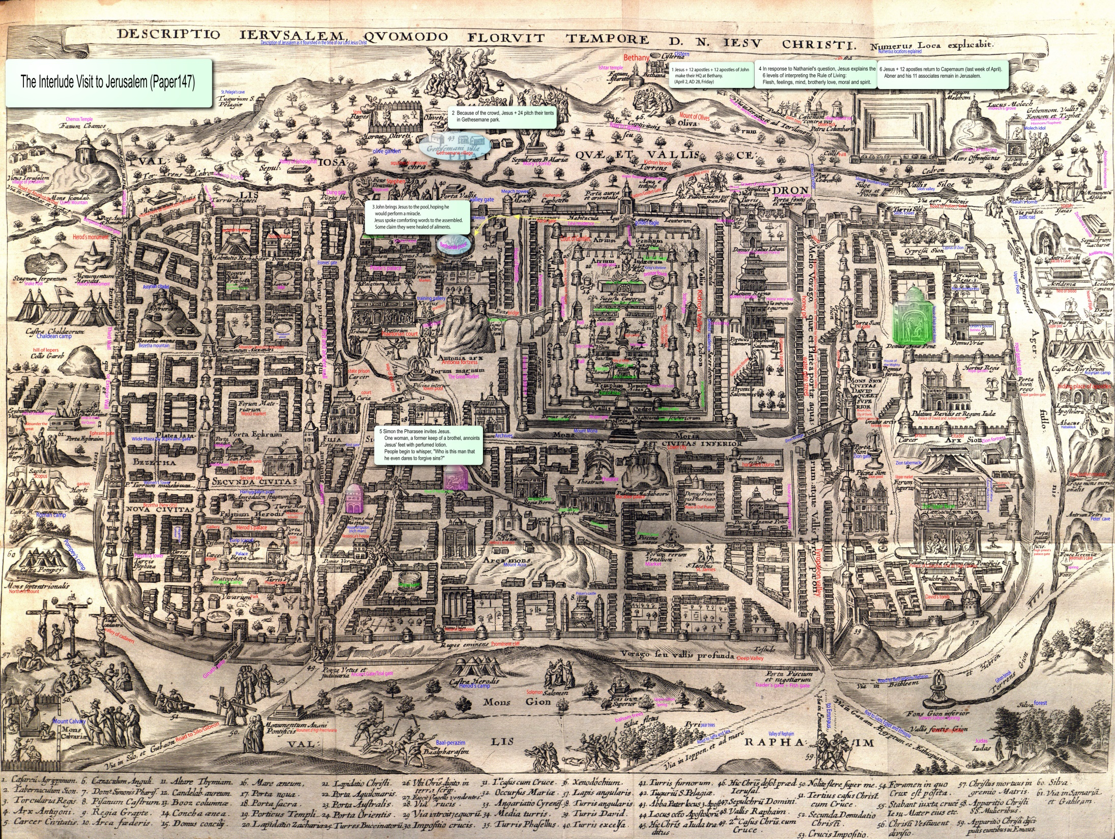
Notes:
his map not only shows the location of the pool of Bethesda, but also the house of Simon the Pharisee, even a woman annointing Jesus' feet.
Gethesemane park must have been around the Gethesemane village in the map.

Slide 19
^{147:3.2} ^{(1649.2)} The apostles were somewhat restless under the restrictions imposed by Jesus, and John, the youngest of the twelve, was especially restive under this restraint. He had brought Jesus to the pool thinking that the sight of the assembled sufferers would make such an appeal to the Master's compassion that he would be moved to perform a miracle of healing, and thereby would all Jerusalem be astounded and presently be won to believe in the gospel of the kingdom. Said John to Jesus: "Master, see all of these suffering ones; is there nothing we can do for them?" And Jesus replied: "John, why would you tempt me to turn aside from the way I have chosen? Why do you go on desiring to substitute the working of wonders and the healing of the sick for the proclamation of the gospel of eternal truth? My son, I may not do that which you desire, but gather together these sick and afflicted that I may speak words of good cheer and eternal comfort to them."

Slide 20
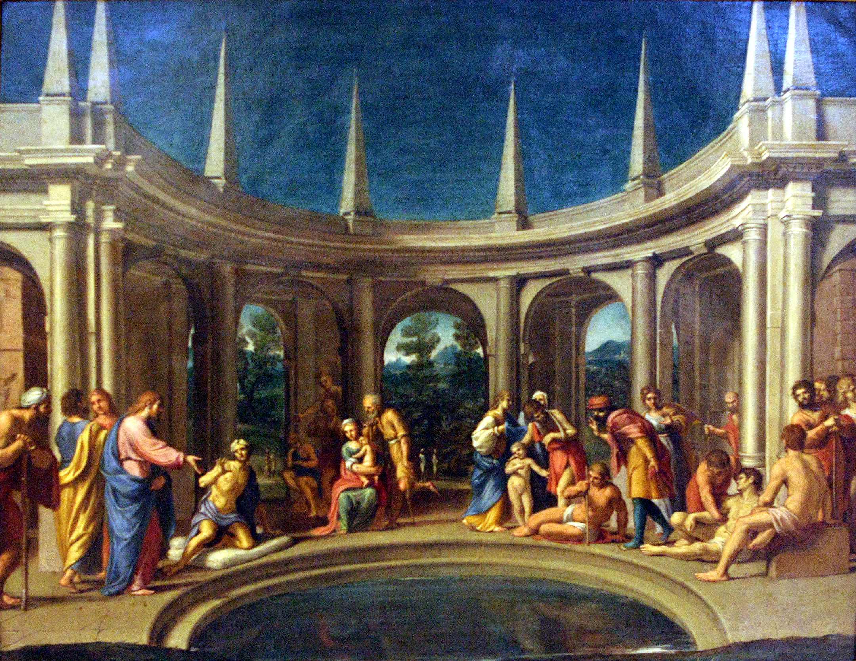
Notes:
Surrounding this pool [Bethesda] was a structure of five porches (p.1649)

Slide 21
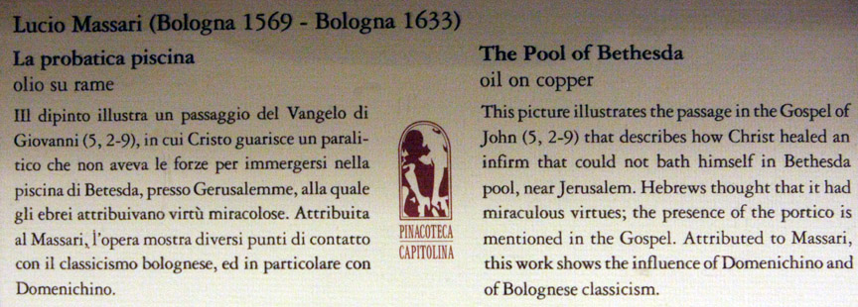

Slide 22
^{147:3.3} ^{(1649.3)} In speaking to those assembled, Jesus said: "Many of you are here, sick and afflicted, because of your many years of wrong living. Some suffer from the accidents of time, others as a result of the mistakes of their forebears, while some of you struggle under the handicaps of the imperfect conditions of your temporal existence. But my Father works, and I would work, to improve your earthly state but more especially to insure your eternal estate. None of us can do much to change the difficulties of life unless we discover the Father in heaven so wills. After all, we are all beholden to do the will of the Eternal. If you could all be healed of your physical afflictions, you would indeed marvel, but it is even greater that you should be cleansed of all spiritual disease and find yourselves healed of all moral infirmities. You are all God's children; you are the sons of the heavenly Father. The bonds of time may seem to afflict you, but the God of eternity loves you. And when the time of judgment shall come, fear not, you shall all find, not only justice, but an abundance of mercy. Verily, verily, I say to you: He who hears the gospel of the kingdom and believes in this teaching of sonship with God, has eternal life; already are such believers passing from judgment and death to light and life. And the hour is coming in which even those who are in the tombs shall hear the voice of the resurrection."

Slide 23
^{147:3.4} ^{(1649.4)} And many of those who heard believed the gospel of the kingdom. Some of the afflicted were so inspired and spiritually revivified that they went about proclaiming that they had also been cured of their physical ailments.

Slide 24
^{147:3.5} ^{(1649.5)} One man who had been many years downcast and grievously afflicted by the infirmities of his troubled mind, rejoiced at Jesus' words and, picking up his bed, went forth to his home, even though it was the Sabbath day. This afflicted man had waited all these years for somebody to help him; he was such a victim of the feeling of his own helplessness that he had never once entertained the idea of helping himself which proved to be the one thing he had to do in order to effect recovery—take up his bed and walk.

Slide 25
^{147:3.6} ^{(1650.1)} Then said Jesus to John: "Let us depart ere the chief priests and the scribes come upon us and take offense that we spoke words of life to these afflicted ones." And they returned to the temple to join their companions, and presently all of them departed to spend the night at Bethany. But John never told the other apostles of this visit of himself and Jesus to the pool of Bethesda on this Sabbath afternoon.

Slide 26
4. The Rule of Living Audio Version
^{147:4.1} ^{(1650.2)} On the evening of this same Sabbath day, at Bethany, while Jesus, the twelve, and a group of believers were assembled about the fire in Lazarus's garden, Nathaniel asked Jesus this question: "Master, although you have taught us the positive version of the old rule of life, instructing us that we should do to others as we wish them to do to us, I do not fully discern how we can always abide by such an injunction. Let me illustrate my contention by citing the example of a lustful man who thus wickedly looks upon his intended consort in sin. How can we teach that this evil-intending man should do to others as he would they should do to him?"

Slide 27
^{147:4.2} ^{(1650.3)} When Jesus heard Nathaniel's question, he immediately stood upon his feet and, pointing his finger at the apostle, said: "Nathaniel, Nathaniel! What manner of thinking is going on in your heart? Do you not receive my teachings as one who has been born of the spirit? Do you not hear the truth as men of wisdom and spiritual understanding? When I admonished you to do to others as you would have them do to you, I spoke to men of high ideals, not to those who would be tempted to distort my teaching into a license for the encouragement of evil-doing." *

Slide 28
^{147:4.3} ^{(1650.4)} When the Master had spoken, Nathaniel stood up and said: "But, Master, you should not think that I approve of such an interpretation of your teaching. I asked the question because I conjectured that many such men might thus misjudge your admonition, and I hoped you would give us further instruction regarding these matters." And then when Nathaniel had sat down, Jesus continued speaking: "I well know, Nathaniel, that no such idea of evil is approved in your mind, but I am disappointed in that you all so often fail to put a genuinely spiritual interpretation upon my commonplace teachings, instruction which must be given you in human language and as men must speak. Let me now teach you concerning the differing levels of meaning attached to the interpretation of this rule of living, this admonition to `do to others that which you desire others to do to you':

Slide 29
^{147:4.4} ^{(1650.5)} "1. The level of the flesh. Such a purely selfish and lustful interpretation would be well exemplified by the supposition of your question.

Slide 30
^{147:4.5} ^{(1650.6)} "2. The level of the feelings. This plane is one level higher than that of the flesh and implies that sympathy and pity would enhance one's interpretation of this rule of living.

Slide 31
^{147:4.6} ^{(1650.7)} "3. The level of mind. Now come into action the reason of mind and the intelligence of experience. Good judgment dictates that such a rule of living should be interpreted in consonance with the highest idealism embodied in the nobility of profound self-respect.

Slide 32
^{147:4.7} ^{(1651.1)} "4. The level of brotherly love. Still higher is discovered the level of unselfish devotion to the welfare of one's fellows. On this higher plane of wholehearted social service growing out of the consciousness of the fatherhood of God and the consequent recognition of the brotherhood of man, there is discovered a new and far more beautiful interpretation of this basic rule of life.

Slide 33
^{147:4.8} ^{(1651.2)} "5. The moral level. And then when you attain true philosophic levels of interpretation, when you have real insight into the rightness and wrongness of things, when you perceive the eternal fitness of human relationships, you will begin to view such a problem of interpretation as you would imagine a high-minded, idealistic, wise, and impartial third person would so view and interpret such an injunction as applied to your personal problems of adjustment to your life situations.

Slide 34
^{147:4.9} ^{(1651.3)} "6. The spiritual level. And then last, but greatest of all, we attain the level of spirit insight and spiritual interpretation which impels us to recognize in this rule of life the divine command to treat all men as we conceive God would treat them. That is the universe ideal of human relationships. And this is your attitude toward all such problems when your supreme desire is ever to do the Father's will. I would, therefore, that you should do to all men that which you know I would do to them in like circumstances."

Slide 35
^{147:4.10} ^{(1651.4)} Nothing Jesus had said to the apostles up to this time had ever more astonished them. They continued to discuss the Master's words long after he had retired. While Nathaniel was slow to recover from his supposition that Jesus had misunderstood the spirit of his question, the others were more than thankful that their philosophic fellow apostle had had the courage to ask such a thought-provoking question.

Slide 36
5. Visiting Simon the Pharisee Audio Version
^{147:5.1} ^{(1651.5)} Though Simon was not a member of the Jewish Sanhedrin, he was an influential Pharisee of Jerusalem. He was a halfhearted believer, and notwithstanding that he might be severely criticized therefor, he dared to invite Jesus and his personal associates, Peter, James, and John, to his home for a social meal. Simon had long observed the Master and was much impressed with his teachings and even more so with his personality. *

Slide 37
^{147:5.2} ^{(1651.6)} The wealthy Pharisees were devoted to almsgiving, and they did not shun publicity regarding their philanthropy. Sometimes they would even blow a trumpet as they were about to bestow charity upon some beggar. It was the custom of these Pharisees, when they provided a banquet for distinguished guests, to leave the doors of the house open so that even the street beggars might come in and, standing around the walls of the room behind the couches of the diners, be in position to receive portions of food which might be tossed to them by the banqueters.

Slide 38
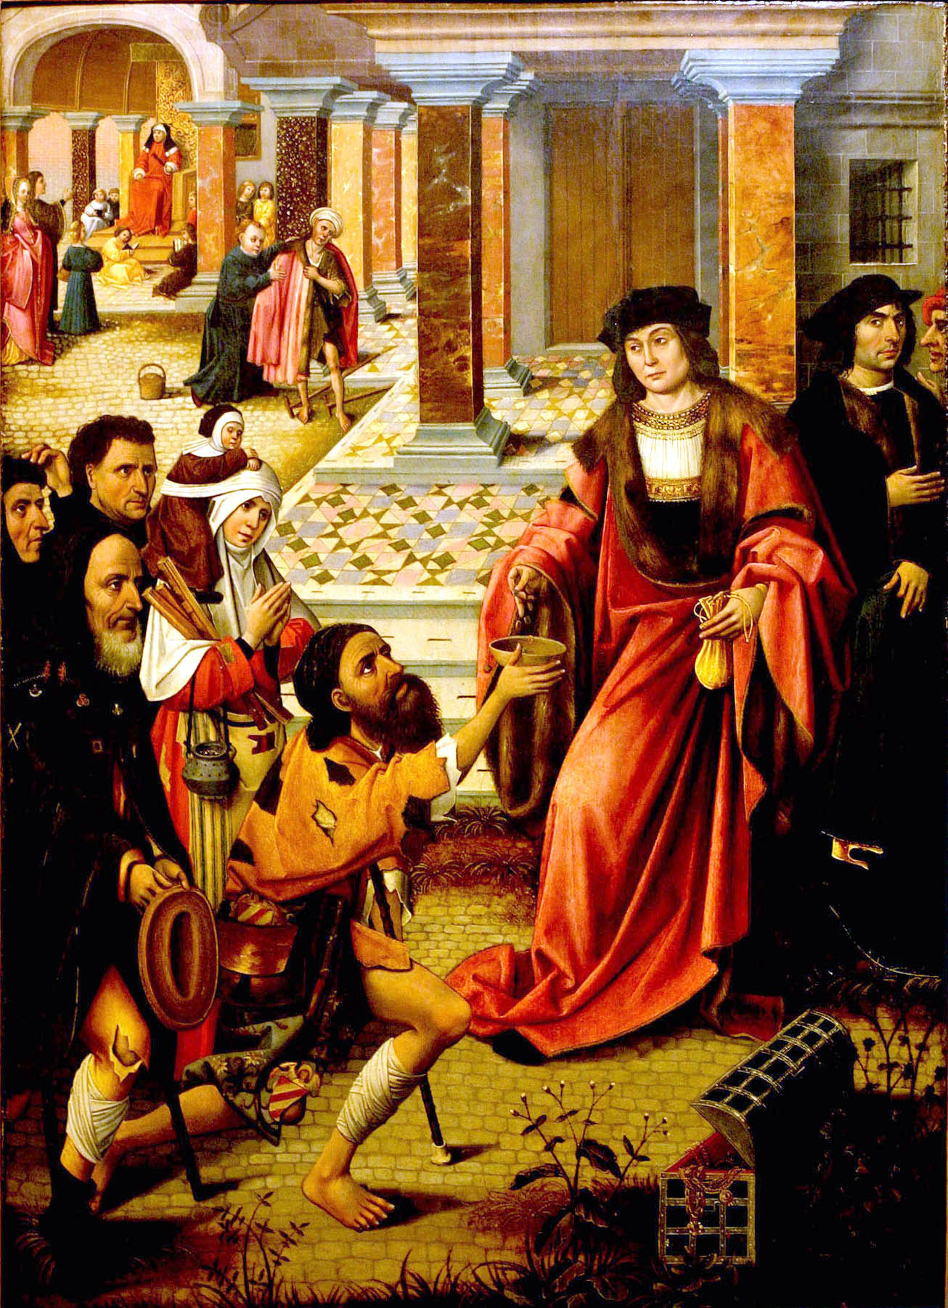
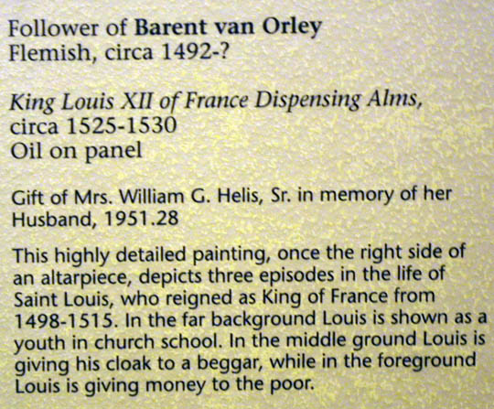
Notes:
devoted to almsgiving and they did not shun publicity (p.1651)

Slide 39
^{147:5.3} ^{(1651.7)} On this particular occasion at Simon's house, among those who came in off the street was a woman of unsavory reputation who had recently become a believer in the good news of the gospel of the kingdom. This woman was well known throughout all Jerusalem as the former keeper of one of the so-called high-class brothels located hard by the temple court of the gentiles. She had, on accepting the teachings of Jesus, closed up her nefarious place of business and had induced the majority of the women associated with her to accept the gospel and change their mode of living; notwithstanding this, she was still held in great disdain by the Pharisees and was compelled to wear her hair down—the badge of harlotry. This unnamed woman had brought with her a large flask of perfumed anointing lotion and, standing behind Jesus as he reclined at meat, began to anoint his feet while she also wet his feet with her tears of gratitude, wiping them with the hair of her head. And when she had finished this anointing, she continued weeping and kissing his feet.

Slide 40
^{147:5.4} ^{(1652.1)} When Simon saw all this, he said to himself: "This man, if he were a prophet, would have perceived who and what manner of woman this is who thus touches him; that she is a notorious sinner." And Jesus, knowing what was going on in Simon's mind, spoke up, saying: "Simon, I have something which I would like to say to you." Simon answered, "Teacher, say on." Then said Jesus: "A certain wealthy moneylender had two debtors. The one owed him five hundred denarii and the other fifty. Now, when neither of them had wherewith to pay, he forgave them both. Which of them do you think, Simon, would love him most?" Simon answered, "He, I suppose, whom he forgave the most." And Jesus said, "You have rightly judged," and pointing to the woman, he continued: "Simon, take a good look at this woman. I entered your house as an invited guest, yet you gave me no water for my feet. This grateful woman has washed my feet with tears and wiped them with the hair of her head. You gave me no kiss of friendly greeting, but this woman, ever since she came in, has not ceased to kiss my feet. My head with oil you neglected to anoint, but she has anointed my feet with precious lotions. And what is the meaning of all this? Simply that her many sins have been forgiven, and this has led her to love much. But those who have received but little forgiveness sometimes love but little." And turning around toward the woman, he took her by the hand and, lifting her up, said: "You have indeed repented of your sins, and they are forgiven. Be not discouraged by the thoughtless and unkind attitude of your fellows; go on in the joy and liberty of the kingdom of heaven."

Slide 41
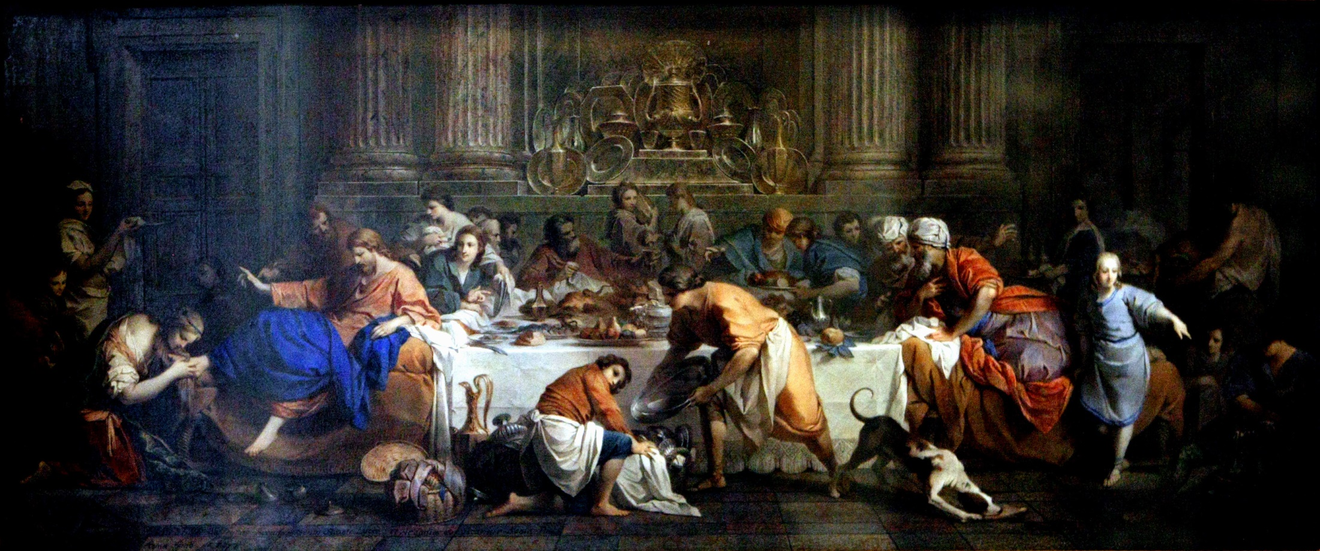
Notes:
"Simon, take a good look at this woman ..." "Woman, go in peace." (p.1652)

Slide 42
^{147:5.5} ^{(1652.2)} When Simon and his friends who sat at meat with him heard these words, they were the more astonished, and they began to whisper among themselves, "Who is this man that he even dares to forgive sins?" And when Jesus heard them thus murmuring, he turned to dismiss the woman, saying, "Woman, go in peace; your faith has saved you."

Slide 43
^{147:5.6} ^{(1652.3)} As Jesus arose with his friends to leave, he turned to Simon and said: "I know your heart, Simon, how you are torn betwixt faith and doubts, how you are distraught by fear and troubled by pride; but I pray for you that you may yield to the light and may experience in your station in life just such mighty transformations of mind and spirit as may be comparable to the tremendous changes which the gospel of the kingdom has already wrought in the heart of your unbidden and unwelcome guest. And I declare to all of you that the Father has opened the doors of the heavenly kingdom to all who have the faith to enter, and no man or association of men can close those doors even to the most humble soul or supposedly most flagrant sinner on earth if such sincerely seek an entrance." And Jesus, with Peter, James, and John, took leave of their host and went to join the rest of the apostles at the camp in the garden of Gethsemane.

Slide 44
^{147:5.7} ^{(1653.1)} That same evening Jesus made the long-to-be-remembered address to the apostles regarding the relative value of status with God and progress in the eternal ascent to Paradise. Said Jesus: "My children, if there exists a true and living connection between the child and the Father, the child is certain to progress continuously toward the Father's ideals. True, the child may at first make slow progress, but the progress is none the less sure. The important thing is not the rapidity of your progress but rather its certainty. Your actual achievement is not so important as the fact that the direction of your progress is Godward. What you are becoming day by day is of infinitely more importance than what you are today.

Slide 45
^{147:5.8} ^{(1653.2)} "This transformed woman whom some of you saw at Simon's house today is, at this moment, living on a level which is vastly below that of Simon and his well-meaning associates; but while these Pharisees are occupied with the false progress of the illusion of traversing deceptive circles of meaningless ceremonial services, this woman has, in dead earnest, started out on the long and eventful search for God, and her path toward heaven is not blocked by spiritual pride and moral self-satisfaction. The woman is, humanly speaking, much farther away from God than Simon, but her soul is in progressive motion; she is on the way toward an eternal goal. There are present in this woman tremendous spiritual possibilities for the future. Some of you may not stand high in actual levels of soul and spirit, but you are making daily progress on the living way opened up, through faith, to God. There are tremendous possibilities in each of you for the future. Better by far to have a small but living and growing faith than to be possessed of a great intellect with its dead stores of worldly wisdom and spiritual unbelief."

Slide 46
^{147:5.9} ^{(1653.3)} But Jesus earnestly warned his apostles against the foolishness of the child of God who presumes upon the Father's love. He declared that the heavenly Father is not a lax, loose, or foolishly indulgent parent who is ever ready to condone sin and forgive recklessness. He cautioned his hearers not mistakenly to apply his illustrations of father and son so as to make it appear that God is like some overindulgent and unwise parents who conspire with the foolish of earth to encompass the moral undoing of their thoughtless children, and who are thereby certainly and directly contributing to the delinquency and early demoralization of their own offspring. Said Jesus: "My Father does not indulgently condone those acts and practices of his children which are self-destructive and suicidal to all moral growth and spiritual progress. Such sinful practices are an abomination in the sight of God."

Slide 47
^{147:5.10} ^{(1653.4)} Many other semiprivate meetings and banquets did Jesus attend with the high and the low, the rich and the poor, of Jerusalem before he and his apostles finally departed for Capernaum. And many, indeed, became believers in the gospel of the kingdom and were subsequently baptized by Abner and his associates, who remained behind to foster the interests of the kingdom in Jerusalem and thereabouts.

Slide 48
6. Returning to Capernaum Audio Version
^{147:6.1} ^{(1653.5)} The last week of April, Jesus and the twelve departed from their Bethany headquarters near Jerusalem and began their journey back to Capernaum by way of Jericho and the Jordan.

Slide 49
^{147:6.2} ^{(1654.1)} The chief priests and the religious leaders of the Jews held many secret meetings for the purpose of deciding what to do with Jesus. They were all agreed that something should be done to put a stop to his teaching, but they could not agree on the method. They had hoped that the civil authorities would dispose of him as Herod had put an end to John, but they discovered that Jesus was so conducting his work that the Roman officials were not much alarmed by his preaching. Accordingly, at a meeting which was held the day before Jesus' departure for Capernaum, it was decided that he would have to be apprehended on a religious charge and be tried by the Sanhedrin. Therefore a commission of six secret spies was appointed to follow Jesus, to observe his words and acts, and when they had amassed sufficient evidence of lawbreaking and blasphemy, to return to Jerusalem with their report. These six Jews caught up with the apostolic party, numbering about thirty, at Jericho and, under the pretense of desiring to become disciples, attached themselves to Jesus' family of followers, remaining with the group up to the time of the beginning of the second preaching tour in Galilee; whereupon three of them returned to Jerusalem to submit their report to the chief priests and the Sanhedrin.

Slide 50
^{147:6.3} ^{(1654.2)} Peter preached to the assembled multitude at the crossing of the Jordan, and the following morning they moved up the river toward Amathus. They wanted to proceed straight on to Capernaum, but such a crowd gathered here they remained three days, preaching, teaching, and baptizing. They did not move toward home until early Sabbath morning, the first day of May. The Jerusalem spies were sure they would now secure their first charge against Jesus—that of Sabbath breaking—since he had presumed to start his journey on the Sabbath day. But they were doomed to disappointment because, just before their departure, Jesus called Andrew into his presence and before them all instructed him to proceed for a distance of only one thousand yards, the legal Jewish Sabbath day's journey.

Slide 51
^{147:6.4} ^{(1654.3)} But the spies did not have long to wait for their opportunity to accuse Jesus and his associates of Sabbath breaking. As the company passed along the narrow road, the waving wheat, which was just then ripening, was near at hand on either side, and some of the apostles, being hungry, plucked the ripe grain and ate it. It was customary for travelers to help themselves to grain as they passed along the road, and therefore no thought of wrongdoing was attached to such conduct. But the spies seized upon this as a pretext for assailing Jesus. When they saw Andrew rub the grain in his hand, they went up to him and said: "Do you not know that it is unlawful to pluck and rub the grain on the Sabbath day?" And Andrew answered: "But we are hungry and rub only sufficient for our needs; and since when did it become sinful to eat grain on the Sabbath day?" But the Pharisees answered: "You do no wrong in eating, but you do break the law in plucking and rubbing out the grain between your hands; surely your Master would not approve of such acts." Then said Andrew: "But if it is not wrong to eat the grain, surely the rubbing out between our hands is hardly more work than the chewing of the grain, which you allow; wherefore do you quibble over such trifles?" When Andrew intimated that they were quibblers, they were indignant, and rushing back to where Jesus walked along, talking to Matthew, they protested, saying: "Behold, Teacher, your apostles do that which is unlawful on the Sabbath day; they pluck, rub, and eat the grain. We are sure you will command them to cease." And then said Jesus to the accusers: "You are indeed zealous for the law, and you do well to remember the Sabbath day to keep it holy; but did you never read in the Scripture that, one day when David was hungry, he and they who were with him entered the house of God and ate the showbread, which it was not lawful for anyone to eat save the priests? and David also gave this bread to those who were with him. And have you not read in our law that it is lawful to do many needful things on the Sabbath day? And shall I not, before the day is finished, see you eat that which you have brought along for the needs of this day? My good men, you do well to be zealous for the Sabbath, but you would do better to guard the health and well-being of your fellows. I declare that the Sabbath was made for man and not man for the Sabbath. And if you are here present with us to watch my words, then will I openly proclaim that the Son of Man is lord even of the Sabbath."

Slide 52
^{147:6.5} ^{(1655.1)} The Pharisees were astonished and confounded by his words of discernment and wisdom. For the remainder of the day they kept by themselves and dared not ask any more questions.

Slide 53
^{147:6.6} ^{(1655.2)} Jesus' antagonism to the Jewish traditions and slavish ceremonials was always positive. It consisted in what he did and in what he affirmed. The Master spent little time in negative denunciations. He taught that those who know God can enjoy the liberty of living without deceiving themselves by the licenses of sinning. Said Jesus to the apostles: "Men, if you are enlightened by the truth and really know what you are doing, you are blessed; but if you know not the divine way, you are unfortunate and already breakers of the law."

Slide 54
7. Back in Capernaum Audio Version
^{147:7.1} ^{(1655.3)} It was around noon on Monday, May 3, when Jesus and the twelve came to Bethsaida by boat from Tarichea. They traveled by boat in order to escape those who journeyed with them. But by the next day the others, including the official spies from Jerusalem, had again found Jesus.

Slide 55
^{147:7.2} ^{(1655.4)} On Tuesday evening Jesus was conducting one of his customary classes of questions and answers when the leader of the six spies said to him: "I was today talking with one of John's disciples who is here attending upon your teaching, and we were at a loss to understand why you never command your disciples to fast and pray as we Pharisees fast and as John bade his followers."And Jesus, referring to a statement by John, answered this questioner: " Do the sons of the bridechamber fast while the bridegroom is with them? As long as the bridegroom remains with them, they can hardly fast. But the time is coming when the bridegroom shall be taken away, and during those times the children of the bridechamber undoubtedly will fast and pray. To pray is natural for the children of light, but fasting is not a part of the gospel of the kingdom of heaven. Be reminded that a wise tailor does not sew a piece of new and unshrunk cloth upon an old garment, lest, when it is wet, it shrink and produce a worse rent. Neither do men put new wine into old wine skins, lest the new wine burst the skins so that both the wine and the skins perish. The wise man puts the new wine into fresh wine skins. Therefore do my disciples show wisdom in that they do not bring too much of the old order over into the new teaching of the gospel of the kingdom. You who have lost your teacher may be justified in fasting for a time. Fasting may be an appropriate part of the law of Moses, but in the coming kingdom the sons of God shall experience freedom from fear and joy in the divine spirit." And when they heard these words, the disciples of John were comforted while the Pharisees themselves were the more confounded.

Slide 56
^{147:7.3} ^{(1656.1)} Then the Master proceeded to warn his hearers against entertaining the notion that all olden teaching should be replaced entirely by new doctrines. Said Jesus: "That which is old and also true must abide. Likewise, that which is new but false must be rejected. But that which is new and also true, have the faith and courage to accept. Remember it is written: `Forsake not an old friend, for the new is not comparable to him. As new wine, so is a new friend; if it becomes old, you shall drink it with gladness.'"

Slide 57
8. The Feast of Spiritual Goodness Audio Version
^{147:8.1} ^{(1656.2)} That night, long after the usual listeners had retired, Jesus continued to teach his apostles. He began this special instruction by quoting from the Prophet Isaiah:

Slide 58
^{147:8.2} ^{(1656.3)} "`Why have you fasted? For what reason do you afflict your souls while you continue to find pleasure in oppression and to take delight in injustice? Behold, you fast for the sake of strife and contention and to smite with the fist of wickedness. But you shall not fast in this way to make your voices heard on high.

Slide 59
^{147:8.3} ^{(1656.4)} "`Is it such a fast that I have chosen—a day for a man to afflict his soul? Is it to bow down his head like a bulrush, to grovel in sackcloth and ashes? Will you dare to call this a fast and an acceptable day in the sight of the Lord? Is not this the fast I should choose: to loose the bonds of wickedness, to undo the knots of heavy burdens, to let the oppressed go free, and to break every yoke? Is it not to share my bread with the hungry and to bring those who are homeless and poor to my house? And when I see those who are naked, I will clothe them.

Slide 60
^{147:8.4} ^{(1656.5)} "`Then shall your light break forth as the morning while your health springs forth speedily. Your righteousness shall go before you while the glory of the Lord shall be your rear guard. Then will you call upon the Lord, and he shall answer; you will cry out, and he shall say—Here am I. And all this he will do if you refrain from oppression, condemnation, and vanity. The Father rather desires that you draw out your heart to the hungry, and that you minister to the afflicted souls; then shall your light shine in obscurity, and even your darkness shall be as the noonday. Then shall the Lord guide you continually, satisfying your soul and renewing your strength. You shall become like a watered garden, like a spring whose waters fail not. And they who do these things shall restore the wasted glories; they shall raise up the foundations of many generations; they shall be called the rebuilders of broken walls, the restorers of safe paths in which to dwell.'"

Slide 61
^{147:8.5} ^{(1656.6)} And then long into the night Jesus propounded to his apostles the truth that it was their faith that made them secure in the kingdom of the present and the future, and not their affliction of soul nor fasting of body. He exhorted the apostles at least to live up to the ideas of the prophet of old and expressed the hope that they would progress far beyond even the ideals of Isaiah and the older prophets. His last words that night were: "Grow in grace by means of that living faith which grasps the fact that you are the sons of God while at the same time it recognizes every man as a brother."

Slide 62
^{147:8.6} ^{(1656.7)} It was after two o'clock in the morning when Jesus ceased speaking and every man went to his place for sleep.

Slide 63
Paper 148 - Training Evangelists at Bethsaida

